Slide 1
#IamStigmaFree

Slide 2
“Mental illness is nothing to be ashamed of,
but stigma and bias shame us all.”
– Bill Clinton
Photo credit: myishacherry. Modified.
#IamStigmaFree

Slide 3
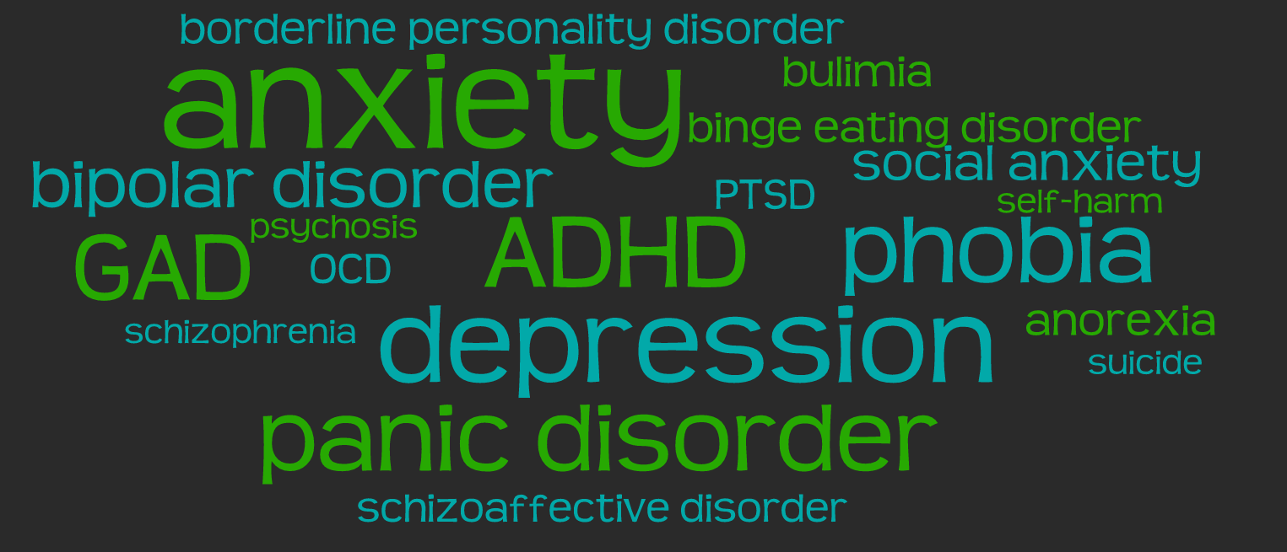
Mental Health Conditions
Mental health conditions impact thinking, feelings and mood
Result of biological and environmental factors
Often involve feelings that everyone experiences - like worry, sadness or stress…
… but they don’t go away on their own and can be so intense and persistent that they interfere with life
Photo credit: tagul. Modified.
#IamStigmaFree

Slide 4
Mental Health
Conditions Are Common
1 in 5 people experience a mental health condition
This may be you, a friend or a family member
Photo credit: Les Haines.
#IamStigmaFree
Notes:
Ask: How common do you think mental health conditions are? (Can frame as “1 in how many people experience a mental health condition?”)
That’s 20% of people, so it is very likely that we all know at least one person with a mental health condition.

Slide 5
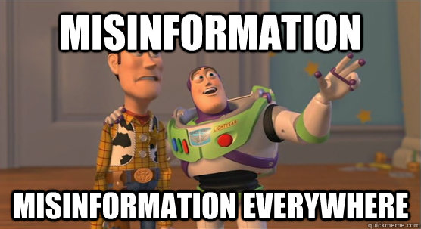
Did You Know…
Most people get information about mental health from the media?
TV dramas often show people with mental health conditions committing acts of violence…
… but most violent crimes are committed by people without a mental health condition
Photo credit: Imgflip. Modified.
#IamStigmaFree
Notes:
Media portrayals of mental health conditions are notoriously inaccurate, but most people report getting information and impressions about mental health from the media
In TV dramas, almost half of story lines about mental health showed individuals with mental health conditions committing acts of violence
In reality, the majority of violent crimes are committed by people without mental health conditions
People with mental health conditions are no more likely to commit violent crimes than anyone else
This image skews people’s perception of mental health conditions and the people who have them and makes it hard for people to start conversations about mental health.

Slide 6
Stigma
Negative attitudes and inaccurate beliefs about people who have mental health conditions
Stems from myths, inaccurate perceptions and lack of information
Photo credit: tagul. Modified.
#IamStigmaFree

Slide 7
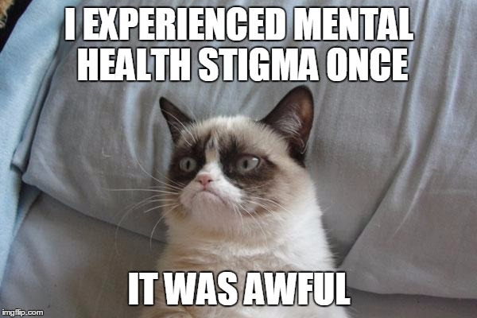
Why is Stigma a Problem?
Prevents people from seeking treatment and getting support
Discrimination in jobs, education, housing and medical care
Experienced by 90% of people with a mental health condition
The experience can be worse than living with a mental health condition
Photo credit: Imgflip. Modified.
#IamStigmaFree
Notes:
Ask: “Why is stigma a problem for people experiencing a mental health condition?”
Prevents people from seeking treatment
Prevents people from getting needed support from family and friends
Leads to discrimination in jobs, education, housing and even in medical care
Prejudice and discrimination are experienced by 9/10 of people with a mental health condition
For many, experiencing stigma is worse than living with a mental health condition. Stigma comes from many sources and can cause people to feel ashamed of having a mental health condition and afraid to seek help from friends, family and mental health providers.

Slide 8
Join us in creating
a stigma-free campus.
#IamStigmaFree
Notes:
Let’s do something about it. Let’s create a campus where students aren’t afraid or ashamed to talk about mental health conditions. Let’s create a campus that is stigma free.

Slide 9
Take the Pledge
Learn more about mental health
See the person, not the condition
Take action
#IamStigmaFree
Photo credit: iemoji.

Slide 10
Learn More About Mental Health
Know the facts.
Mental health conditions can affect anyone.
Get perspective on peoples’ lived experiences.
Attend a NAMI In Our Own Voice presentation
Visit OK2Talk.org
Check out the Hope and Grace initiative on YouTube
Learn from reliable sources:
NAMI: www.nami.org
NIMH: www.nimh.nih.gov
#IamStigmaFree
Notes:
Know the facts. There is inaccurate information out there- make sure you get it right
Mental health conditions can affect anyone, regardless of gender, age, race, ethnicity, religion, socioeconomic status, political affiliation, sexual orientation or veteran status

Slide 11
Learn More About Mental Health
Know the 10 common warning signs.
Photo credit: Imgflip. Modified.
#IamStigmaFree
Notes:
We’ll read them to you, and we also have a flyer you can take with you to remember them.
The 10 common warning signs are:
Feeling very sad or withdrawn for more than 2 weeks
Trying to harm or kill oneself or making plans to do so
Severe out-of-control, risk-taking behaviors that can cause harm to self or others
Sudden overwhelming fear for no reason
Not eating, throwing up or using laxatives to lose weight; significant weight loss or weight gain
Seeing, hearing or believing things that are not real
Repeated use of drugs or alcohol
Drastic changes in mood, behavior, personality or sleeping habits
Extreme difficulty concentrating or staying still that puts a person in danger or causes school failure
Intense worries or fears that get in the way of daily activities

Slide 12
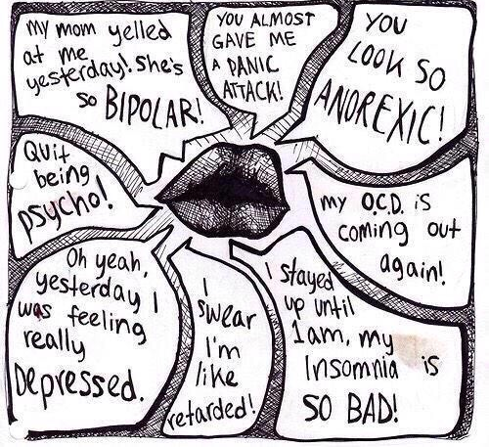
See the Person, Not the Condition
Language Matters
Your words have impact
Using words like “bipolar” “psychotic” and “OCD” to describe a person or behavior reinforces negative stereotypes
Always use “person first” language
“People with mental health conditions” not “The mentally ill.”
Don’t use words like “crazy” as adjectives
Photo credit: theoddesyonline. Modified.
#IamStigmaFree
Notes:
More “person first” language examples: “A person with schizophrenia” not “A schizophrenic”
“People with mental health conditions” not “The mentally ill”
Using words like “bipolar” “psychotic” and “OCD” to describe a person or behavior reinforces negative stereotypes
It implies people with mental health conditions are flawed and defined entirely by their condition. You wouldn’t say “my Mom is cancerous,” you would say “my Mom has breast cancer.”
There are smart, popular, funny, athletic, etc. people all around you, who also happen to have a mental health condition

Slide 13
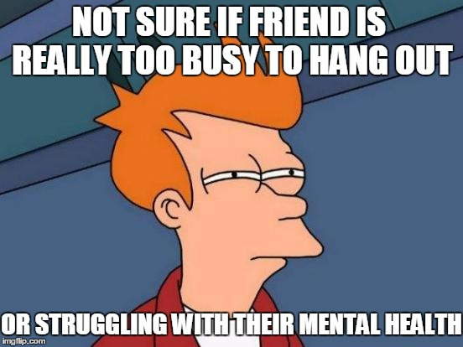
See the Person, Not the Condition
Connections Matter
Sometimes people with mental health conditions find it hard to stay connected to friends
This is when they need support most.
Reach Out
“We haven’t hung out in a while. How are you doing?
Ask if they want help with anything
“I’m going to Chipotle. Want me to bring you a burrito?”
A little support goes a long way
Photo credit: Imgflip. Modified.
#IamStigmaFree
Notes:
Sometimes people with mental health conditions find it hard to socialize, return texts and see friends--this is when they need support most
Stay connected- keep talking with your friend and including them in your plans.
Your friend may be having a hard time. They may blow you off. Don’t take it personally; keep reaching out. If they don’t want to go out somewhere, suggest going to where they live and spending time with them there.
Ask if they want help with anything, like getting food or doing laundry.
Worried about what to say? Let them know you support them and ask how they are doing. If you aren’t sure if they want to talk, ask.
A little support can go a long way. Even if they don’t ask you for anything or agree to hang out (or cancel plans you’ve made), knowing you’re still there for them when they’re ready makes a difference.

Slide 14
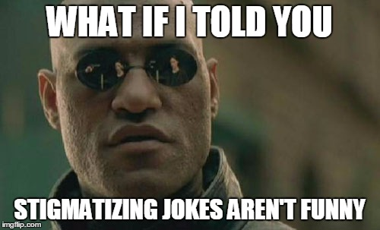
Take Action
Speak Out
Speak with respect, compassion and authority when you take with others about mental health – don’t let stigmatizing comments slide!
If you if you notice someone is struggling, start a conversation
Collaborate with other student organizations
Write a blog post or editorial for campus sites and newspapers
Photo credit: Imgflip. Modified.
#IamStigmaFree
Notes:
When people talk about mental health, be the one who speaks with respect, compassion and authority – don’t just go along with stigmatizing jokes and comments, respectfully try and start a conversation to use the moment as a chance to teach someone about mental health.
If you see someone struggling, reach out or ask others to join you in helping the person seek help.
If you run a student organization, collaborate with NAMI on Campus to promote good mental health on campus – especially during stressful times in the semester like midterms and finals.
Submit blog posts and editorials to campus blogs and newspapers.
Remember, not everyone has a mental health condition, but everyone has mental health. We all can benefit from awareness events.

Slide 15
Take Action
Raise Awareness
Share articles and videos about mental health on social media
Share the 10 common warning signs
Work with others to plan an event to raise mental health awareness
Work with campus health and counseling centers to start an awareness campaign
Photo credit: marketingweekly.
#IamStigmaFree
Notes:
See an article or video about mental health that you like? Share it on social media so others can learn too
Share the 10 common warning signs with others so they know what to look for and when to lend a hand
Work with others to plan an event to raise mental health awareness that might include a speaker, a film, or just a conversation

Slide 16
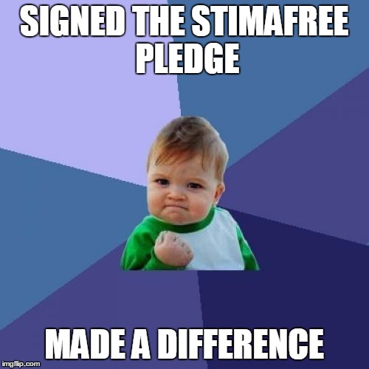
Take Action
Make a Difference
Take the StigmaFree pledge right now
www.nami.org/stigmafree
Encourage others to take the pledge by sharing the www.nami.org/stigmafree link on social media
Share that you are committed to a StigmaFree campus with the #IamStigmaFree on Twitter and Instagram
Photo credit: Imgflip. Modified.
#IamStigmaFree
Notes:
Join NAMI on Campus or other initiatives to make a positive difference on your campus. Bring your friends!
Take the StigmaFree pledge right now by jumping on your phone and visiting www.nami.org/stigmafree
Tweet #IamStigmaFree and ask your followers to join you. Encourage others to take the pledge
Share that you are committed to a StigmaFree campus by posting pictures of yourself with your StigmaFree sticker on social media. Put the sticker on your door so everyone who comes over knows that they are in a StigmaFree space.

Slide 17
A campus starts with us.
Together, we can create it.
#IamStigmaFree
Notes:
We have the tools to end stigma on our campus and make a positive difference in the lives of students.
What are your thoughts and ideas on creating a StigmaFree campus?

