Slide 1
Ending the Death Penalty for Mental Illness
Aurelie Tabuteau Mangels, Mental Illness Initiative Fellow, American Bar Association’s Death Penalty Due Process Review Project, Washington, D.C.
Greg Hansch, Public Policy Director, NAMI Texas, Austin, Texas
Barbara Moser, Director of Policy and Outreach, NAMI Indiana, Indianapolis
Mira Signer, Former Executive Director of NAMI Virginia, Richmond, Va.
Moderator: Ron Honberg, Senior Policy Advisor, NAMI, Arlington, Va

Slide 2
There is no categorical protection from the death penalty for those with severe mental illness
Why is this an issue?
The Supreme Court views the death penalty as the ultimate punishment reserved for the “worst of the worst:”
“With respect to retribution—the interest in seeing that the offender gets his “just deserts”—the severity of the appropriate punishment necessarily depends on the culpability of the offender. Since Gregg, our jurisprudence has consistently confined the imposition of the death penalty to a narrow category of the most serious crimes.”
Atkins v. Virginia, 536 U.S. 304 (2002)

Slide 3
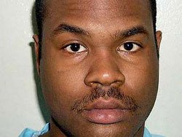
… But the Constitution protects defendants with intellectual disability and juveniles
The Supreme Court has recognized that the execution of two particular less culpable categories of the population is unconstitutional:
Atkins v. Virginia (2002): executions of defendants with intellectual disability are “cruel and unusual punishment” prohibited by the 8th Amendment.
Roper v. Simmons (2005): executions of juveniles are “cruel and unusual punishment” prohibited by the 8th Amendment.
Daryl Atkins
Atkins had a full scale IQ of 59
Christopher Simmons
Received the death penalty for a crime committed at age 17

Slide 4
Individuals with severe mental illness should not be executed: a growing national consensus…
From the public
2014: 58% of Americans in favor of an SMI exemption (Public Policy Polling)
2015: 66% of Americans in favor of an SMI exemption (David Binder Research)
From relevant professional organizations
2006: American Bar Association National Alliance on Mental Illness, American Psychiatric Association, American Psychological Association
2011: Mental Health America

Slide 5
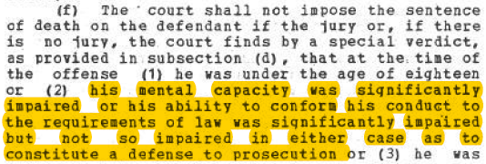
…but currently no legislation
But no state legislative action
Connecticut (1973) was the only state to ever have a severe mental illness exemption in its statutes. Connecticut abolished the death penalty in 2012.

Slide 6
So what happens currently for defendants with severe mental illness claims in capital cases?
There are some limited and narrow mechanisms that may allow for mental illness to be taken into account in capital proceedings,
But individuals with SMI continue to be sentenced to death and executed
Recently: Adam Ward in Texas, executed on March 22nd 2016
Fifth Circuit opinion: “Petitioner has been afflicted with mental illness his entire life. He was diagnosed with bipolar disorder and placed on lithium as early as age 4.”
Scheduled for execution July 6: William Morva, diagnosed with delusional disorder
Notes:
However, people with SMI continue to be sentenced to death & executed. Most recently” adam ward TX. Headlineas reflect groweing understanding/consensus. “lawyers claims” major issue of focus.

Slide 7
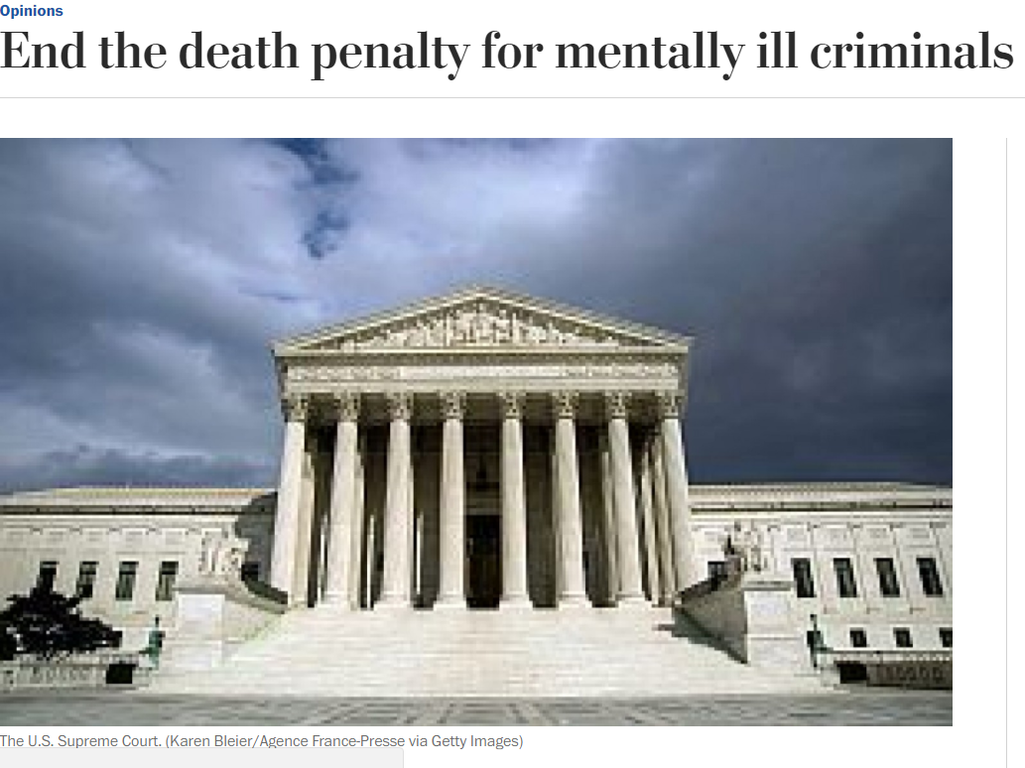
What remedies exist?
Legislative action:
In 2017, 8 states introduced bills that would create a severe mental illness exemption from the death penalty. We expect effort to expand and strengthen in 2018.
Public education & communications work:
Raise awareness of the fact that individuals with severe mental illness can still be executed
Legal remedies in individual cases

Slide 8
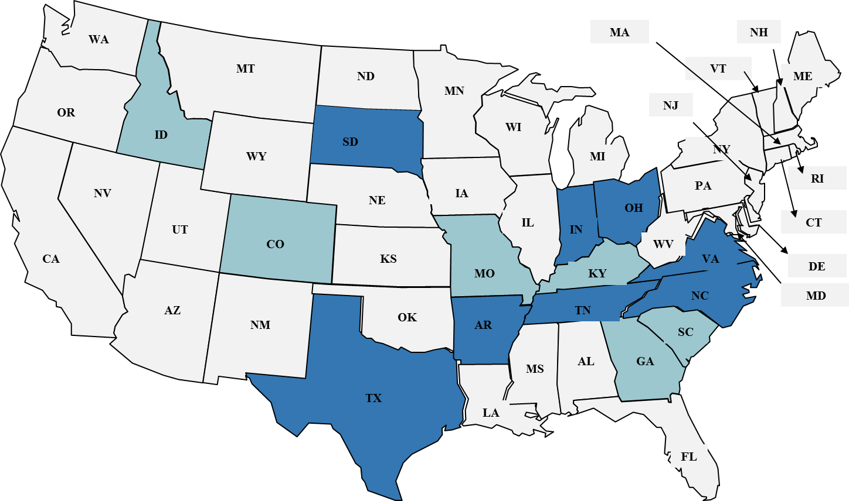
National landscape
8
Bill introduced in 2017/2016 sessions
6
Potential 2018 effort
More information at ambar.org/smiexemption

Slide 9
Barbara Moser
Director of Policy and Outreach, NAMI Indiana, Indianapolis, IN

Slide 10
Greg Hansch
Public Policy Director, NAMI Texas, Austin, TX

Slide 11
Mira Signer
Former Executive Director of NAMI Virginia, Richmond, VA

Slide 12
Thank you!
Questions?

