Slide 1
HelpLine And Data Outcomes
James Stewart, NAMI CIO @_JimmyStewart
Kate Mallow, NAMI HelpLine Manager

Slide 2
Crawl – Walk - Run

Slide 3
Crawl

Slide 4
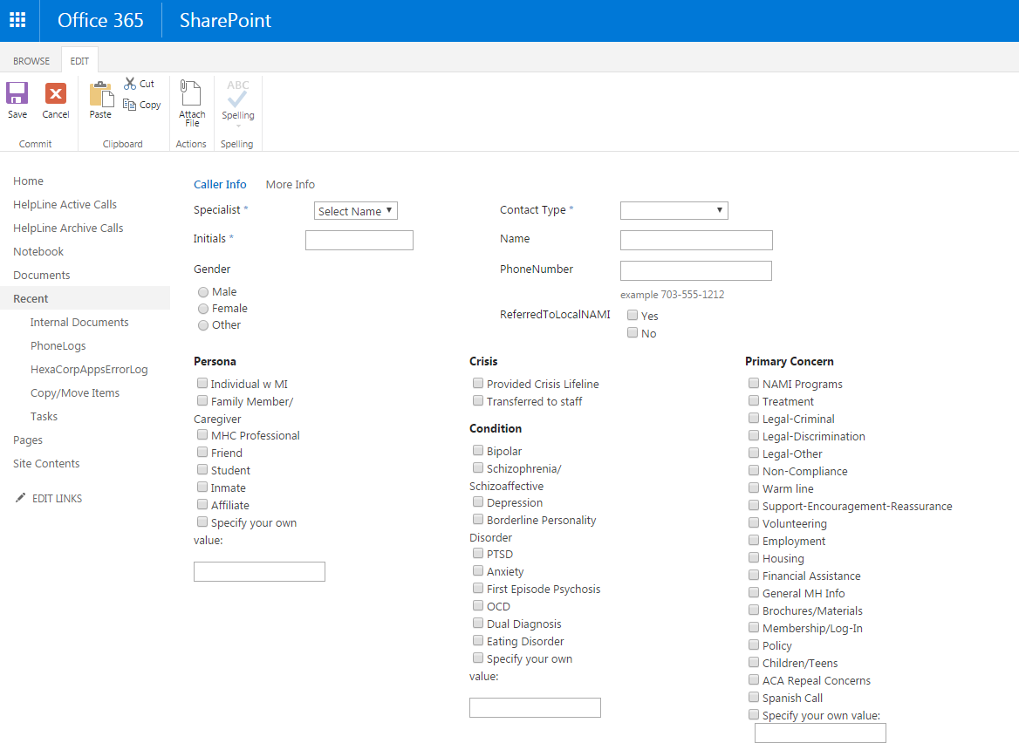
Walk

Slide 5
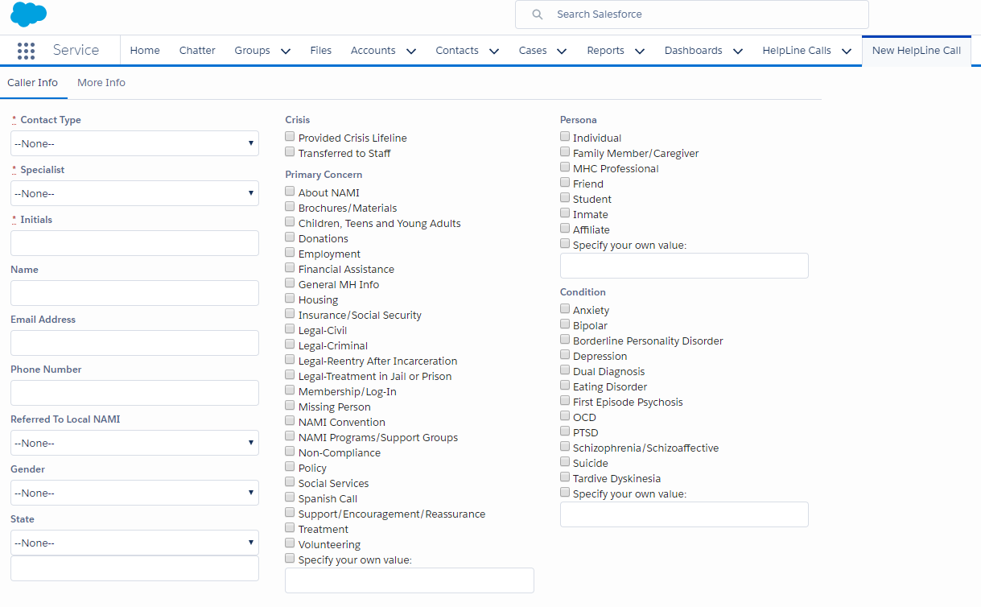
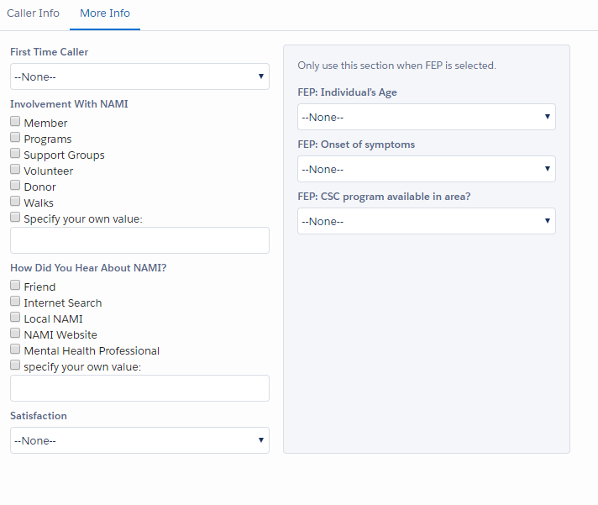
Run (jogging)

Slide 6
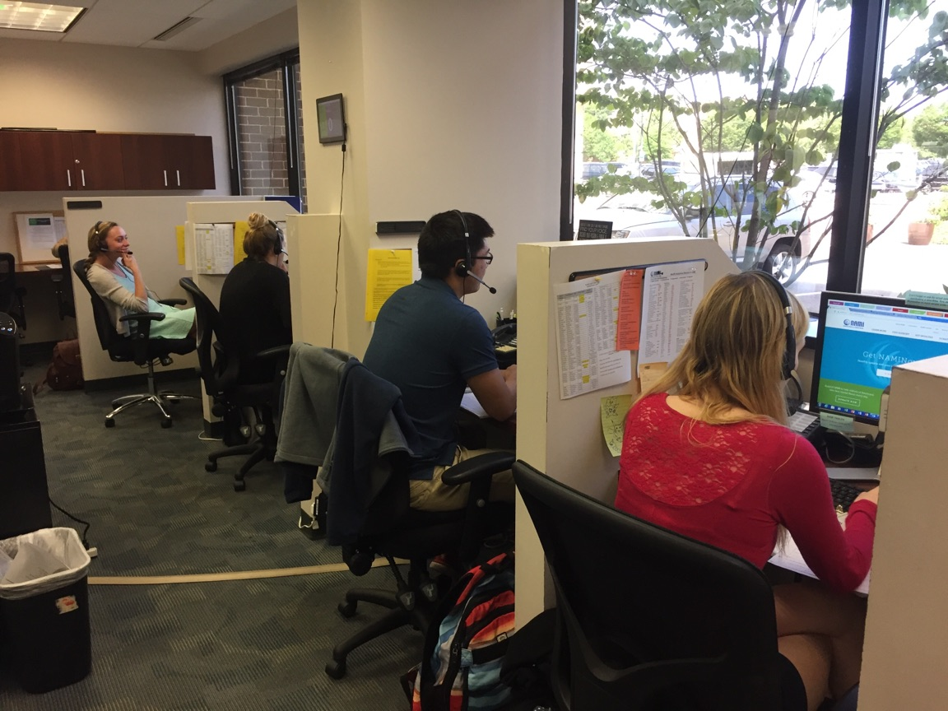
National HelpLine

Slide 7
Data Elements
Crisis call?
Contact information
Persona
Condition
Primary Concern
First time caller?
NAMI involvement
FEP

Slide 8
Volunteer Training
Usage of Office Mix
NAMI Learning Management System (LMS)
Built –in assessments
Rapid deployment of training on new topics
Reusable training

Slide 9
What’s Next
Adding Zip Code and finder app
Telephone integration
Call history
Resource library

Slide 10
Live Demo

Slide 11
Additional Information
The dashboard we showed can be accessed using the HelpLine Data link at https://nami.org/helpline
If you need data for a grant, please work with us
If you would like to align your data, we can provide a schema and data map

Slide 12
Questions?

