Slide 1
Best Practices in the NAMIWalks Event

Slide 2
Todays Presenters: Kris Eschman – “Deepening Engagement” Wayne Baldaro – “ Communications” Darcey Mamone – “ Strategic Social Media” Majose Carrasco – “Partnerships”

Slide 3
Deepening Engagement
Through

Slide 4
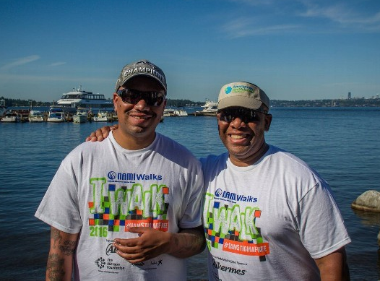
Deepening Engagement through NAMIWalks- Brad Benson
NAMIWalks Washington
1st year: Walked
2nd year: Volunteered
3rd year: On Walk Committee
and Held Key Position
on Walk Day

Slide 5
Deepening Engagement via NAMIWalks- Brad Benson
Raised over $2600 in past 2 years for NAMIWalks Washington
on NAMI Seattle Development Committee
On Depression Cake Bake Committee
In discussion about joining the NAMI Seattle Board
Strong Advocate- Talks to anyone and everyone about NAMI

Slide 6
Deepening Engagement via NAMIWalks- Brad Benson
Brad’s Tips for Other NAMIs:
At every NAMI event, you should ALWAYS:
Talk about the Walk.
Ask people to Join NAMI.

Slide 7
Deepening Engagement through NAMIWalks- Jen Madsen
NAMIWalks Greater Houston
Team: Madsen Mania
Jen’s husband and 2 of their 3 children were diagnosed with bipolar disorder at around the same time
Learned about the Walk at support group- the Walk was a better “fit” for their family
All of their involvement with NAMI is centered around NAMIWalks

Slide 8
Deepening Engagement through NAMIWalks- Jen Madsen
Madsen Mania has participated in NAMIWalks Greater Houston for 6 years, raising over $12,000
Jen is the Walk Family Chair
Daughter Abi was 2016 NAMI Texas Youth Volunteer of the Year
Published post about her family and their Walk experience on NAMI National blog
“In 1 spot in 1 Day, 3,000 people who are connected to mental illness-- that’s powerful!”

Slide 9
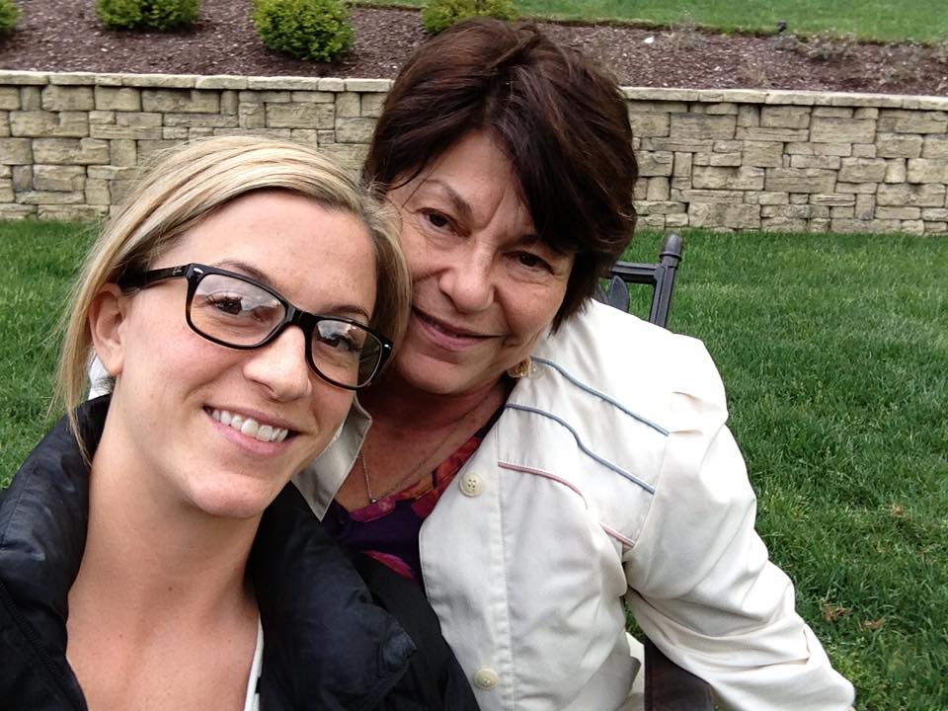
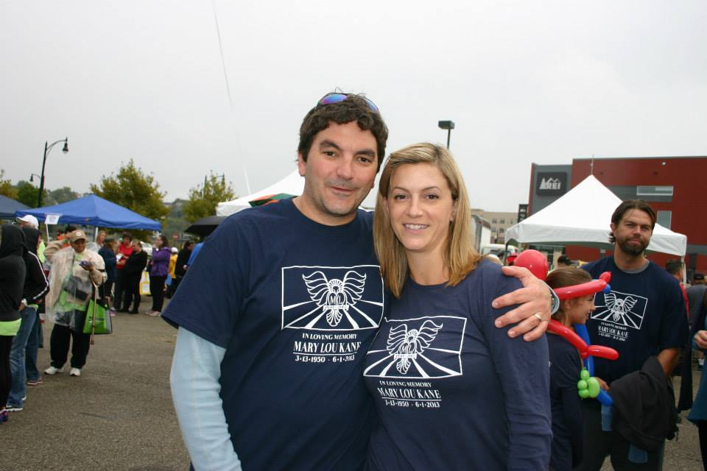
Deepening Engagement through NAMIWalks- Libby Mascaro
NAMIWalks Southwestern Pennsylvania

Slide 10
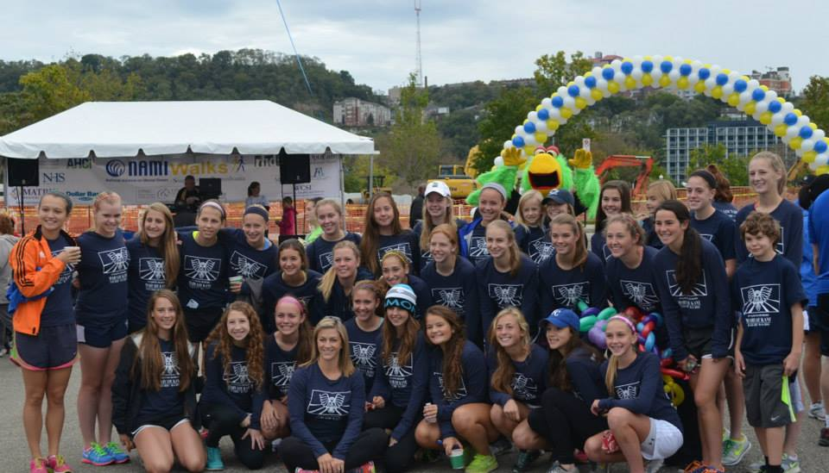
Deepening Engagement through NAMIWalks- Libby Mascaro
2012: Approached NAMISWPA
2013: Registered for NAMIWalks;
“Mary Lou’s Crew” raised over $10k

Slide 11
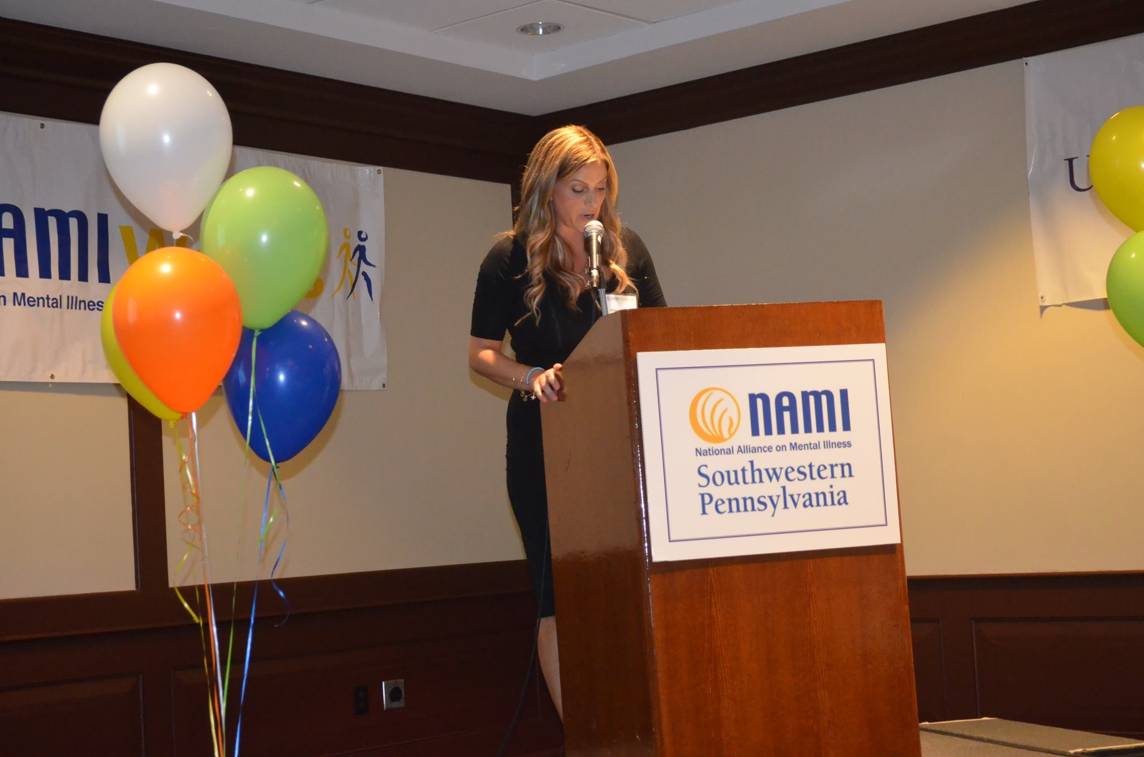
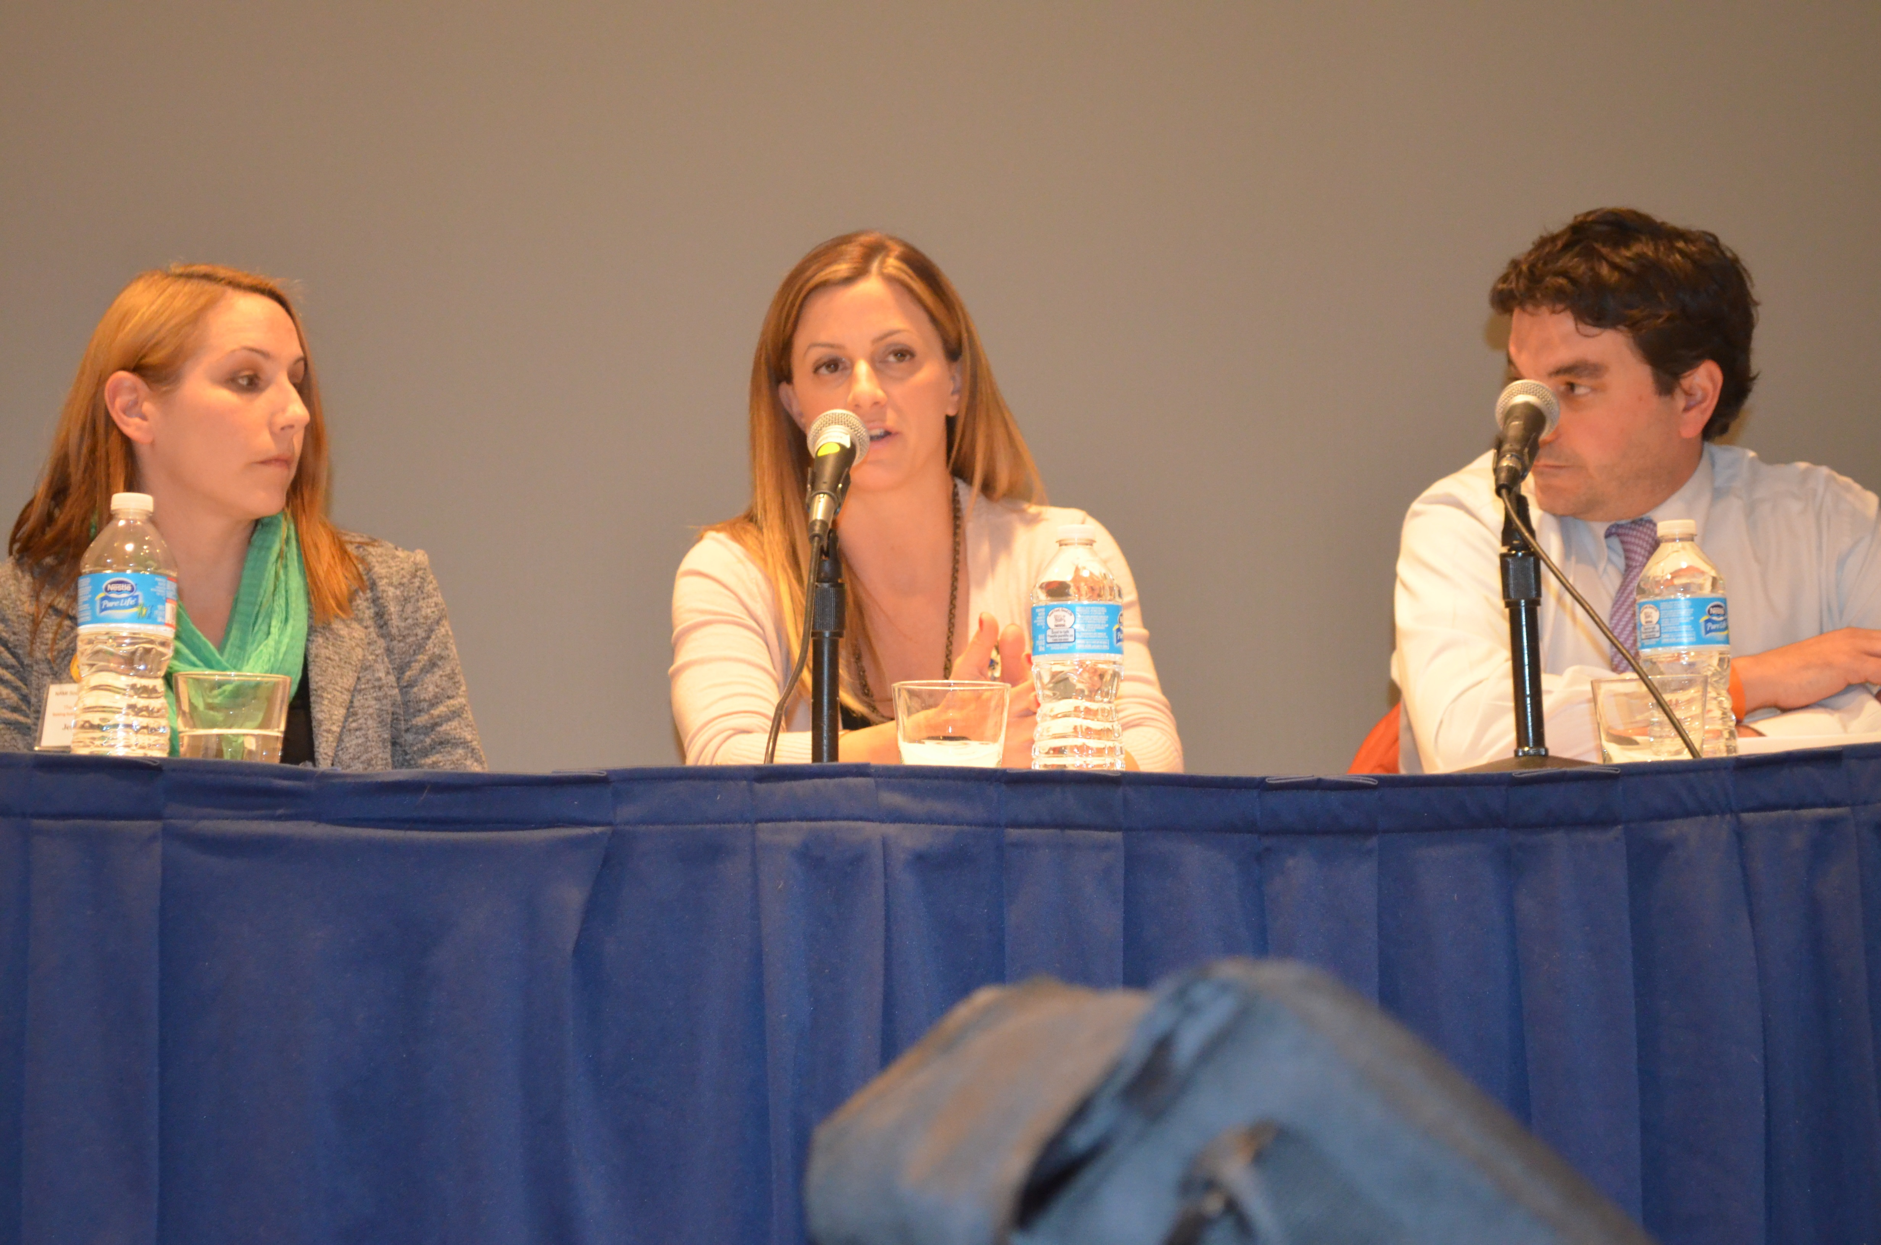
Deepening Engagement through NAMIWalks- Libby Mascaro
2014: Special guest speaker at Walk Kick-Off Event;
Panelist at inaugural SWPA Suicide Prevention Conference;
Top Fundraising Team at Walk;
Approached SWPA about hosting a Gala

Slide 12
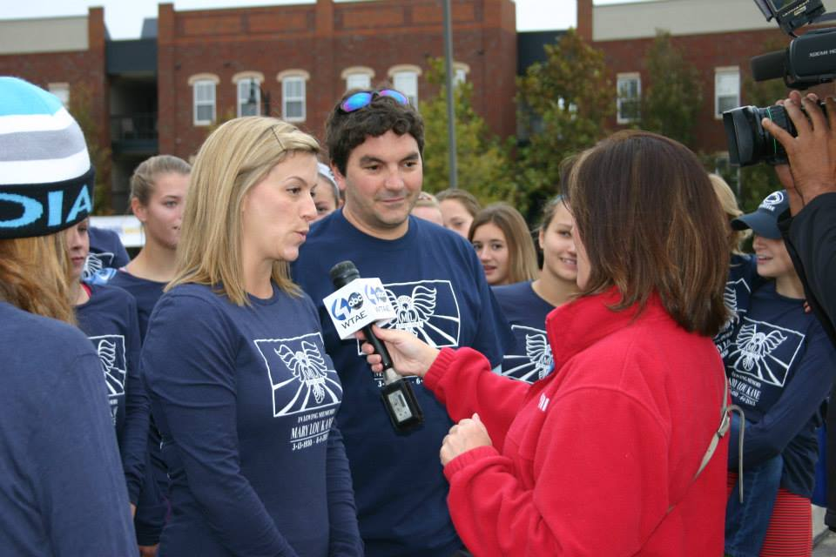
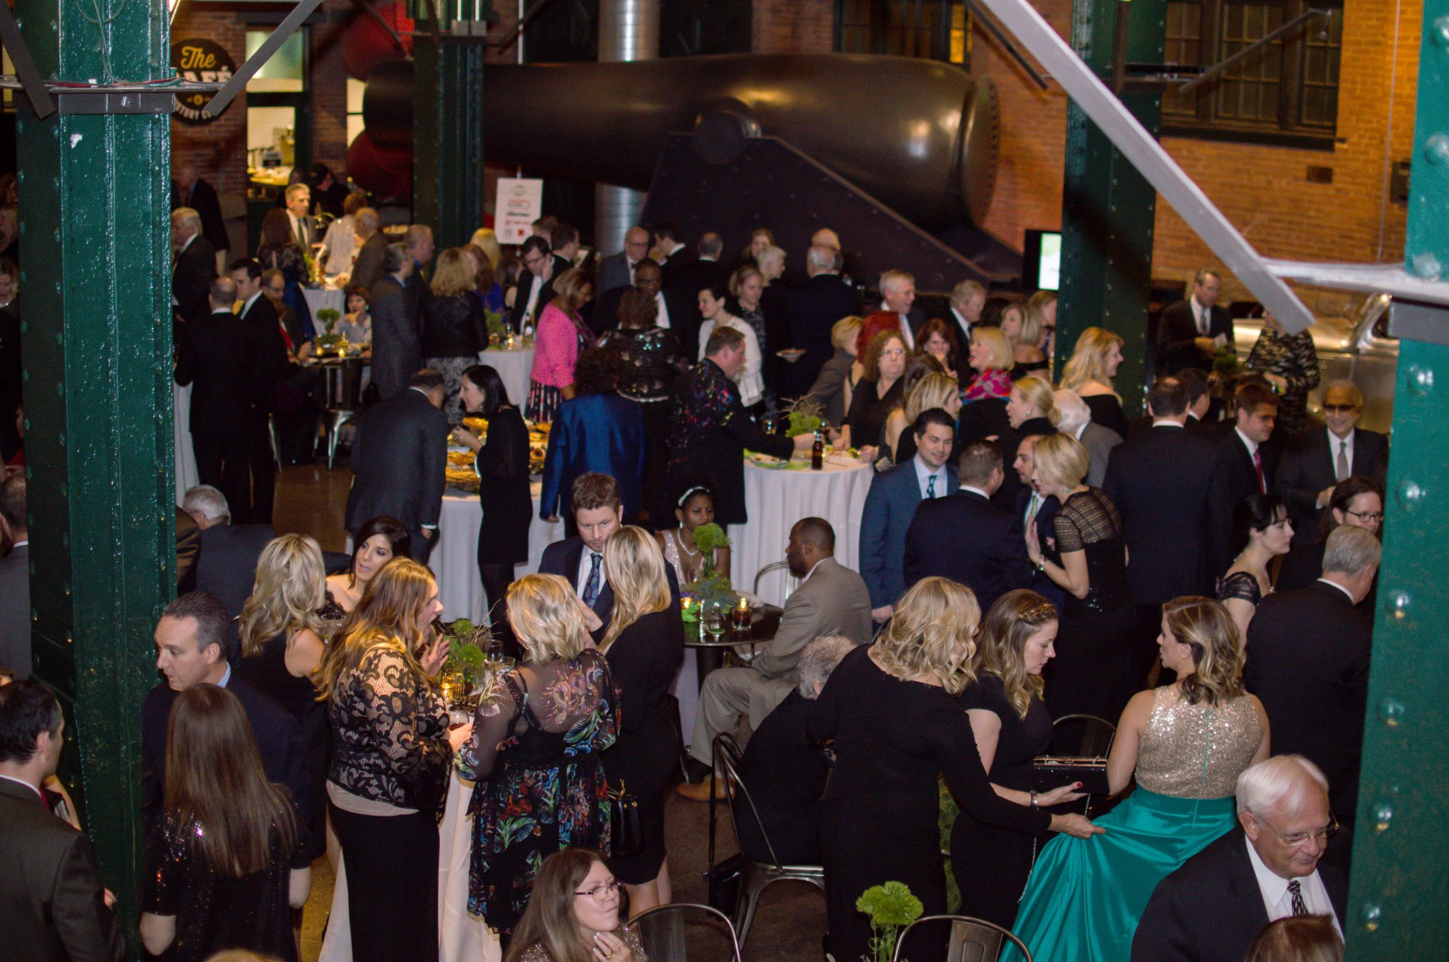
Deepening Engagement through NAMIWalks- Libby Mascaro
2015: Top Fundraising Team at the Walk
Planning for Gala began
2016: Chaired 1st Mental Health Gala in Pittsburgh: Green Light Gala- successful event!
2017: 2nd annual Gala will be in the Fall

Slide 13
Deepening Engagement through National Fundraising Recognition Program

Slide 14
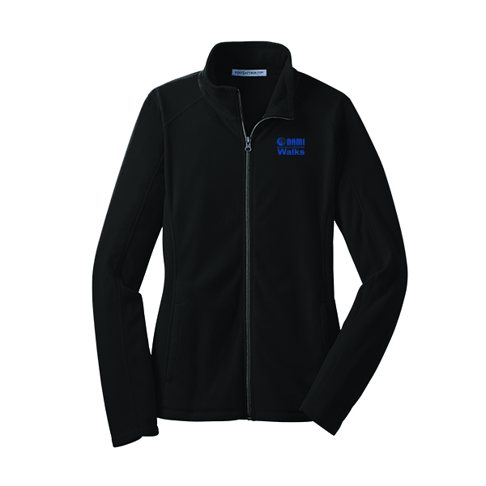
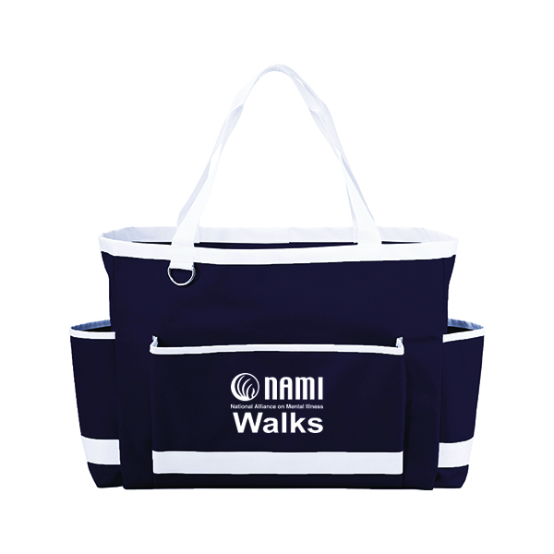
Deepening Engagement through National Fundraising Recognition Program
50+ NAMIWalks sites participating
Participants “earn” NAMIWalks branded items by fundraising.
Tools are provided to make this very simple for participant and donor

Slide 15
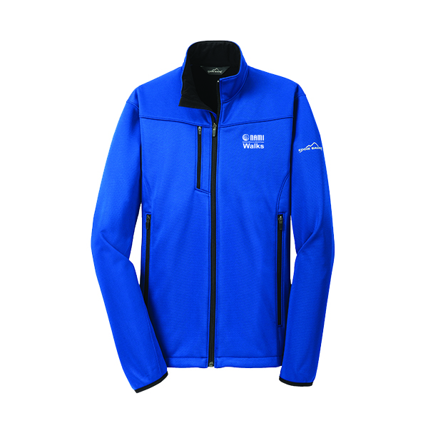
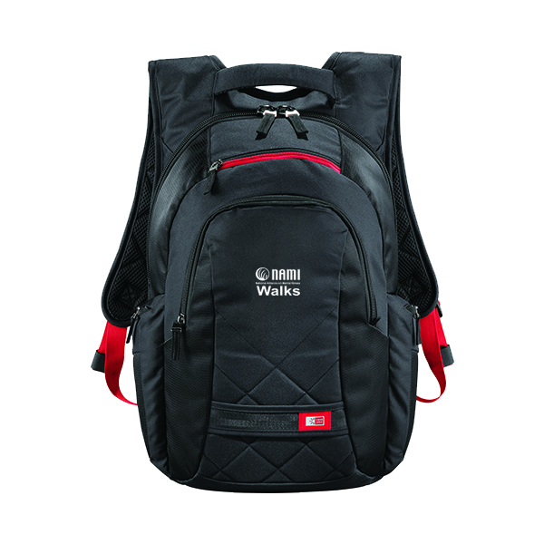
Deepening Engagement through National Fundraising Recognition Program
Participants feel appreciated, “recognized”
And more bonded to NAMI
Increased fundraising AND increased participant engagement= NAMIWalks WIN

