Slide 1
“Communications and What Works”

Slide 2
What’s Working
Clear subject line
“Three Actions You Can Take Today”
“Add Your Voice”
Brevity
“Call to Action”
“Make a gift”
“Call today”
“GPS”
Website, phone, name to contact

Slide 3
What’s Needed
Consistency
Conciseness
A Calendar – in pencil
An Audience – To segment or not to segment
Use the NAMI Mood & Branding
Second set of Eyes

Slide 4
Let’s Look At Some of the Best

Slide 5
NAMIWalks Southern Arizona
Subject: “2 More Weeks”
Missing – Link to donate.
Needs –
What I like:
While busy it has a great message. The walk picture is excellent
To the point!

Slide 6
NAMI North Carolina
Weekly Newsletter
Missing – Not a thing!
Needed –
What I like:
Always on time, has the right amount of information, layout is well done.

Slide 7
NAMIWalks NY Metro
Subject Line:
“Join the Movement”
Nice use of poster, great calls to action, highlights and clear language.

Slide 8
NAMIWalks New Mexico
Subject: “Thank You”
Why I like this one:
Good use of image.
Linkage to more information.
Great call to action.

Slide 9
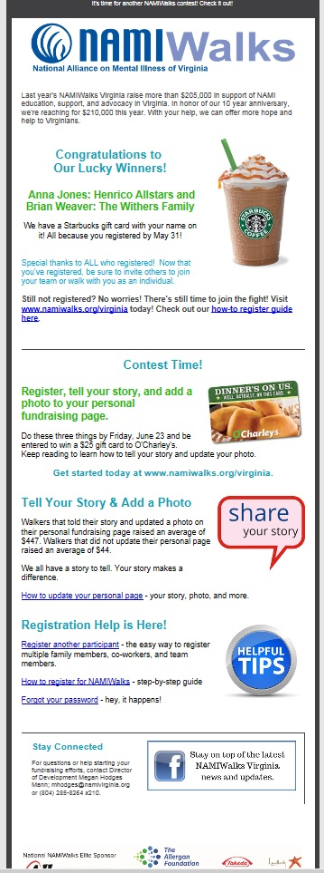
NAMIWalks Virginia
Subject: “Kick Off the Summer with NAMIWalks”
Why I like this one:
Good use of images.
Linkage to more information. Resources & More
Great call to action.
Contest.

