Slide 1

Caring for the Caregiver
Debra Lerner, MSc, PhD, Director, Program on Health, Work and Productivity Professor of Medicine and Psychiatry, Tufts University School of Medicine and Sackler School of Graduate Biomedical Sciences
Adrienne Kennedy, MA National Trainer: NAMI Basics, NAMI Provider Education State Trainer: NAMI Family to Family, Family Support Group
Sita Diehl, MA, MSSW
Director of Policy & State Outreach, NAMI

Slide 2


Mental Health Caregiver
Unpaid help for a family member or friend with a mental illness
Emotional support
Financial management
Service access
Treatment adherence
Housing
Shopping
Meal preparation
Transportation
Paperwork
Respond to crises
Essential to NAMI’s mission: Caring for the caregivers

Slide 3

It’s not just you Caregiving is a struggle
Mental Illness = Difficult caregiving dynamic
Onset early in life
Episodic
Caregiving demands
Impinges on work
Financial consequences
Secondary stigma
Social isolation
Inadequate help
Navigation
Service access
Respite
Family caregivers excluded from care team

Slide 4
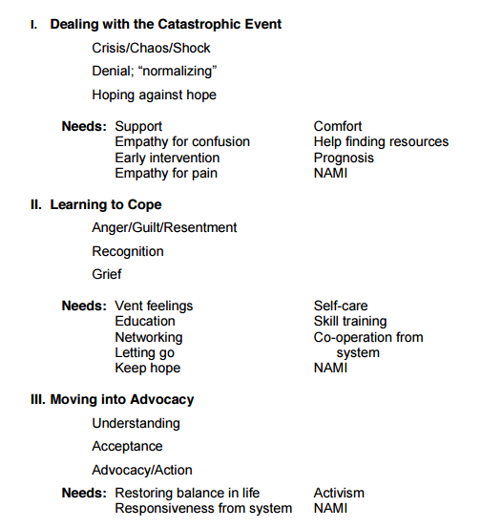
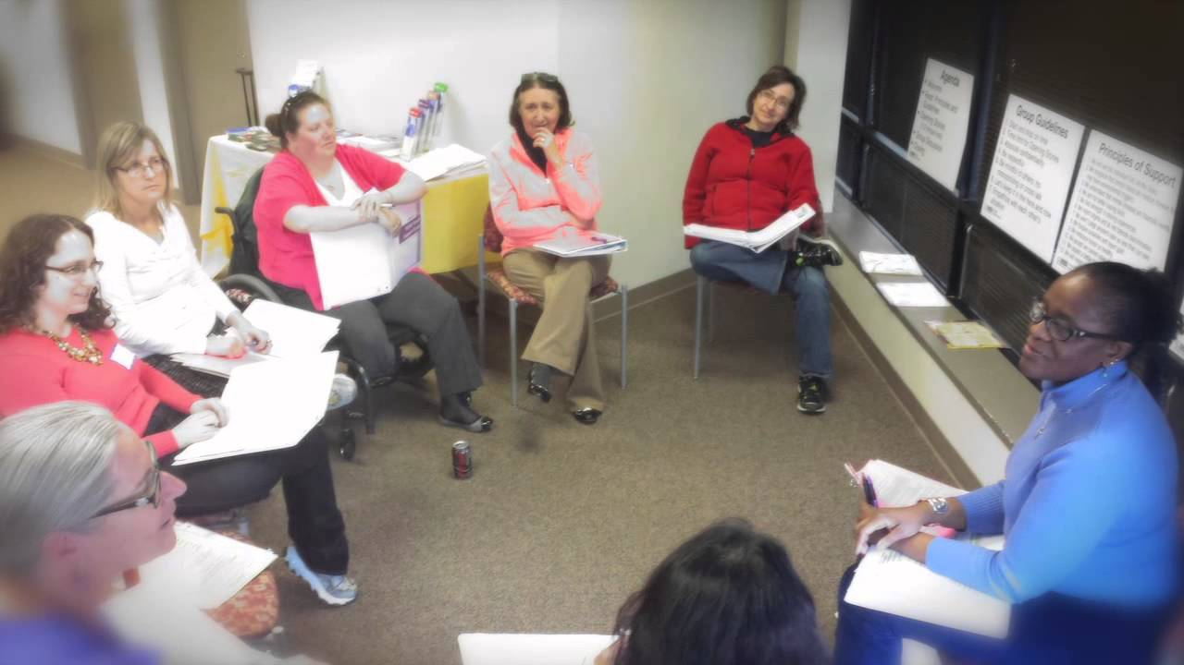

Predictable Stages of Emotional Reactions

Slide 5

Principles of Support
We will see the individual first, not the illness.
We recognize that mental illnesses are medical illnesses that may have environmental triggers.
We understand that mental illnesses are traumatic events.
We aim for better coping skills.
We find strength in sharing experiences.
We reject stigma and do not tolerate discrimination.
We won’t judge anyone’s pain as less than our own.
We forgive ourselves and reject guilt.
We embrace humor as healthy.
We accept we cannot solve all problems.
We expect a better future in a realistic way.
We will never give up hope.

Slide 6

Research: Mental Health Caregivers
Hatfield (1978) Psychological costs of schizophrenia to the family
Cook, Lefley, Pickett, Cohler, (1994). Age and family burden among parents of offspring with severe mental illness
Tessler & Gamache (1994) Instruments Measuring Family or Caregiver Burden in Severe Mental Illness
Dixon et al (2011) Outcomes of a Randomized Study of a Peer-Taught Family-to-Family Education Program for Mental Illness
Hunt, Greene, Whiting (2016) Pins & Needles: Caregivers of adults with mental illness

Slide 7
Caring for the Caregiver
Debra Lerner, MSc, PhD, Director, Program on Health, Work and Productivity
Professor of Medicine and Psychiatry, Tufts University School of Medicine and Sackler School of Graduate Biomedical Sciences

Slide 8
2015 Population-based survey of caregivers of persons with schizophrenia and/or schizoaffective disorder
Online survey of informal caregivers
Sponsored by Janssen Scientific, LLC
Recruitment ads posted by NAMI National, NAMI MA, Ms. Jeanne Phillips (Dear Abby), Mental Health America, National Psychosis Prevention Council, Schizophrenia and Related Disorders Alliance of America, reddit Caregiver Chat Group
Research collaborators
Bill Rogers, PhD
Hong Chang, PhD
Mercedes Lyson, PhD
Carmela J. Benson, MSc
Lisa Dixon, MD
David Adler, MD
6/13/17
Debra Lerner, MSc, PhD

Slide 9
Who is an informal caregiver?
You are a caregiver, if all of the following statements are true:
At anytime in the past year you provided unpaid help, or arranged for help, to a relative or friend with an illness or disability that left the person unable to do some things for him/herself, or who needed assistance due to getting older.
The kind of help involved assistance with household chores, finances, personal or medical needs.
The person who needed help lived in his or her own home, in your home or another caregiver’s home or in another place such as a nursing home.
6/13/17
Debra Lerner, MSc, PhD

Slide 10
Who is providing care?
Website hits = 2,338
Current caregivers = 1,142
Family caregivers = 1,043
6/13/17
Debra Lerner, MSc, PhD

Slide 11
Who are the caregivers?
6/13/17
Debra Lerner, MSc, PhD

Slide 12
How many caregivers were employed?
6/13/17
Debra Lerner, MSc, PhD

Slide 13
Where did caregivers and persons receiving care live?
6/13/17
Debra Lerner, MSc, PhD

Slide 14
Who are the care recipients?
6/13/17
Debra Lerner, MSc, PhD

Slide 15
How does caregiving impact work? Caregiver Work Limitations Questionnaire scores (N=710 employed caregivers)
9
Average
% of time limited past 4 weeks
6/13/17
Debra Lerner, MSc, PhD

Slide 16
What is contributing to psychological distress among caregivers? The model we tested
Individual Characteristics
Younger C
Younger CR
Diagnosed past 5 years
Health of C
Relationship to CR
Caregiver
Psychological
Distress
Work Characteristics
Employed
Negative Cognitive Appraisals
Financial burden
Emotionally unrewarding
Caregiver Role Demands
Primary C
Frequent contact
Provide most of the care
Medication concerns
Frequent ADL/IADL assistance
Frequent level of supervision
Social Support/Resources
Substitute C when needed
Caregiving guidance & advice
Lower income
6/13/17
Debra Lerner, MSc, PhD

Slide 17
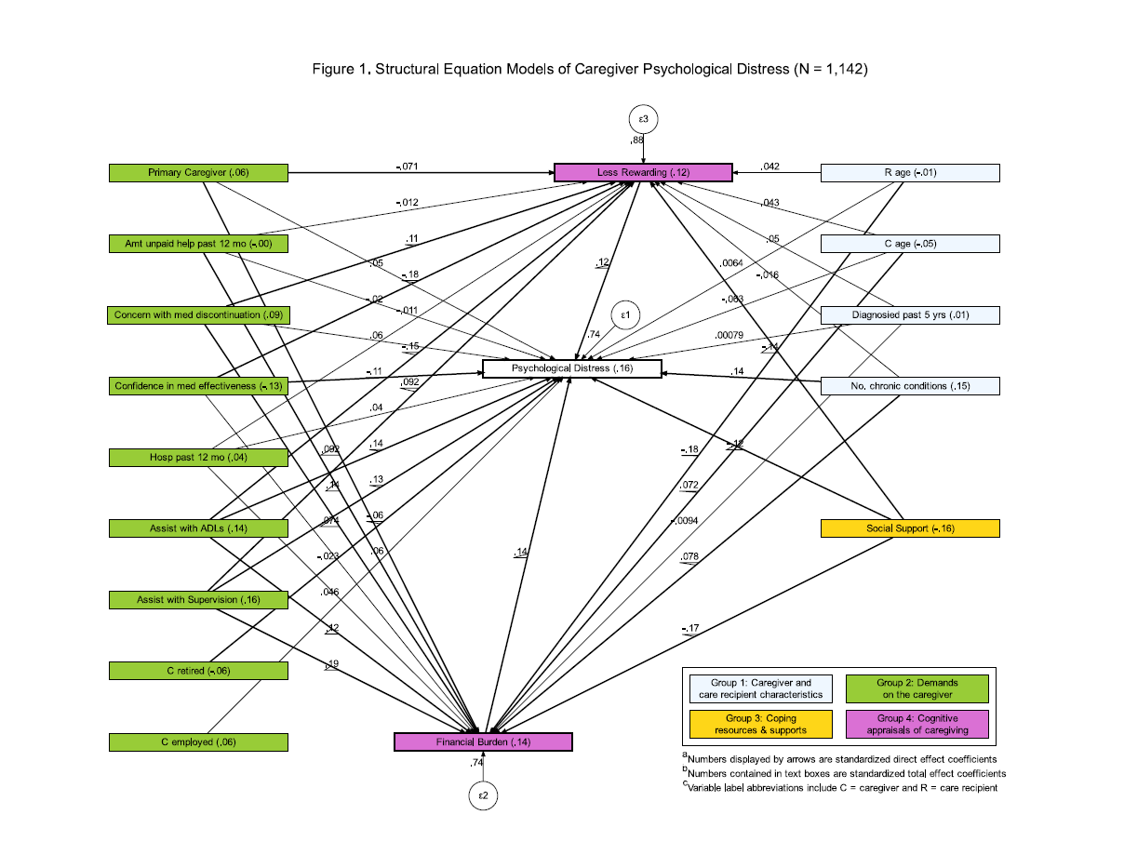
Predictors of psychological distress in caregivers What does it all mean?
6/13/17
Debra Lerner, MSc, PhD

Slide 18
What is the magnitude of caregiver psychological distress?
According to results on the Perceived Stress Scale:
Higher than the US norm
Higher than Hurricane Sandy victims
30% of this sample met classification of “high stress”
6/13/17
Debra Lerner, MSc, PhD

Slide 19
What is contributing the most to caregiver distress?
Caregiver characteristics
Personal health problems
Caregiving demands
Frequent assisting with ADLs/IADLs
Frequent supervision
Concern with medication discontinuation
Caregiver resources
Low availability of social supports (including a substitute)
Caregiver appraisals
Perceived financial burden
Perceived lack of rewards
6/13/17
Debra Lerner, MSc, PhD

Slide 20
What else do we know?
Many other variables have an impact on demands and appraisals including caregiver and care recipient age, relationship and duration of diagnosis.
The caregivers who have the highest levels of demands are:
Spouses or partners of care recipients
Relatively young parents of young care recipients
Slightly older parents of slightly older adult recipients
6/13/17
Debra Lerner, MSc, PhD

Slide 21
Caregiver groups vary in amount of caregiving demands Standardized Demand Index Score (Mean=0) by Caregiver Group
6/13/17
Debra Lerner, MSc, PhD

Slide 22
Even caregivers with relatively low demands have demands
Demand Index | Minimum Score | What the minimum means
Financial Burden | 44 | Small to moderate financial burden
ADL/IADL Assistance | 28 | Performing a little bit more than once a week, not everyday
Supervision | 11 | Performing less than once a week
Amount of Care | 66 | Provide between some to most of the care
Frequency of Contact | 60 | Seeing several times a week but not everyday
Primary Caregiver | 50 | Percentage in primary caregiver role
6/13/17
Debra Lerner, MSc, PhD

Slide 23
What do these results tell us about caregivers’ unmet needs?
The average caregiver is overloaded:
pressured-physically, emotionally and financially
Does not have an adequate safety net
Solutions are needed to address contributors to distress such as:
Personal physical and mental health promotion
Innovative approaches to helping caregivers access healthcare (e.g., technologies and tools)
Creative solutions to reducing caregiving demands (e.g., role re-engineering, skill training, helpers) without increasing the cost to caregivers
Fewer barriers to accessing information, assistance and services
Help defraying the costs directly and indirectly associated with caregiving
6/13/17
Debra Lerner, MSc, PhD

Slide 24

Seize the Day: Policy Focus on Caregivers
21st Century Cures Act of 2016
Interdepartmental Serious Mental Illness Coordinating Committee includes family caregiver & peer positions
Authorizes funds to train health providers, regulators, individuals and families on HIPAA
Strengthens MH Workforce, ACT, Crisis services, CJ diversion
First Episode Psychosis
10% of mental health block grant must go to FEP
Coordinated Specialty Array includes Family education & support
CARE Act (Caregiver Advise, Record, Enable)
Hospitals must ask patients to designate a caregiver for follow up.
AARP sponsored. Now law in 36 states

Slide 25

Self-Care is Essential
A well-functioning family is important to recovery
Caregiver education & Support: NAMI leads
Family to Family
NAMI Homefront
NAMI Basics
Family Support Groups
Education & Training
Validate caregiver experience
Caregiver & care recipient needs
What quality care looks like
Big hits to self care, how to address
Family coping skills
Principles of support
Use these tools to regain balance in our lives

Slide 26

Thank you! Questions?
Debra Lerner, PhD, Tufts University School of Medicine dlerner@tuftsmedicalcenter.org
Adrienne Kennedy, MA, NAMI Austin adrienne.kennedy@namiaustin.org
Sita Diehl, MSSW, NAMI sdiehl@nami.org

