Slide 1
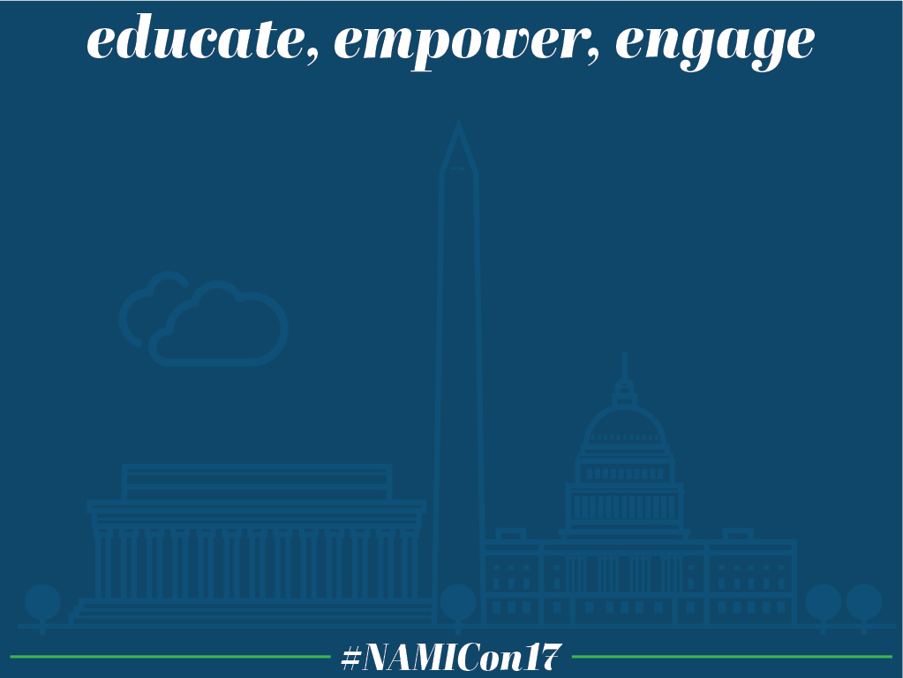
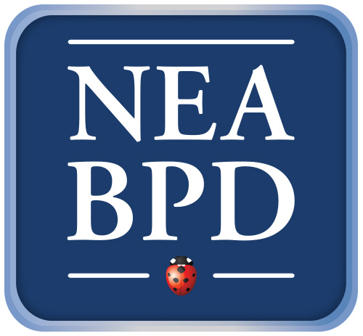
Borderline Personality Disorder: Through the Lens of Family Members
Perry D. Hoffman, Ph.D., Elizabeth McCrave
and Joy Sprague
National Education Alliance for Borderline Personality Disorder

Slide 2

THE IMPORTANCE OF SKILLS FOR FAMILIES

Slide 3
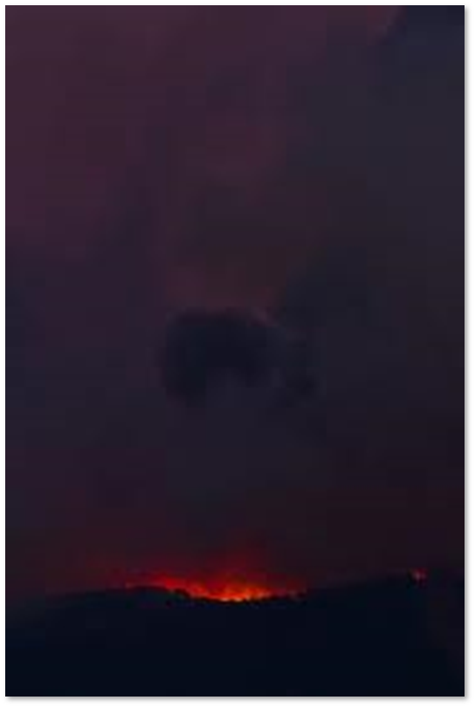

Slide 4
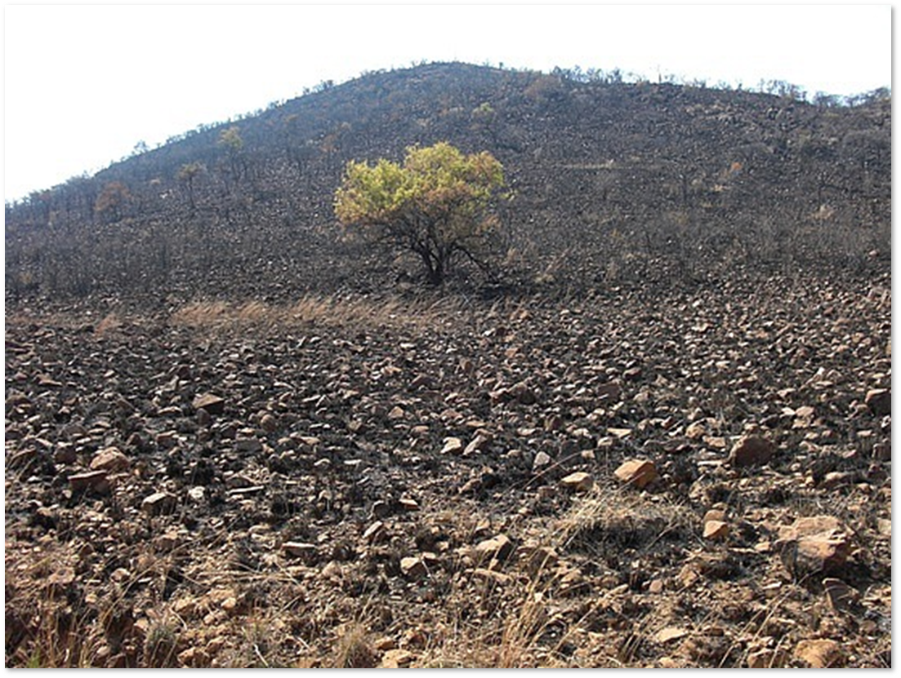

Slide 5
Family Connections
Developed by Alan Fruzzetti, Ph.D., and Perry Hoffman, Ph.D. from the National Education Alliance for Borderline Personality Disorder (NEABPD)
12 week structured course
Led by professionals or family members
Integrates DBT principles of acceptance and mindfulness
www.borderlinepersonalitydisorder.com

Slide 6
How do we do this?
Education - Skills - Support
“The class was a lifeline for us when we were very, very low and not completely understanding our daughter and her issues…[our life together today] would have not been possible without the skills and understanding that we acquired ... The class lifted the curtain of ignorance about this illness and exposed it to the light.”

Slide 7
Getting started Skills
Rights of Relatives:
  healthy selfishness,
  Learn to say no
  accept that we cannot solve our relative's problems,
  accept that we will lose our cool at times)
Basic Assumptions to be Effective:
  interpret things in the most benign way possible,
  no one or absolute truth,
  everyone is doing the best they can in this moment AND
  everyone needs to try harder

Slide 8
Developing interest & curiosity
Sensitivity, reactivity, return to baseline
Awareness of validating vs invalidating family/social environment
Awareness of our relative's need for support AND our need for balancing our relative's and our needs (oxygen mask)
Emotion mindfulness: Observe, Describe, Participate Non-Judgmentally, One-Mindfully and Effectively

Slide 9
Relationship Mindfulness
Observing and describing another
Letting go of judgments
Stay with facts
Benign interpretations
Recognize transactional nature of the relationship
“Sure, we still have our moments of conflict, but we can usually come to a place of understanding, thanks to our new skills...”

Slide 10
Radical Acceptance
What is the reality?
Four ways to deal with any problem
Acceptance reduces suffering
Acceptance gives you more control, not less
Practice acceptance every day
Start small
Change/Tolerance starts with you

Slide 11
Limit Setting Skills
“Boundaries” can be a loaded term/ abandonment issues can be raised.
In this class we “Observe our limits”.
“I wish I could help you but this is all I can do.”
Fine line between enabling and being supportive. We will find the balance to avoid burning out in the long run.

Slide 12
Validation Skills
Really understand the other person
Communicate that you understand
A. and I had a big breakthrough this morning (…). A. dysregulated and I was of course the target. I managed to stay calm, listen to her and validate the emotion I thought she was feeling. IT WORKED!!!! We have a long way to go but this was huge.
Thanks for all you do.

Slide 13
Validation – What to validate?
  Feelings or emotions
  Legitimacy in desires
  Opinions or thoughts
  Values / Priorities
  Task difficultly
  Effort made towards goals
  Things that enhance relationships
Only validate the valid things.
There are always valid parts.
Validation doesn't mean you agree.

Slide 14
The Big Picture for Relatives
Take care of ourselves first
  Observe and stick to our limits. Our relative needs to know we are safe and predictable.
  Change starts with us
Keep in mind the importance of the relationship.
  A good goal is to act effectively. Being effective presents more opportunities to engage.
Not escalating is usually more effective than being right.
  Be aware of longer term goals
  Try to see both sides. “You don’t have to be wrong for me to be right.”

Slide 15
Final Parent Words
Thank you SO very much for the incredible learning experience of this Family Connections class. You have been so informative, warm, supportive and Validating, that this exceeded all of my expectations. …There just is no substitute for the sharing, and networking, and heart to heart with other families who are dealing with BPD loved ones.
(…) I believe that through my personal research, and focus on DBT learning skills, it has made me a more effective parent. Together we are learning to trust. I do believe that the more I naturally assume the DBT communication strategies and principles, the better things will get. I would like to continue to pursue this, and help other families who might not have some of the resources and experience that I have. We are all on a journey, schooled, skilled, or not.

Slide 16
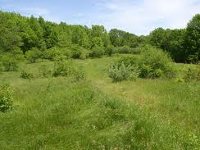

Slide 17
For More Information
Family Connections
www.borderlinepersonalitydisorder.com

