Slide 1

Change the World:
Tell Your Story
Schatzie Brunner: Presentation Coach,
Author: The Face of Depression
Sita Diehl: Director, Policy & State Outreach
Julie Erickson: Manager, National Education Programs

Slide 2


Mental Health in America
1 in 5
Stigma
Discrimination

Slide 3

What does your story do?
We help ourselves
Help others
Fight stigma
Create change
Listen…

Slide 4

Effective Storytelling
Introduce yourself
Your relationship to the issue
Low point…

Slide 5

Effective Storytelling
Turning point: What helped?
What’s going right?
What do you hope for?
When to have an ask

Slide 6

TIP #1: Know your audience

Slide 7

TIP #2: Keep it BRIEF
Stick to the highlights

Slide 8
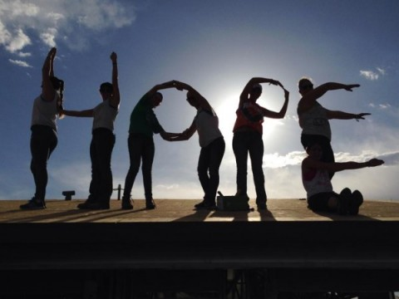
TIP #3: Motivate with Hope

Slide 9

Your Turn!
Write your story
REMEMBER…
Your story is always RIGHT (it’s your story)
Your lived experience has value and meaning
You don’t need to have answers

Slide 10

Practice in Pairs
Storyteller:
  Speak from your story practice sheets
  2 minute limit
Listener:
  Time story with cell phone
  Stop the person at 2 minutes
  Give positive feedback, 2 minute limit
    What moved you?
    What really worked?
    What could make it even stronger?
Switch roles

Slide 11

TIP #4: Practice, practice, practice
NOTE: Your delivery is part of your message Be sincere, confident and clear

Slide 12

TIP #4: Emotion should MOVE, not overwhelm
  HOW? Dial it back just enough
  Understand your limits

Slide 13

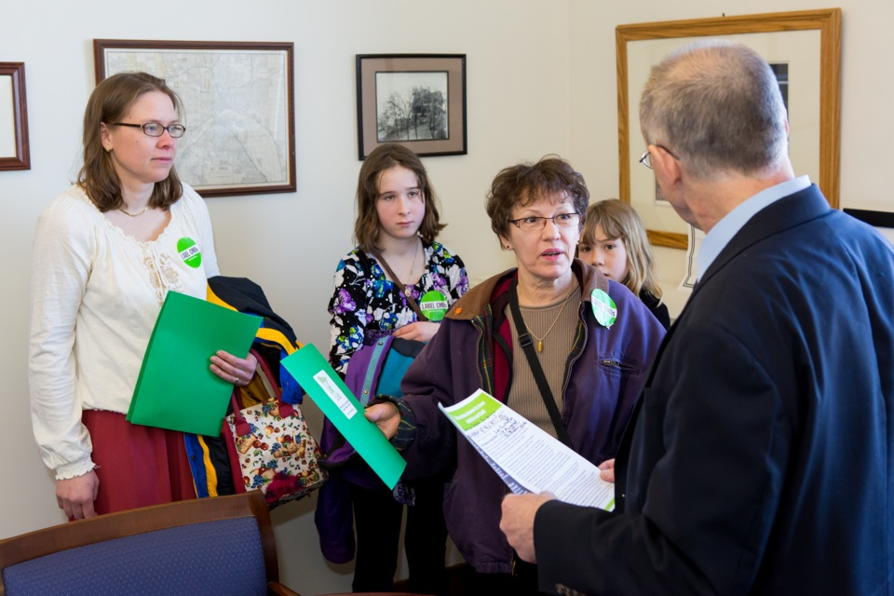
NAMI Smarts for Advocacy
Grassroots advocacy skills
Hands on learning
Shape your story
Use it to change policy
Want a Smarts Workshop?
  Contact your NAMI State Organization

Slide 14
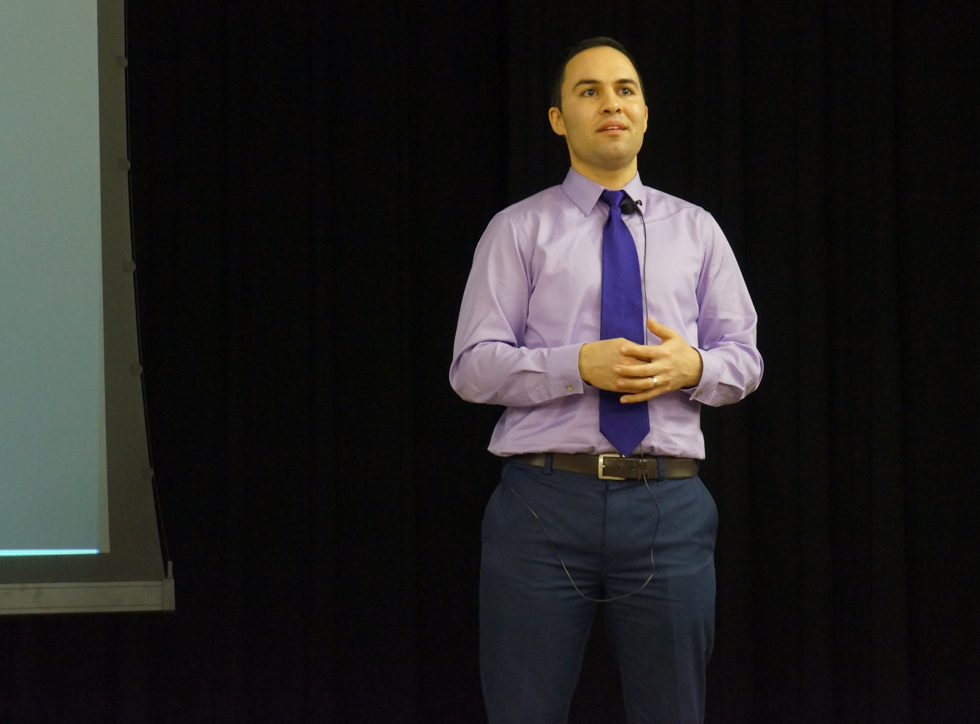
NAMI In Our Own Voice
Features two presenters with lived experience
Creates a safe space for dialogue on mental health
Breaks down stigma
Empowers presenters
Update: January 2018

Slide 15

Thank you!
Questions?

