Slide 1
Update From the NIMH
Joshua A. Gordon, M.D., Ph.D.
Director, NIMH
July 1, 2017

Slide 2
Welcome
About the NIMH Director
Director’s Research Priorities
Current State of NIMH
Science Highlights and Updates
Participation in Research
Future Directions
Notes:
Note: this slide needs to be updated when final

Slide 3
Introduction
About the NIMH Director
Director’s Research Priorities
Current State of NIMH
Science Highlights and Updates
Participation in Research
Future Directions
Notes:
Note: this slide needs to be updated when final

Slide 4
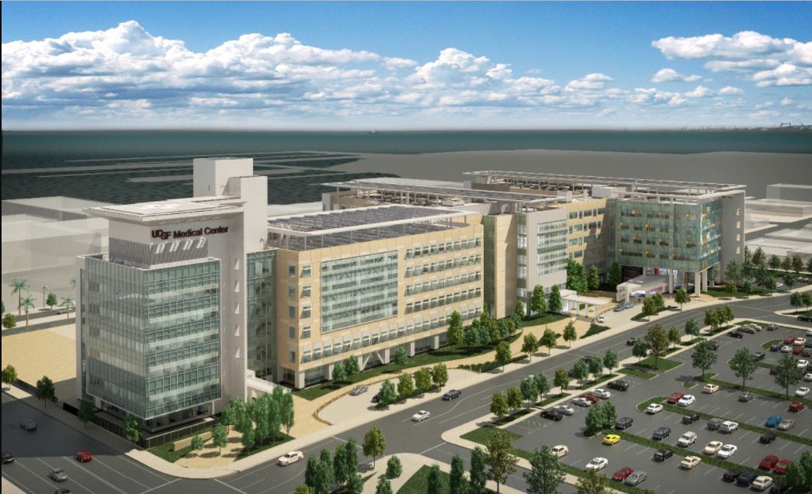

Background
University of California, San Francisco
  Received dual M.D./Ph.D.
  Pioneered methods to study brain plasticity in mice
Columbia University
  Psychiatry residency, neuroscience fellowship
  Joined Department of Psychiatry
  Director of the Columbia University/New York State Psychiatric Institute Adult Psychiatry Residency Program
  Research focus on neural activity in mice carrying mutations of relevance to psychiatric disease
  Maintained psychiatric practice, caring for patients who suffer from the illnesses studied in the lab

Slide 5
Director Priorities
About the NIMH Director
Director’s Research Priorities
  Balanced Portfolio: Timeframes
  Short-term: Suicide Prevention
  Medium-term: Circuit Neuroscience
  Long-term: Computational & Theoretical
Current State of NIMH
Science Highlights and Updates
Participation in Research
Future Directions
Notes:
Note: this slide needs to be updated when final

Slide 6

NIMH Portfolio Balance
Good Science
  Strong Study Design
  High Standard of Rigor
  Potential Impact
Diversity
  Subject Matter
  Workforce
  Research Participants
  Timeframes
Notes:
My number one priority is to support excellent science - funding decisions are based on proposed study design, adherence to the highest standards of rigor, and potential impact on the field.
Excellent science requires diversity in subject matter, workforce, research participants, and timeframes.
Such diversity is the cornerstone of a strong and balanced research portfolio.

Slide 7

Research Priorities
Short-term Goals: Suicide Prevention
  Identify implementable evidence-based practices and knowledge gaps
Medium-term Goals: Neural Circuits
  Develop technologies to interrogate neural circuits, and ultimately improve the understanding and treatment of mental health disorders
Long-term Goals: Computational Psychiatry
  Develop computational perspectives and approaches to improve the understanding and treatment of mental health disorders
Notes:
It is important to invest in research across diverse timeframes; research that has the potential to yield results or improve clinical care over the short, medium, and long-term.
I came in with scientific priorities, and am beginning to explore how to accomplish them.

Slide 8
NIMH Updates
About the NIMH Director
Director’s Research Priorities
Current State of NIMH
  Budget
  Grants
  Interactions with SAMHSA
Science Highlights and Updates
Participation in Research
Future Directions
Notes:
Note: this slides needs to be updated when final

Slide 9
NIMH Budget Updates
Notes:
On May 5, 2017, President Trump signed the Consolidated Appropriations Act of 2017 providing funds through September 30, 2017.
NIMH received $1.602 billion, a 3.5 percent increase over the FY 2016 appropriation.
President’s budget proposal, released on March 16, is proposing major cuts to the NIH.
We don’t know yet how this will affect NIMH.
We will know more about FY 18 in the coming months.

Slide 10
NIMH Budget Updates
Notes:
Josh used his own words here (uptick in 2016, # projects holding steady, etc.)
FY 2016 - NIMH awarded an estimated 587 new and competing research project grants (RPGs) in 2016, and achieved an overall success rate of approximately 23 percent (defined as number of RPG applications funded divided by the number of applications received. NIMH awarded grants to 84 New Investigators, and achieved a success rate of approximately 24 percent for Early Stage Investigators.
FY 2017 - NIMH anticipates awarding more than 600 new and competing research project grants (RPGs) in FY 2017, with an estimated success rate of 23 percent, as can be seen in Figure 1 below. FY 2017 will be the first year NIMH will exceed 600 competing RPGs.

Slide 11
NIMH Budget Updates
Notes:
This figure shows the number of applications received and the number of awards made through the 25th percentile “that come out of the review boards "for RPGs.
Not included are applications/awards higher than the 25th percentile. Note that in Figure 2, the total number of funded grants does not add up to 587, as not all grants are percentiled.
Note: NIH/Office of Extramural Research (NIH/OER) has a new method for showing success rates – we will be using this in the future.

Slide 12

21st Century Cures Act:
Interactions Between NIH and SAMHSA
Key Provisions for Mental Health Care:
  Appoints Directors of NIMH, NIDA, NIAAA to SAMHSA advisory councils
  Encourages collaboration to ensure evidence-based practices
  Strengthens existing mental and behavioral health care parity legislation
  Includes broad provisions to assist for special populations
Notes:
Increases inter-Departmental collaboration and consultation between federal agencies. SAMHSA will receive guidance from NIMH, NIDA, and NIAAA concerning the scientific evidence-base of prevention, treatment, and recovery programs.
Continued support of SAMHSA’s mental health block grants – The bill generally requires states to use at least 10% of their mental health block grants on early intervention for psychosis.

Slide 13

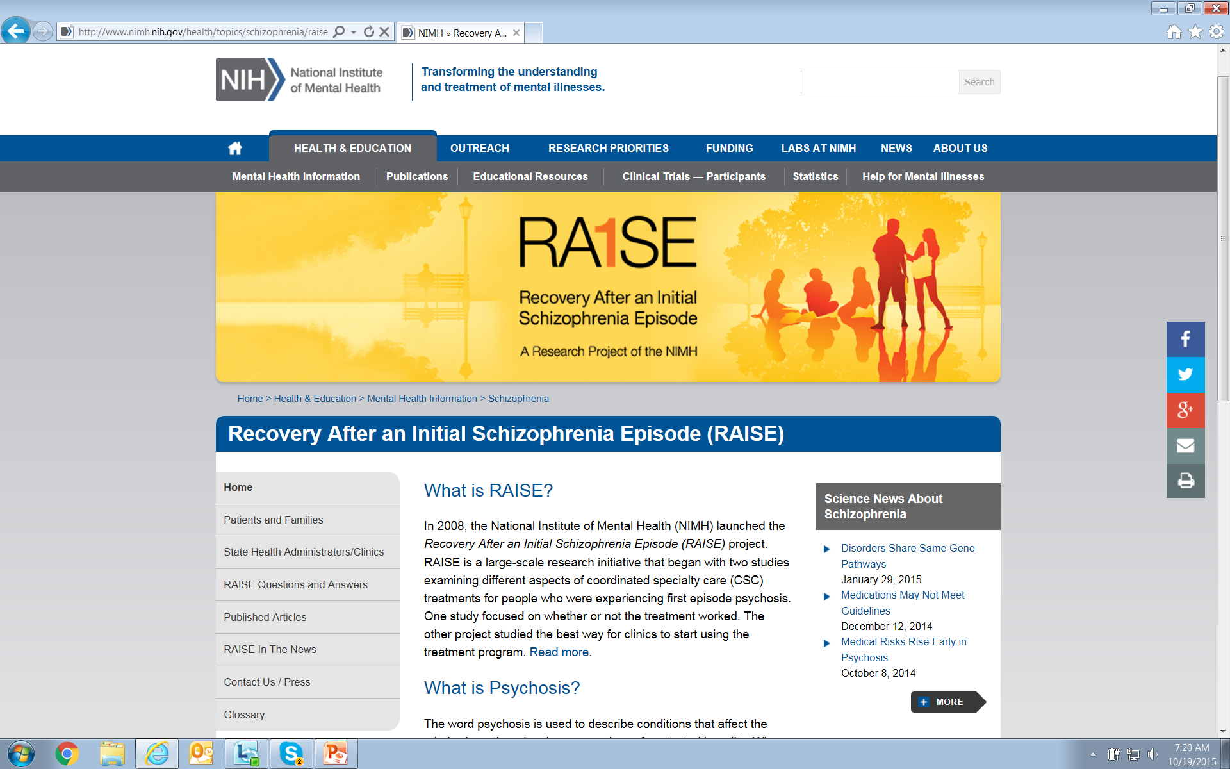
Update on RAISE:
Implementation Science to Broad Clinical Care
Client
Medication/ Primary Care
Psychotherapy
Supported Employment and Education
Case Management
Family Education and Support
Notes:
In 2008, the NIMH launched the Recovery After an Initial Schizophrenia Episode (RAISE) project.
RAISE is a large-scale research initiative that began with two studies examining different aspects of coordinated specialty care (CSC) treatments for people who were experiencing first episode psychosis.
One study focused on whether or not the treatment worked better than care typically available in community settings.
The other project studied the best way for clinics to start using the treatment program.
- - - - -
Slide provided by Bob Heinssen on 3/6/17.

Slide 14
NIMH RAISE Findings Influenced States’ Adoption of
Evidence-Based Care for First Episode Psychosis
Dates and Milestones
July, 2009 RAISE studies begin
December, 2013 RAISE feasibility study completed
January, 2014 H.R. 3547 ($25M set-aside for FEP)
April, 2014 NIMH/SAMHSA provide guidance to states
December, 2014 H.R. 88 ($25M set-aside for FEP)
October, 2015 RAISE clinical trial completed
October, 2015 CMS coverage of FEP intervention services
December, 2015 H.R. 2029 ($50M set-aside for FEP)
Mental Health Block Grant Plans: https://bgas.samhsa.gov/
Notes:
RAISE = Recovery After and Initial Schizophrenia Episode.
States’ status is based on:
November 2014 review of states’ revised FY14 CMHBG program plans submitted in response to the 5% set-aside for FEP treatment programs.
2015 updates to state plans from GA, ME, and MN about new FEP initiatives related to the set-aside initiative.
Plans submitted to SAMHSA in 2015 for the FY2016-FY2017 set-aside initiative.
Plans downloaded from https://bgas.samhsa.gov/

Slide 15
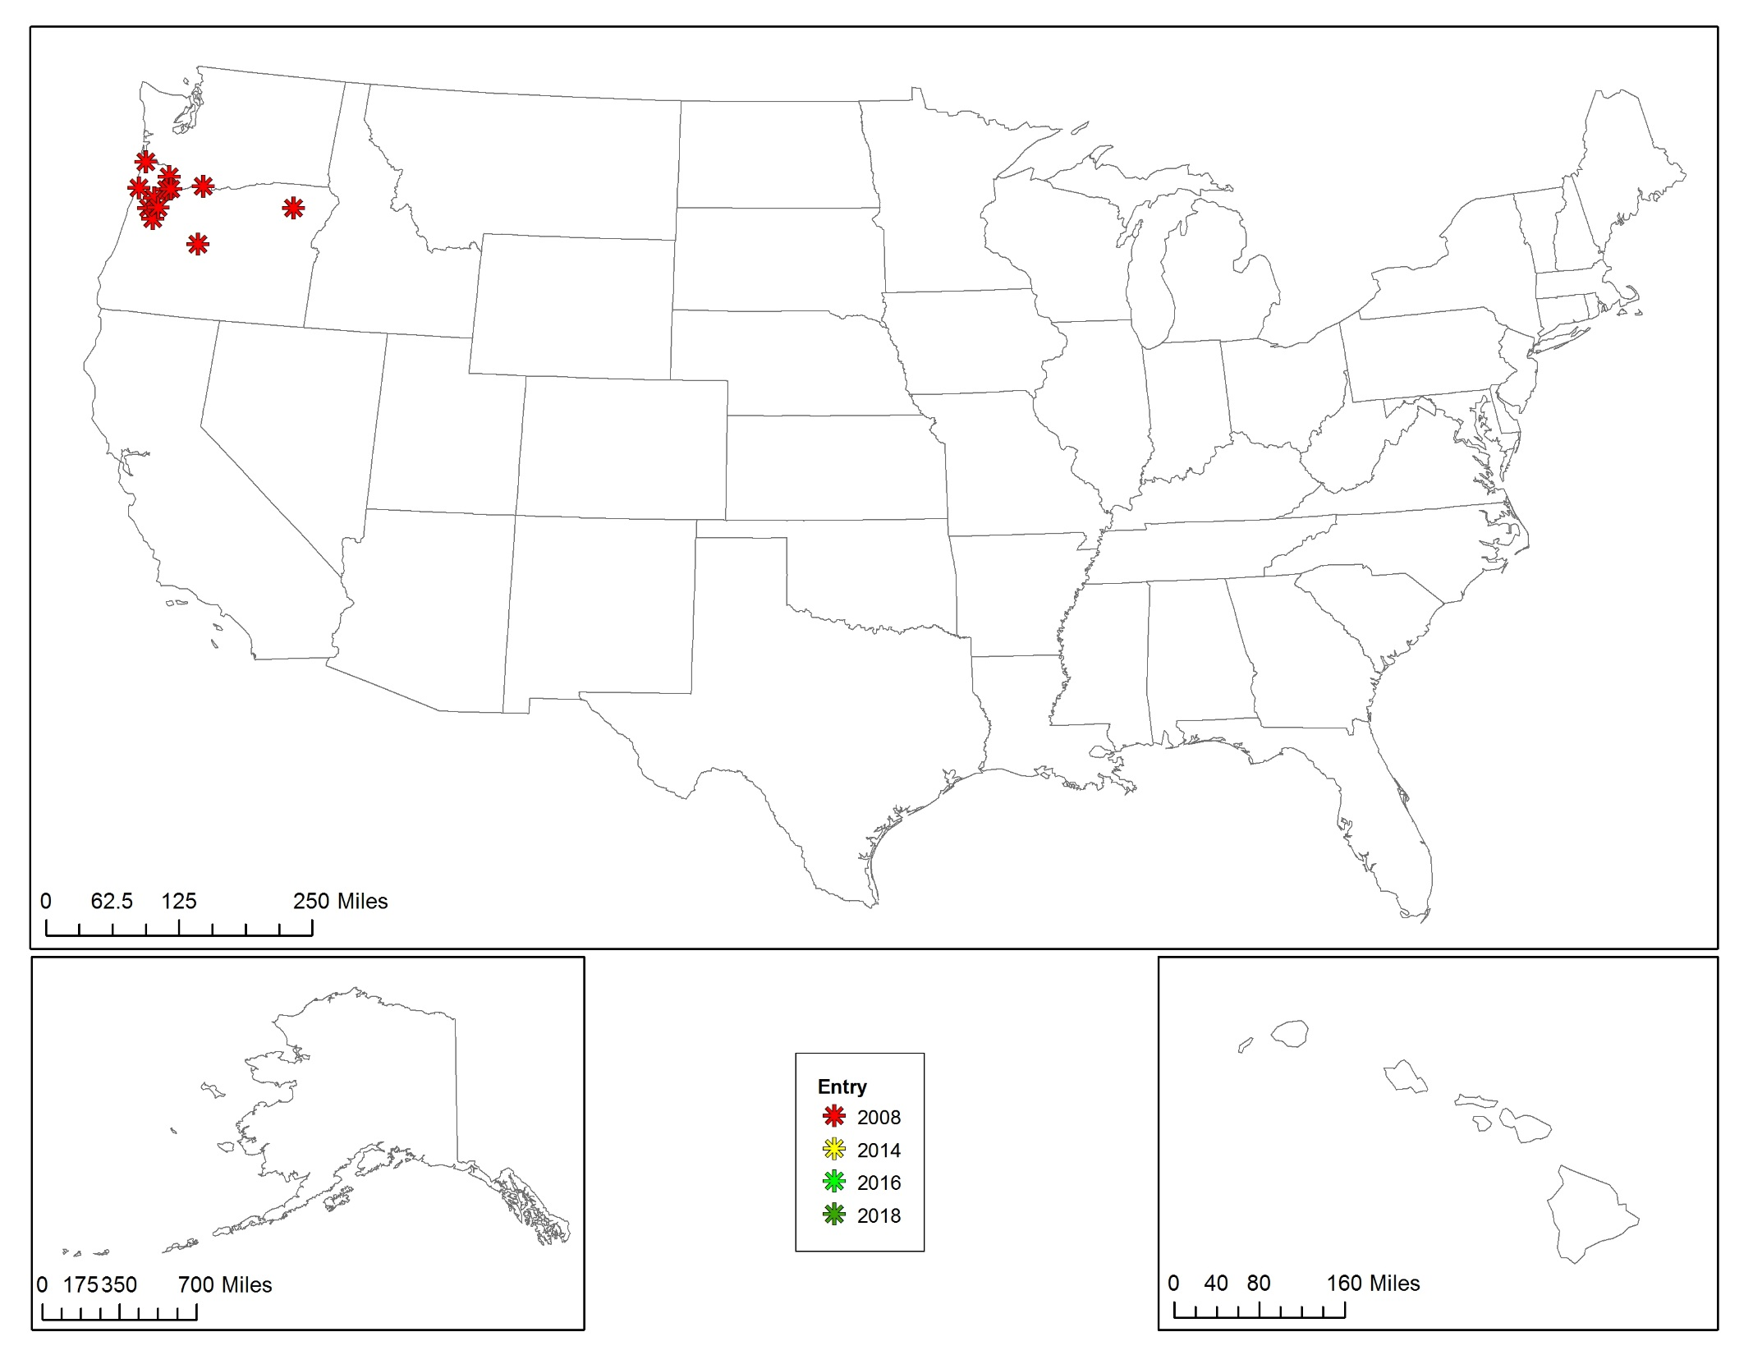
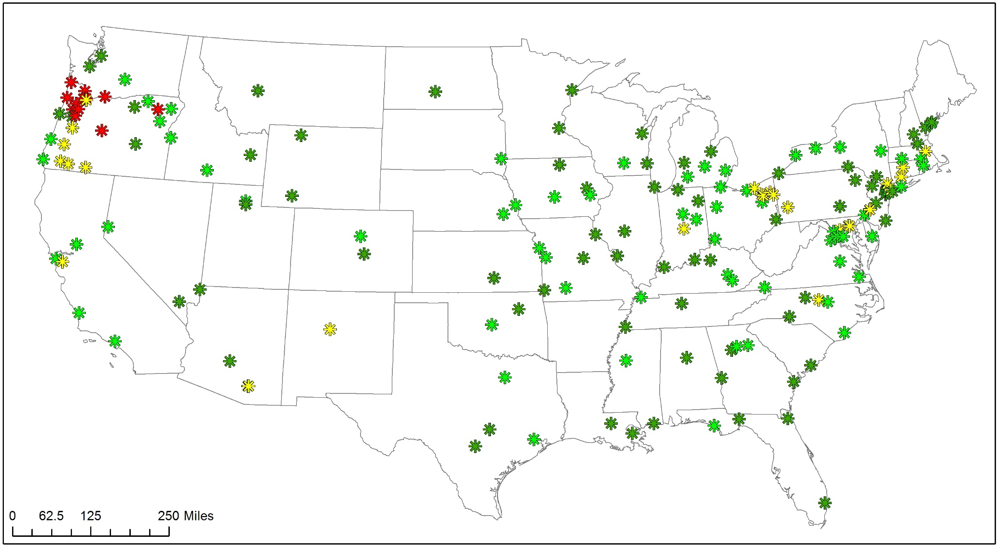
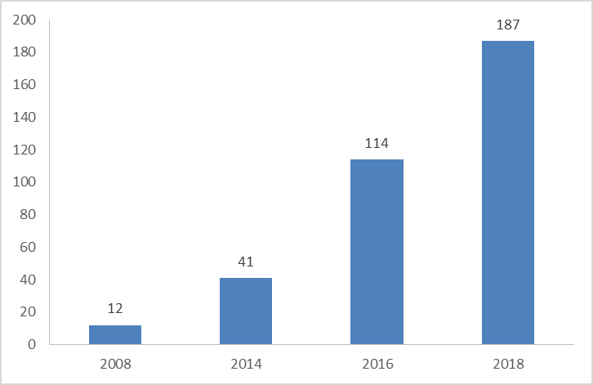
Projected Coordinated Specialty Care
Programs in 2018
$100M in FY16 – FY17: 187 community clinics
2008
2014
2016
2018
Notes:
RAISE findings influenced States’ adoption of evidence-based care programs for first episode psychosis.
New Federal funding has accelerated implementation of those programs.
The number of operational CSC programs increased 15-fold over the 10 year period of 2008-2018.
- - - - -
Slide provided by Bob Heinssen on 3/6/17.

Slide 16
Science Updates
About the NIMH Director
Director’s Research Priorities
Current State of NIMH
Science Highlights and Updates
  Circuit Basis of Psychosis
  Suicide Prevention
  Race and Ethnicity in the Mental Health Research Network
  Brief Therapy for Hispanic Youth with Anxiety and Depression
Participation in Research
Future Directions
Notes:
Note: this slide needs to be updated when final

Slide 17

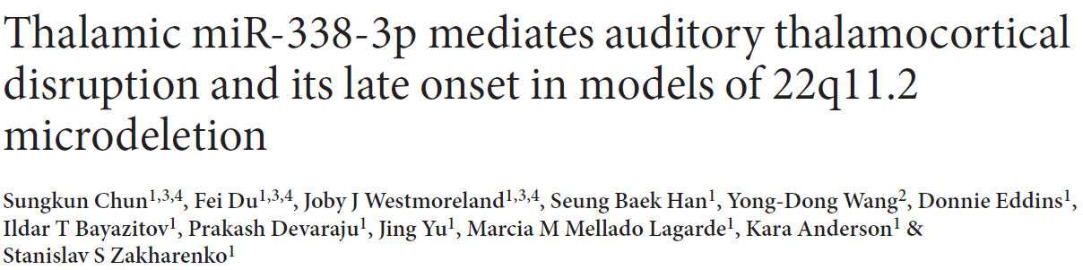
Science Highlight:
Circuit Basis of Psychosis?
Notes:
Turning to recent exciting advances from NIMH-funded research, NIMH funds a lot of great research. I like to talk about some highlights that I found interesting and hopefully you will as well….
Copy variants and overall risk for schizophrenia

Slide 18
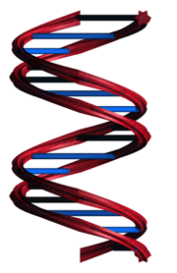
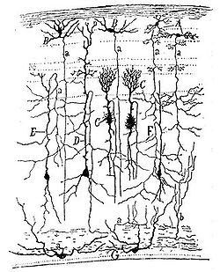
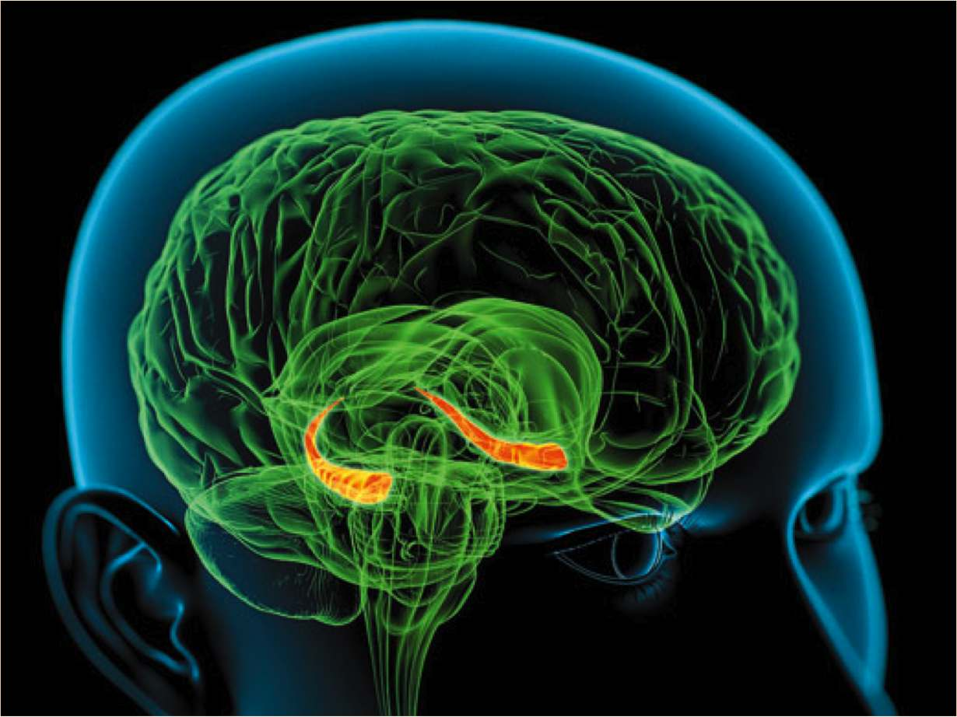
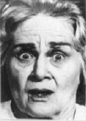
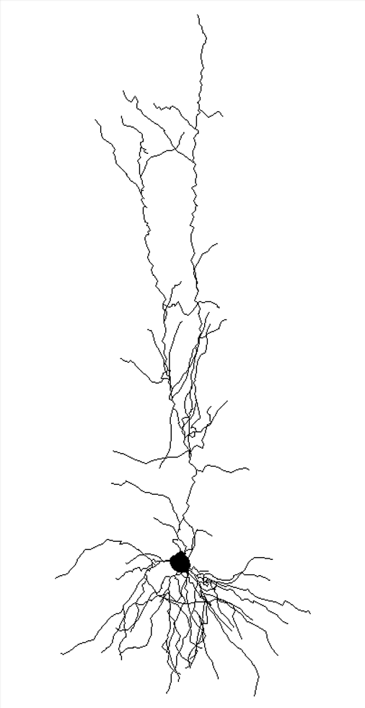
Understanding Genetic Predisposition
Disease
Phenotype
Mutation
Gene
Cell
Circuit
System
Behavior
Notes:
- - - - -
Slide adapted from Josh's talk called "Form gene to behavior in a mouse model of schizophrenia predisposition" for the Federation of European Neuroscience Societies (FENS) Brain Conference, September 2016.

Slide 19
The 22q11 Deletion Syndrome (22q11DS)
De novo copy number variant
High penetrance (25-30%) for psychosis
0.5-2% of schizophrenia cases
22q11.2
Chun…Zakharenko, Nature Medicine, 2017
Notes:
22q11 De5-2% of Schz.
Most Schz is idiopathic.
Although this accts for small portion of schz, it is important

Slide 20
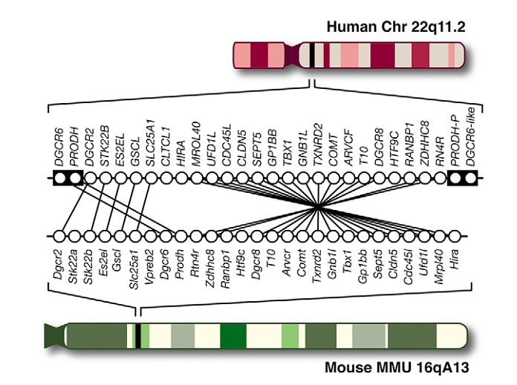
22q11DS Model Mice
Chun…Zakharenko, Nature Medicine, 2017

Slide 21
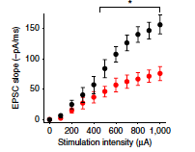
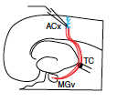
22q11DS Mice have Deficits in
Thalamocortical Synaptic Strength
Chun…Zakharenko, Nature Medicine, 2017
Notes:
It is known that this can be reversed by haloperidol – this study demonstrates that it can also be reversed with MicroRNS 338 (inhibit D2 receptors)

Slide 22
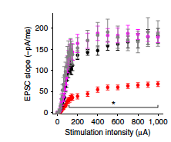
MicroRNA 338 Overexpression Rescues Deficits
Chun…Zakharenko, Nature Medicine, 2017

Slide 23
Understanding Genetic Predisposition
Disease
Phenotype
Mutation
Dgcr8
miRNA
DRD2
Psychosis?
Chun…Zakharenko, Nature Medicine, 2017
Notes:
One of a handful of papers linking genes with behavior with steps along the way that suggest mediators.

Slide 24
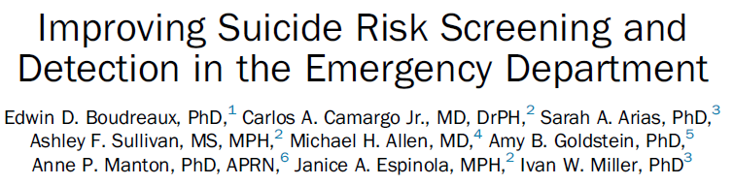
Science Highlight:
Suicide Screening
American Journal of Preventive Medicine

Slide 25

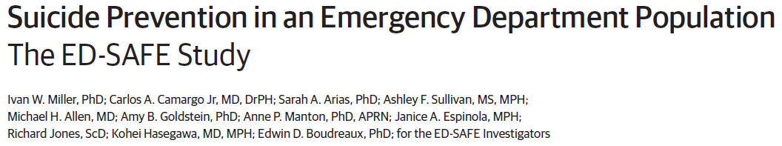
Science Highlight: Emergency Department Safety Assessment and Follow-up Evaluation (ED-SAFE)
2017
Notes:
http://jamanetwork.com/journals/jamapsychiatry/fullarticle/2623157

Slide 26
New Findings from ED-SAFE
Three phase study of 1,400 suicidal patients in eight U.S. EDs
Treatment as usual (phase 1)
Universal suicide risk screening (phase 2)
Universal suicide risk screening + intervention (phase 3):
    Secondary suicide risk screening by ED physician
    Discharge resources
    Post-ED telephone calls to reducing suicide risk
Miller…ED-SAFE Investigators, JAMA Psychiatry, 2017
Notes:
http://jamanetwork.com/journals/jamapsychiatry/fullarticle/2623157

Slide 27
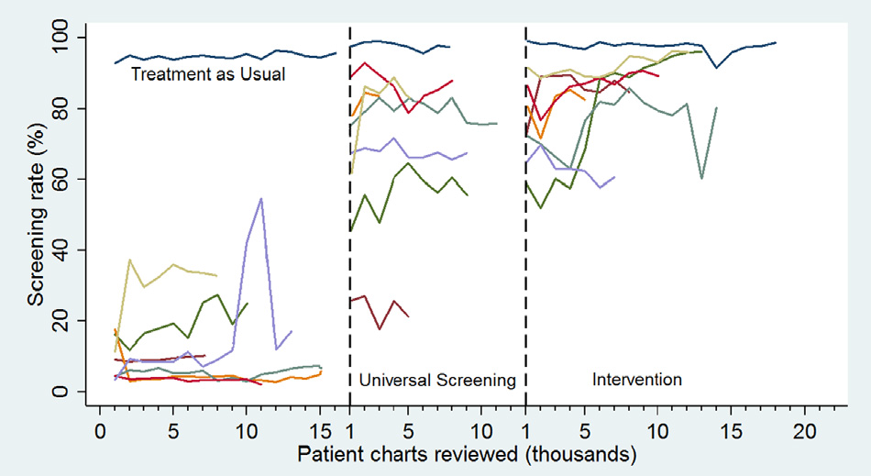
Universal Suicide Screening is
Possible to Implement
Boudreaux…Miller, Am J Prev Med, 2016

Slide 28
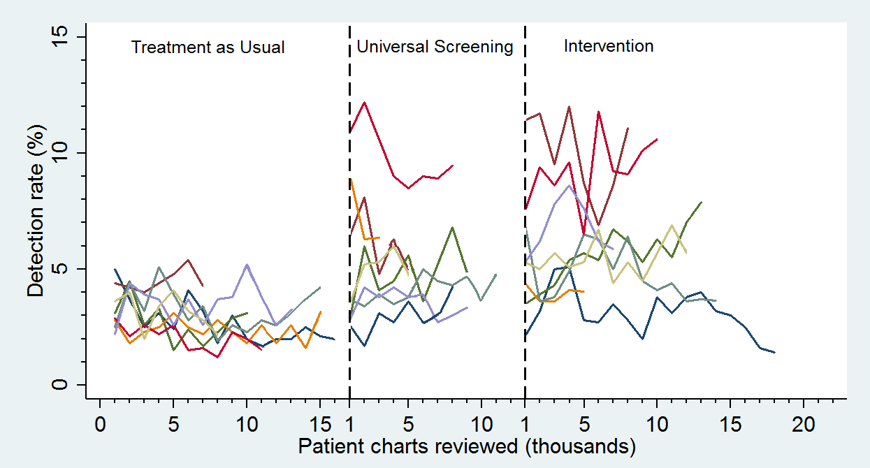
Universal Suicide Screening Increases Detection
Boudreaux…Miller, Am J Prev Med, 2016
Notes:
It is estimat.ed that an additional 3M at-risk individuals could be identified nationwide with ED screening alone.

Slide 29
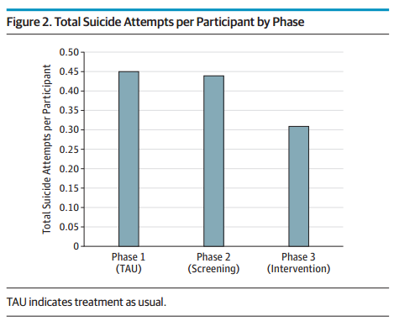
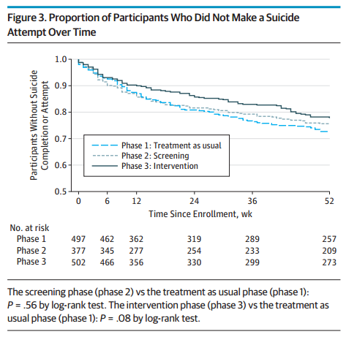
Universal Screening Plus Intervention Reduces Number of Suicide Attempts
Intervention led to a 30% decrease in suicide attempts over the 52-weeks follow-up, as compared to standard emergency treatment care
Miller…ED-SAFE Investigators, JAMA Psychiatry, 2017

Slide 30

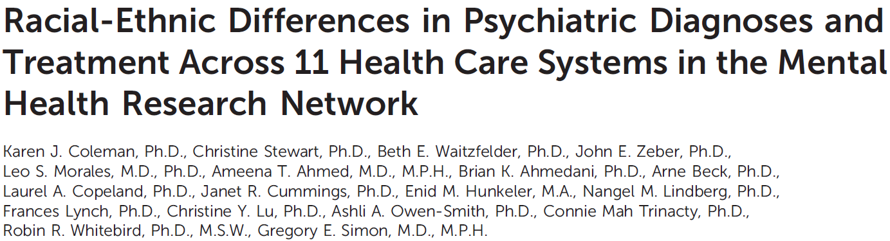
Science Highlight:
Tracking Disparities in Access to Care
2016

Slide 31
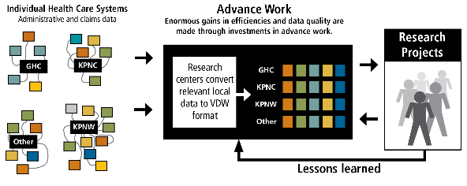
Mental Health Research Network (MHRN)
MHRN is the nation’s preeminent source of population-based research on mental health, partnering with 13 health system research centers that provide care of a diverse population of over 12.5 million people in 15 states ⁽¹⁾
http://hcsrn.org/mhrn/en/ResearchProjects/
Notes:
The MHRN is …
Administrative, clinical, and claims data are translated to a common set of data standards at each site.
This data resource dramatically increases the efficiency of ongoing and future research while protecting patient privacy.

Slide 32
Racial-Ethnic Differences in
Psychiatric Diagnosis and Treatment
  Are Racial-Ethnic Differences in Psychiatric Diagnosis and Treatment Present in Health Care Systems Across the US?
  (n= 7.5 million adults)
Racial-ethnic differences in the diagnosis and treatment of psychiatric conditions persist, especially for Blacks
Blacks were nearly twice as likely as Whites to receive a diagnosis of Schizophrenia
Depression and anxiety diagnoses were lower among racial-ethic minorities compared to non-Hispanic Whites
Exception: Native American and Alaskan Native groups had similar rates as Whites
    Karen Coleman, Greg Simon et al, 2016, Psychiatric Services
Coleman…Simon, Psychiatric Services, 2016
Notes:
This study looked at data from 7.5 million adults at 11 health care systems to answer the question “Are Racial-Ethnic Differences in Psychiatric Diagnosis and Treatment Present in Health Care Systems Across the US?”
They found that …

Slide 33
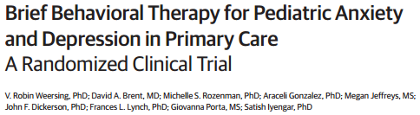
Science Highlight:
Brief Therapy for Pediatric Anxiety and Depression
2017
Notes:
http://jamanetwork.com/journals/jamapsychiatry/fullarticle/2618261

Slide 34
Clinical Trial of Children and
Adolescents with Depression or Anxiety
Enrolled 185 children and adolescents (ages 8 – 16) with depression or an anxiety disorder
Random assignment to assisted referral care (ARC) or brief behavioral therapy (BBT)
BBT addressed both depression and anxiety using a streamlined approach
Children and adolescents in the BBT group showed greater improvement than those in the ARC group
Weersing…Iyengar, JAMA Psychiatry, 2017

Slide 35
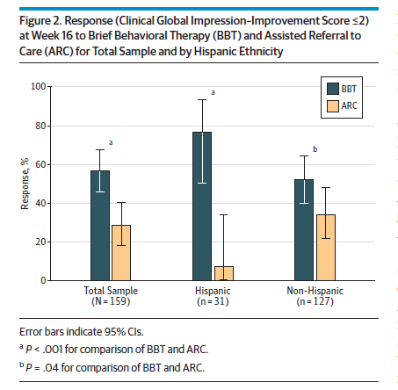
Striking Benefits for Hispanic Children and Adolescents
Hispanic youth who received BBT showed the greatest improvement and performed best on measures of functioning
Weersing…Iyengar, JAMA Psychiatry, 2017
Notes:
.

Slide 36
Active Participation in Research
About the NIMH Director
Director’s Research Priorities
Current State of NIMH
Science Highlights
Participation in Research
  Big Data Approaches
  All of Us Cohort
Future Directions
Notes:
Note: this slide needs to be updated when final

Slide 37
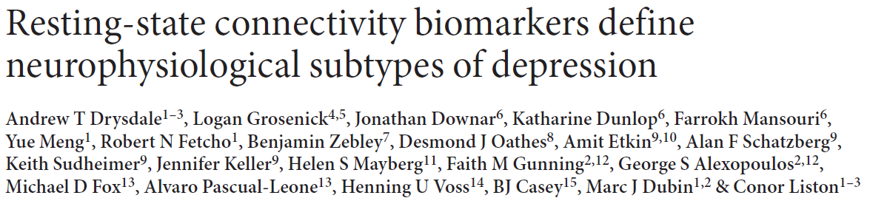
Big Data Approach to
Identifying Depression Subtypes
Notes:
Emphasis big datasets, high tech

Slide 38
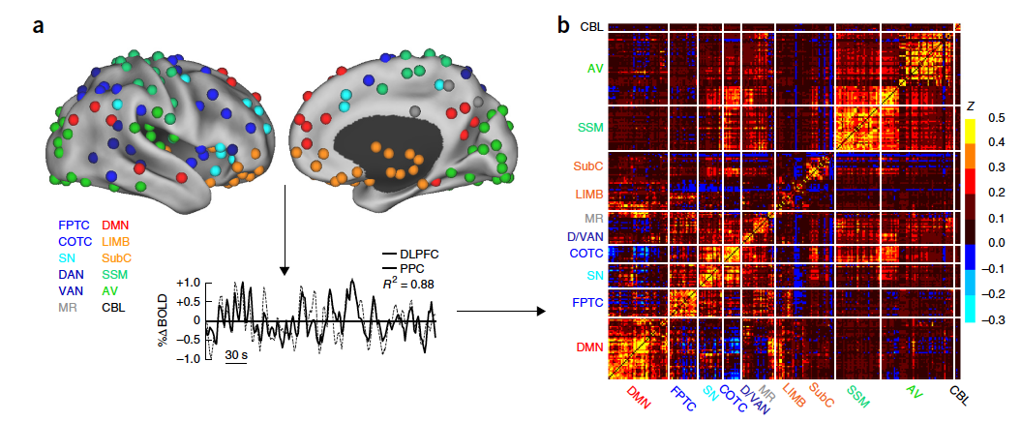
Patterns of Resting State Connectivity
Drysdale…Liston, Nature Medicine, 2017

Slide 39
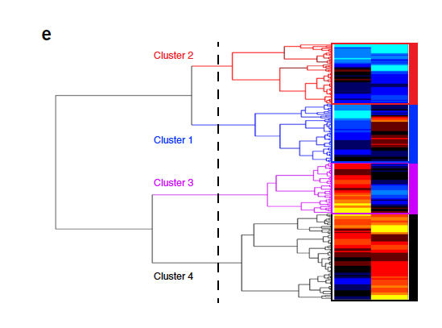
Clustering Patients Based on Connectivity*
Drysdale…Liston, Nature Medicine, 2017
Notes:
Imaging and clinical data – patients and controls
This is one possible clustering mechanism

Slide 40
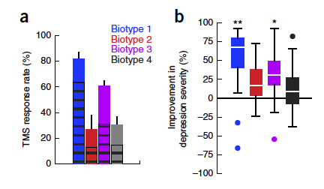
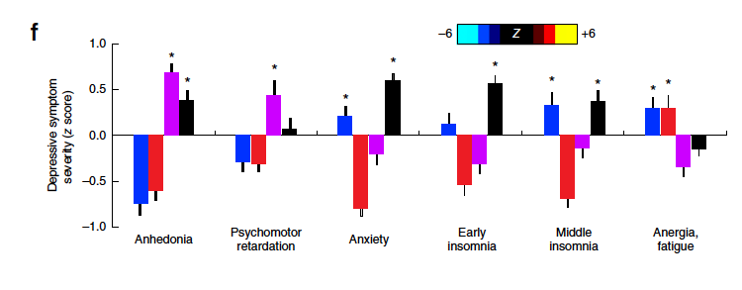
Subtypes Differ in Clinical Dimensions
Drysdale…Liston, Nature Medicine, 2017

Slide 41
Subtypes Differ in Responsivity to Prefrontal Cortex Repetitive Transcranial Magnetic Stimulation
Drysdale…Liston, Nature Medicine, 2017
Notes:
Model constructed on other patients and then applied here (Bayesian methods)

Slide 42


NIH All of Us Research Program
Historic effort to gather data from one million or more people in the U.S.
Focus on individual differences in lifestyle, environment, and biology
Paving the way toward precision medicine
Notes:
Big data approaches will pave the way toward precision medicine
Large sample sizes are required, highlighting the importance of broad, active participation in research

Slide 43
Moving Forward
About the NIMH Director
Director’s Research Priorities
Current State of NIMH
Science Highlights
Participation in Research
Future Directions
Notes:
Note: this slide needs to be updated when final

Slide 44
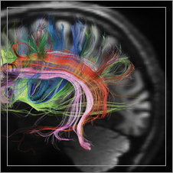



The Road Ahead
Prioritize excellent science, and within the realm of excellent science, diversity.
Focus on learning and working closely with all of you to gain insight that can help inform the future directions of our research programs.
Address challenges facing NIMH.
Think more broadly about neuroscience, psychiatry, and public health.
Help build momentum towards treatments that can change the lives of individuals, families, and communities affected by mental disorders.
Notes:
These are my priorities: excellent science, and within the realm of excellent science, diversity.
This position at NIMH gives me an exciting opportunity to think more broadly about neuroscience, psychiatry, and public health; and to help build momentum towards treatments that can change the lives of individuals, families, and communities affected by mental disorders.

Slide 45
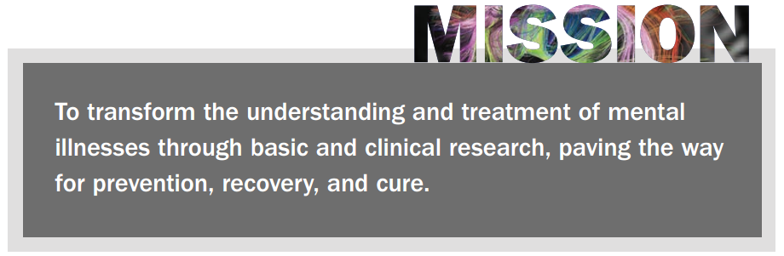
NIMH’s Mission
www.nimh.nih.gov
Research = Hope
Notes:
Thank you.

