Slide 1
Honest, Open, Proud to Erase the Stigma of Mental Illness
Kyra Newman, MSW
Director of Recovery
NAMI Chicago

Slide 2
NAMI Chicago
The mission of the National Alliance on Mental Illness (NAMI) Chicago is to provide hope and improve the quality of life for those whose lives are affected by mental illness, by providing information and referrals, education, support, advocacy, and active community outreach.

Slide 3
Stigma
What is stigma?
Negative stereotypes, labels, judgments and prejudice that can lead to discrimination.
Stereotypes: Generalized belief; “People with mental illness are violent”
Prejudice: Judgment based on that belief; “They’re violent, I’m scared and don’t want anything to do with them”
Discrimination: Action based off those judgments and beliefs; “I won’t hire or rent to a person with mental illness because I’m scared of them”

Slide 7
The movies…

Slide 8
The newspapers…

Slide 9
In advertising…

Slide 10
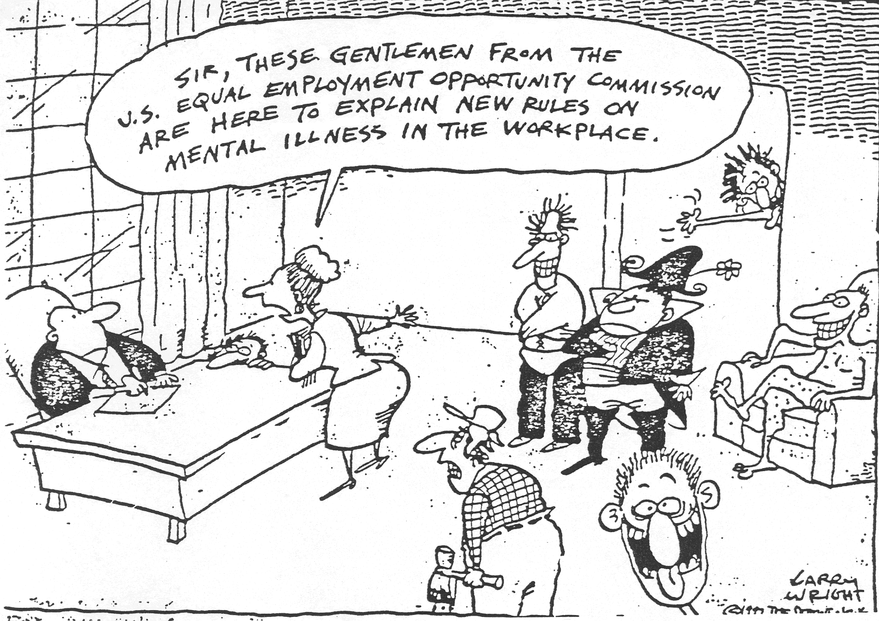
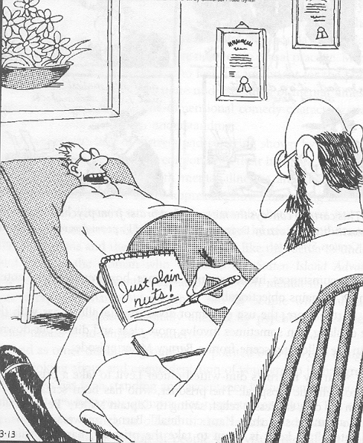
In comics…

Slide 11
Hasn’t it gotten better?
July 10, 2002: Trenton State Hospital (NJ) has a fire…

Slide 12
Types of stigma
Public stigma: Stigma faced externally from a system, group or individual
Public stigma effects many areas of life:
Employment
Housing
Healthcare
Education

Slide 13
Effect on Healthcare
PTCA: percutaneous transluminal coronary angioplasty Druss et al., 2000

Slide 14
Types of stigma
Self-stigma: internalized public beliefs that effect self-esteem and self-efficacy
I’m not worthy, I’m not able
“Why try?” Effect
Diminished care seeking & treatment engagement; people do not want to be seen as one of “those” people so they aren’t likely to seek mental health services
Worse outcomes for recovery

Slide 15
What can we do?
Individual level
Affirming attitudes:
People with mental illness recover
They should determine all their goals and interventions to reach those goals
Actions and Advocacy:
Reasonable accommodations
Community Supports
Easy stuff: CHANGE YOUR WORDS
Use first person language
Avoid stigmatizing teram and call out other people who use them

Slide 16
What can we do?
3 main strategies to decrease sigma at an organizational level:
Education
Protest
Contact

Slide 17
Education
Lets learn from the past…
Education: There is no strong evidence to suggest that public education campaigns have any effect on stigma and behavioral changes
75% of US School Districts
43 countries used DARE
How did it go?

Slide 18
Research on Dare
Uncertain effects
RTI (1994)
No effects
Cal Dept Ed (1995)
U Maryland (1998)
APA (1999)
Worse effects
Indiana U (1992)

Slide 19
The Decade of the Brain
NIH/NIMH Initiative from 1990-2000
Promoted idea that mental illness was a brain disease rather than a character flaw
Spurred neurological research into causes and cures
Unintended consequences:
Belief that recovery was not possible
Diminished acceptance of people living with metal illness as a result
Schomerus, Schwann, Holzinger, Corrigan, Grabe,
Carta, & Angermeyer, 2011

Slide 20
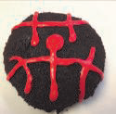
Protest
Review stigmatizing images & protest them
Call people out & demand change
“Shame on you for thinking that way”
Beware “the white bear” phenomenon
“The Crazy Face”
Psycho Donuts now has FRANCHISE OPPORTUNITIES!
“The Suicide SQUEEZE”

Slide 21
Contact
Meet someone!
“Hi, my name is Kyra and I live with mental illness”
Challenges stereotypes
Research has shown regular contact with people with lived experiences has the strongest and longest lasting effect on stigma

Slide 22
Contact & Research
Meta-analysis: 79 studies; 13 RCTs
Mean effect sizes: RCTs only
Corrigan, Michaels et al., 2012

Slide 23
TLC 3 Approach
Targeted
Landlords, teachers, healthcare professionals, employers
Local
Culturally appropriate and as local as possible (city, office, church, etc.)
Credible
Veterans to veterans, etc.
Continuous
Once is not enough
Contact!
Which means disclosure!

Slide 24
TLC 3 Approach: Organizations
Engage with individuals living in recovery!
Utilize peers in mental health services, education and advocacy
Share their stories in the community as a part of education programs
Participate and lead programs and workshops
Provide leadership opportunities in your organization
Peers are the experts on their own experience, and are the most qualified to speak about mental health recovery.

Slide 25
TLC 3 Approach: Individuals
Share your story of recovery in the community, with friends and family!
Listen to each other and give people a platform to use their voices!

Slide 26
Honest, Open, Proud Program
Developed by Dr. Corrigan at the Illinois Institute of Technology (IIT) with peers input
Anti-stigma program focused around the concept of self-disclosure and the complex decision making process that surrounds it
Peer led
6 hour workshop conducted in a group setting with 8-15 peers
The goal of HOP is not to convince people to come out and share their stories, but rather to teach skills and strategies so they can make the best decisions for themselves.

Slide 27
Honest, Open, Proud Program
Lesson One
Language and Identity
Considering the Pros & Cons of Self Disclosure
Lesson Two
Five ways to disclose (or not to disclose)
Strategies to test someone out
Consider what characteristics might make someone safe or good to disclose to
Lesson Three
Learn how to share your story in a personally meaningful way and practice saying it out loud
Learn about peer support and how it can help you in your recovery
Put it all together and move forward!

Slide 28
Multiple Version of HOP
HOP for Anyone
HOP for College Campus
HOP for High School Students
HOP for Veterans and Veterans Health Administration
HOP for people who are currently incarcerated
www.hopprogram.org
www.comingoutproudprogram.org

Slide 29
HOP Development and Research
2 Randomized control trials of the HOP Program have been conducted so far
The results are clear:
Significant reduction in stigma stress, including aspects of self-stigma and improved self-esteem
Less distress at the idea of disclosing their mental illness experience
Perceived less need to keep their identity a secret after completing the program

Slide 30
Learn more about stigma & HOP!
National Consortium on Stigma and Empowerment
http://www.stigmaandempowerment.org/
Honest, Open, Proud Program Website
http://www.honestopenproud.org

Slide 31
Questions?
Kyra Newman, MSW 312-563-0445
kyra@namichicago.org

