Slide 1
Digital Phenotyping in Mental Health
Paul Dagum, MD PhD
Mindstrong Health
National Alliance in Mental Health
Washington, CD
June 30, 2017

Slide 2
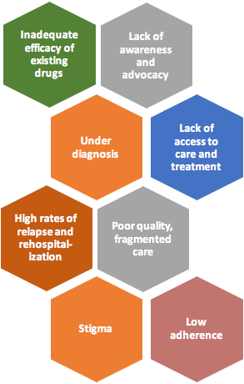
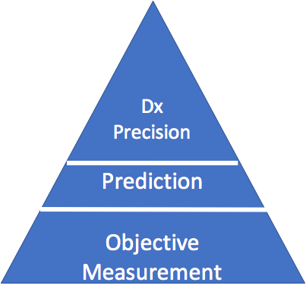
CHALLENGES IN MENTAL HEALTH

Slide 3
LACK OF MEASUREMENT
Episodic, subjective measures in laboratory environments lack sensitivity — may fail to detect clinical change (Rush, J Cain PSych, 2015)
IN
TRIALS
“On the basis of clinical judgement alone, mental health providers detect deterioration for only 21.4% of their patients who experience increased symptom severity.” (Fortney JC et al, Psych Serv, 2016)
IN
PRACTICE
Lack of detection leads to treatment at late stage of illness with significant disability (Addington et al, Psych Serv 2016)
IN
POPULATIONS

Slide 4
LACK OF PREDICTION
Poor stratification of risk precludes trials of disease interception (Cannon et al, 2016)
IN
TRIALS
Interventions are late, not preemptive, and result in modest outcomes (Narayan et al, 2016)
IN
PRACTICE
Care continues to be reactive not proactive (Narayan & Manji, 2016)
IN
POPULATIONS

Slide 5
LACK OF DIAGNOSTIC PRECISION
Diagnostic heterogeneity reduces effect sizes for intervention trials (Insel, 2010)
IN
TRIALS
Treatment continues to be trial an error without biomarkers that predict response or narrow selection of treatment (Hyman, 2015)
IN
PRACTICE
Poor response rates can be attributed to lack of precision medicine (Insel, , 2015)
IN
POPULATIONS

Slide 6
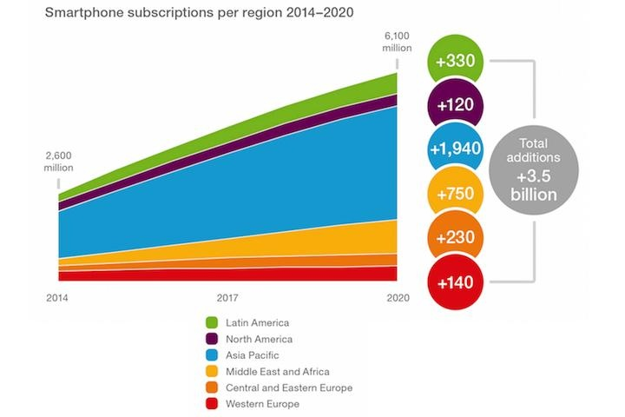
DIGITAL PHENOTYPING
A New Kind of Biomarker
Smartphone subscriptions per region 2014-2020
Over 3 billion globally and 6 billion by 2020
Over 70 daily checks
Over 2600 daily “touches”
More ubiquitous than clean water, indoor plumbing, and stable electricity
Cellphones have become “such a pervasive and insistent part of daily life that the proverbial visitor from Mars might conclude they were an important feature of human anatomy.” - Chief Justice Roberts, 2014

Slide 7
DIGITAL PHENOTYPING
A New Kind of Biomarker
SENSORS
Activity
Location
Sociality
MACHINE LEARNING
Pattern Identification
Feature Extraction
KEYBOARD
Reaction Time
Attention
Memory
Executive Function
VOICE
Prosody
Sentiment
Coherence
Raw Features
Digital Biomarkers
Digital Phenotype
Passive, objective, continuous and ubiquitous longitudinal assessment of mood and cognition.
Signatures for prediction and preemption.
Precision Medicine — Global Impact

Slide 8
MINDSTRONG SOLUTION
Passive, Preemptive, Precise Digital Measures to Improve Outcomes
PRECISE
Comprehensive digital phenotype that can identify diagnostic subgroups (improving stratification)
PREDICTABLE
Derived features that can detect early signatures of relapse or remission leading to preemptive interventions (reducing hospitalization)
MEASURABLE
Continuous, passive, ubiquitous, objective measures of mood and cognition in a persons ecologic day-to-day environment

Slide 9
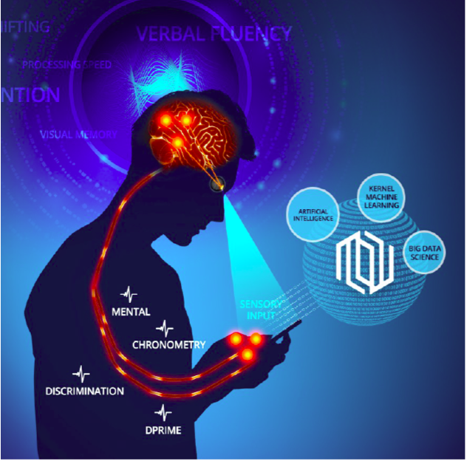
MINDSTRONG STRATEGY
Digital Phenotyping with Machine Learning
Begin with 45 keyboard and scroll patterns (e.g., latency between space and character, scrolling patterns)
Create a time-series of performance measures from each of the 45 patterns
Apply 23 signal processing transforms to each time-series to derive 1,035 potential digital biomarkers
Test highest performing biomarkers with 2-fold cross validation and with replication studies to avoid overfitting errors
Validate in clinical trials along three dimensions: (1) psychometric properties; (2) neural correlates; (3) clinical constructs
9￼

Slide 10
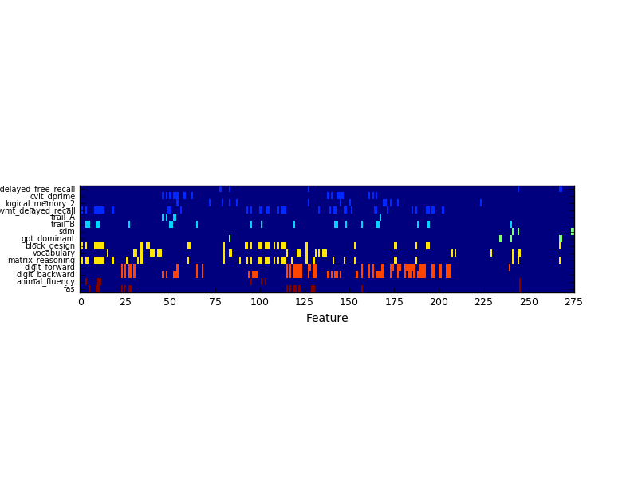
DIGITAL BIOMARKERS LOAD ON COGNITIVE FUNCTION
In an initial study (n= 40), mild-moderate anxiety and depression ages 18 - 35, clusters of digital biomarkers from keyboard behavior correlate with gold standard neuropsychological measures
Delayed Free Recall
CVLT
Logical Memory
Visual Memory
Trail A
Trail B
Symbol Digit Modality
Grooved Peg Board
Block Design
Vocabulary
Matrix Reasoning
Digit Forward
Digit Backward
Animal Fluency
FAS Fluency
Memory
Executive Function
Processing
Vocabulary
Working Memory
Phonemic Fluency
0 25 50 75 100 125 150 175 200 225 250 275
FEATURE
Distinct cognitive domains are grouped by color
10￼

Slide 11
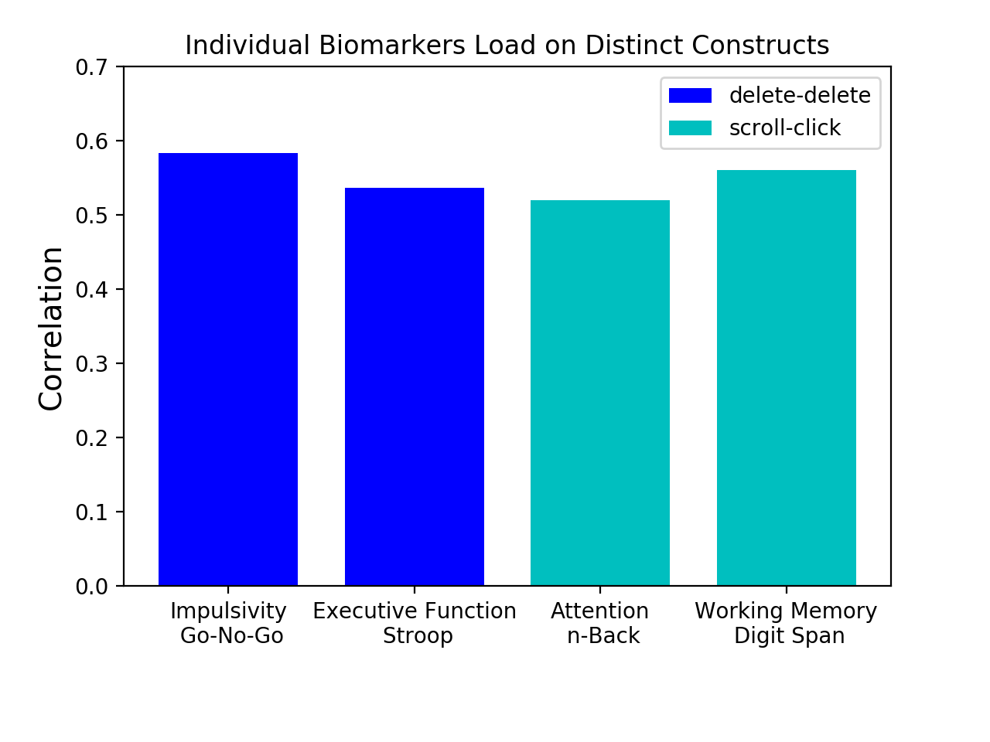
DIGITAL BIOMARKER PSYCHOMETRIC PROPERTIES
Sensitive and specific for cognitive performance
Stanford Study: n =100, 18-65 y/o, MDD
Measured cognitive and emotional function, fMRI, and symptom severity
Examined each biomarker’s psychometric properties, neural correlates, and clinical constructs
Examples of sensitivity : two biomarkers, one correlated w impulsivity and executive function, one correlated w attention and working memory. Note specificity - biomarker for impulsivity does not correlate with attention or working memory.
11￼

Slide 12
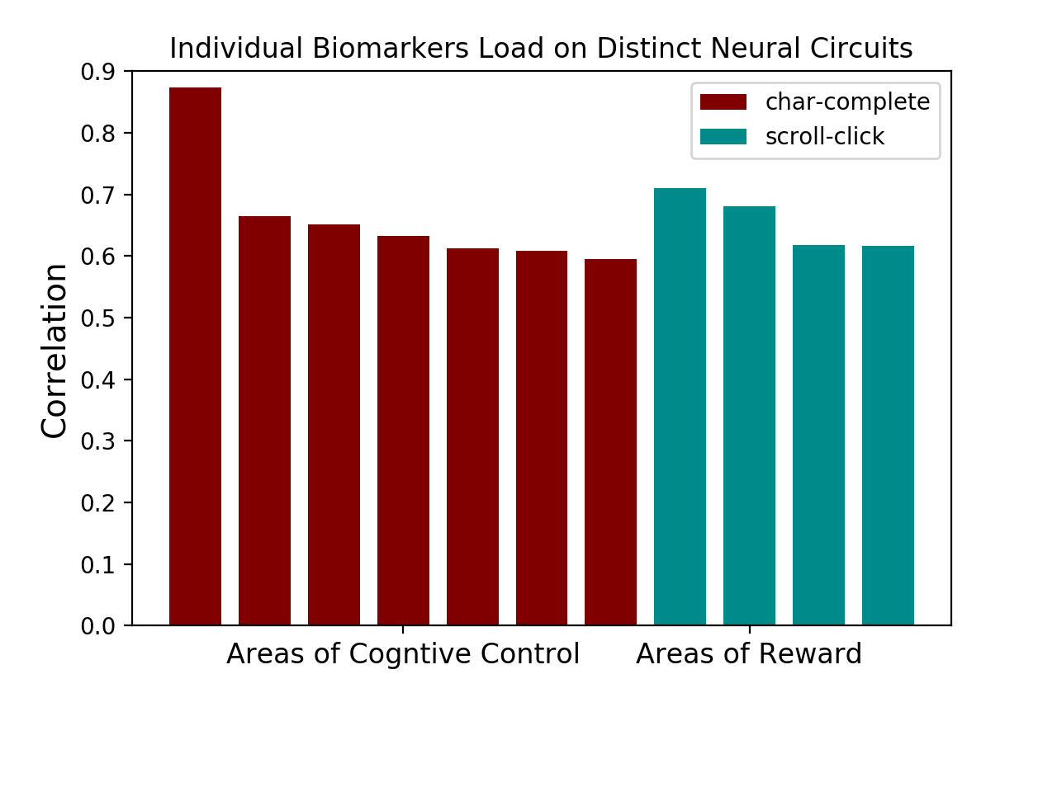
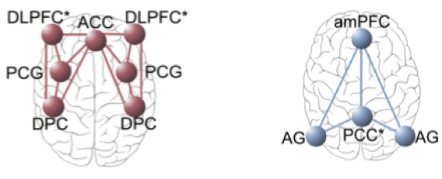
DIGITAL BIOMARKER NEURAL CORRELATES
Maps onto neural circuits detected with BOLD
Shown here are two biomarkers measuring (i) task-switching and impulsivity and (ii) attention and concentration
The biomarkers load on distinct BOLD activated brain regions that correspond to neural circuits for (i) cognitive control and (ii) reward
Each bar corresponds to a brain region that maps to the indicated neural circuit

Slide 13
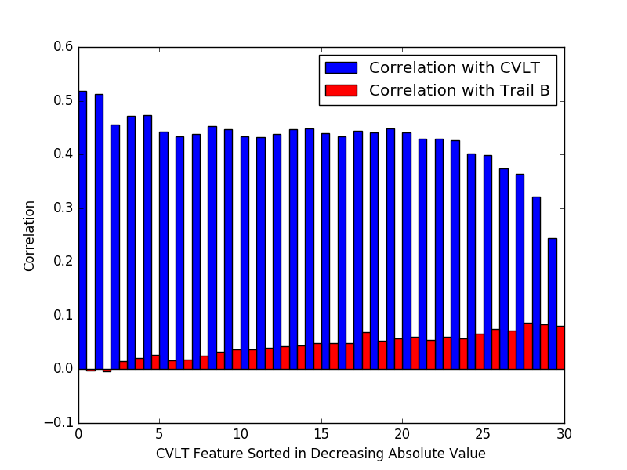
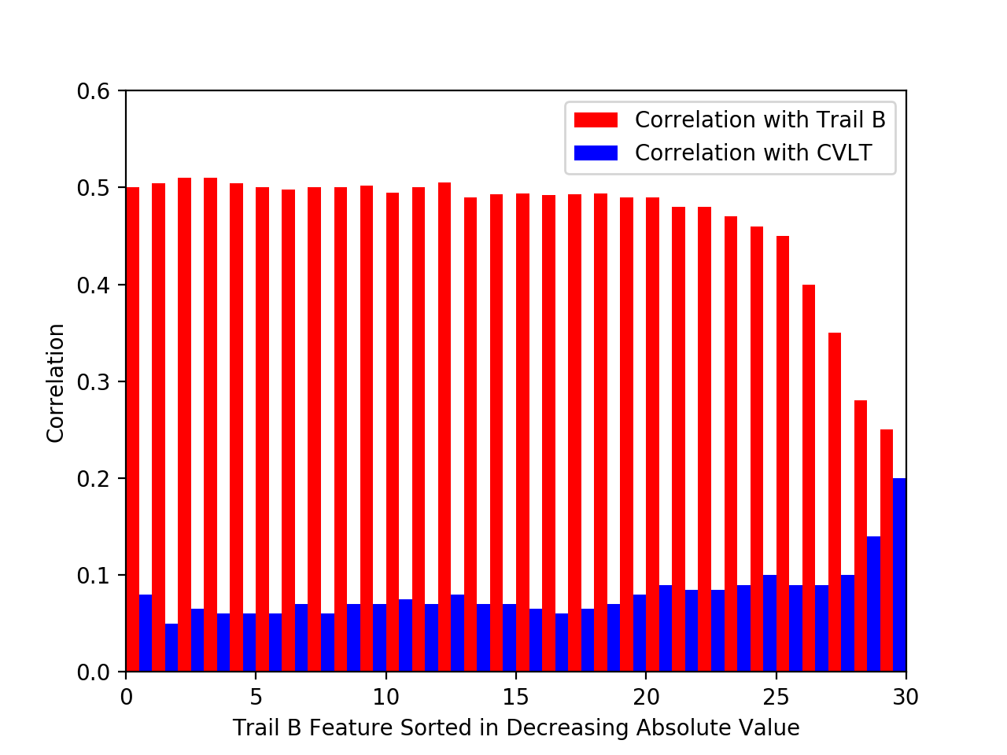
A STEP TOWARD PREDICTION
Individual variation across time (daily correlation, n = 40)
Shows a CVLT feature correlation with CVLT and with Trail B for comparison (latter not statistically significant)
Feature is computed daily and sorted in decreasing value over this thirty-day sample period
Shows a Trail B feature correlation with Trail B and with CVLT for comparison (latter not statistically significant)
Feature is computed daily and sorted in decreasing value over this thirty-day sample period
Peak correlations predict clinical psychometric results
Do deviations from peak capture health and environmental effect?

Slide 14
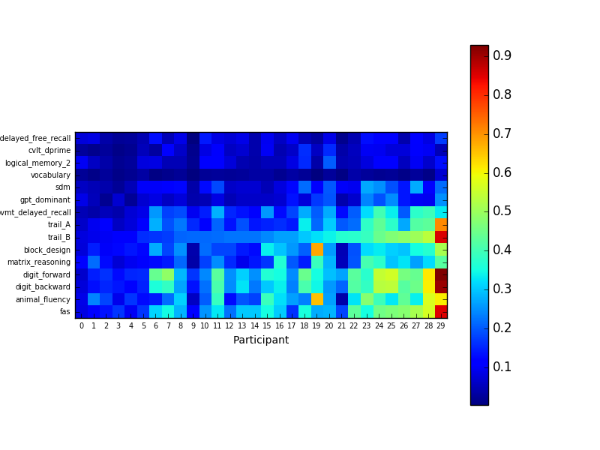
PATTERNS OF TEMPORAL VARIATION
What measures are relevant for tracking clinical state?
Delayed Free Recall
CVLT
Logical Memory
Visual Memory
Trail A
Trail B
Symbol Digit Modality
Grooved Peg Board
Block Design
Vocabulary
Matrix Reasoning
Digit Forward
Digit Backward
Animal Fluency
FAS Fluency
18-35 year old participants with depression or anxiety (n = 30)
Some but not all digital measures of cognitive function vary over a thirty-day period
Biggest changes are in executive function, working memory and verbal fluency

Slide 15
THE BEST DIGITAL BIOMARKERS CREATE SIGNATURES THAT REPRODUCE GOLD STANDARD TESTS
Will digital biomarkers become a new clinical ground truth for cognition?
COGNITIVE METRIC | MEAN (SD) | RANGE | R(predicted)
WORKING MEMORY
Digits Forward | 10.9 (2.9) | 7 — 15 | 0.82*
Digits Backward | 8.3 (2.9) | 4 — 14 | 0.84*
EXECUTIVE FUNCTION
Trails A | 22.6 (7.6) | 12 — 39 | 0.81*
Trails B | 57.4 (14.5) | 42 — 88 | 0.80*
LANGUAGE
Animal Fluency | 21.9 (3.5) | 15 — 29 | 0.78*
FAS Phonemic Fluency | 41 (7.2) | 27 — 52 | 0.60*
DEXTERITY
Grooved Pegboard Test (dominant hand) | 61.2 (7.3) | 46 — 75 | 0.85*
EPISODIC MEMORY
California Verbal Learning Test (delayed free recall) | 13.6 (2.1) | 9 — 16 | 0.85*
WMS-III Logical Memory (delayed free recall) | 28 (5.3) | 19 — 40 | 0.50**
Brief Visuospatial Memory Test (delayed free recall) | 10.0 (2.0) | 5 — 12 | 0.71*
Highest correlating biomarkers are selected for each cognitive metric
Cross-validated kernel PCA ensemble is used to make predictions
Predictions are as good as the test-retest variability of the tests themselves
*p < 10-5
**p<0.01

Slide 16
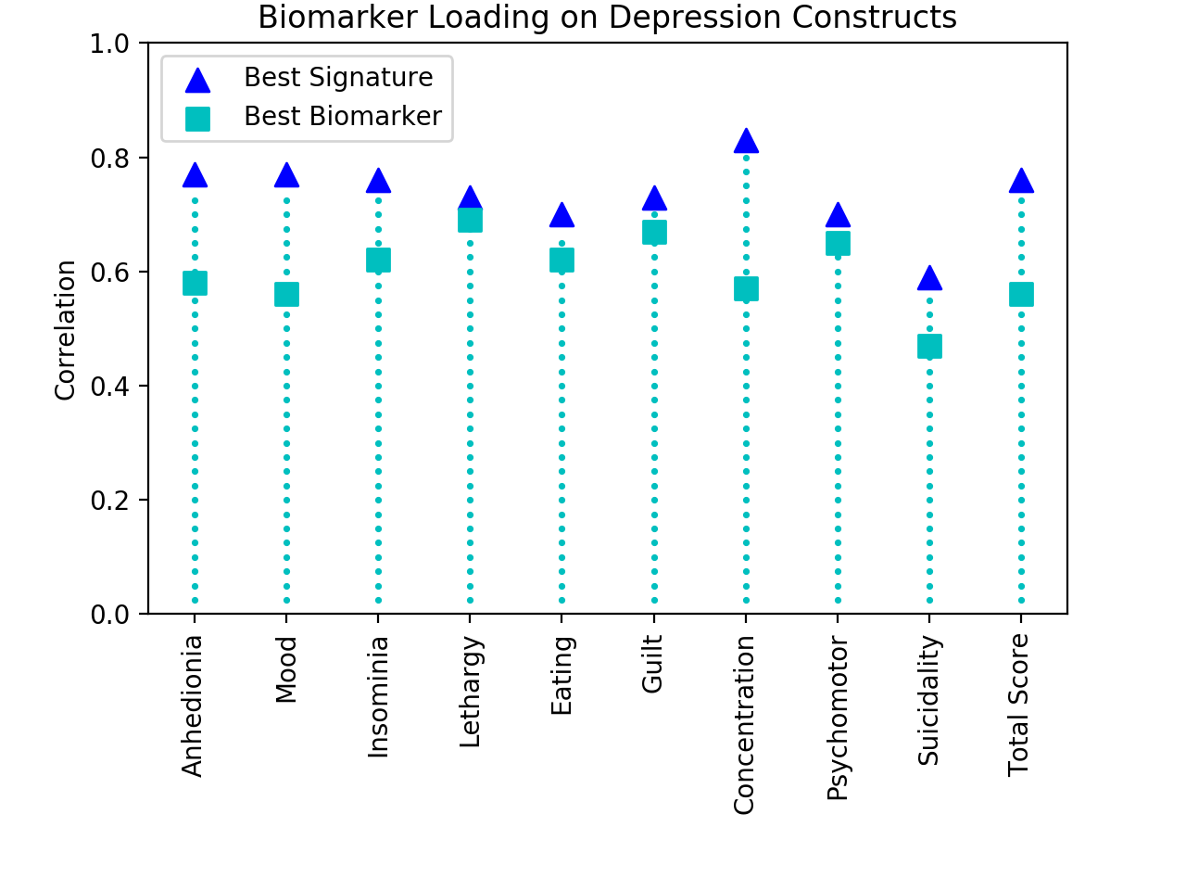
DIGITAL BIOMARKERS: CAN THEY BE USED FOR MEASURING MOOD AS WELL AS COGNITION?
Shown here are the digital biomarker loadings on each of the PHQ-9 items
For each construct we show (i) the best biomarker and (ii) its signature obtained as the first principal component of a kernel of the best set of biomarkers for that construct
Currently looking at correlation and prediction of PHQ-9 scores with digital measures

Slide 17
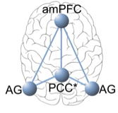
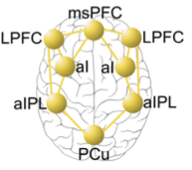
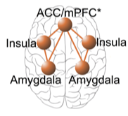
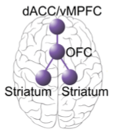
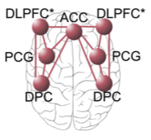
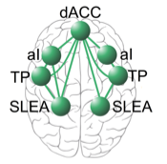
DIAGNOSTIC PRECISION IN MENTAL HEALTH
COGNITIVE
NEURAL
CLINICAL
Attention
Default Mode
Anhedonia
Depression
Mood
Working Memory
Attention
Psychomotor
within MDD
Anxiety
Executive Function
Negative Affect
Anxiety
Assay target engagement with continuous digital measures
Impulsivity
Reward Processing
Guilt
within
PTSD
PTSD
Information Processing
Suicidality
Cognitive Control
Insomnia
within Bipolar
Verbal Fluency
Bipolar
Salience
Lethargy
Historical Approach
Grouping patients by symptoms; resulting heterogeneity
New Temporal Insights
Understanding patients based on dynamic patterns in cognitive, neural and clinical constructs
Mindstrong Approach
Digital stratification into homogenous response subgroups

Slide 18
Thank You
Paul Dagum MD PhD
Founder, CEO
paul@mindstronghealth.com
c: (415) 378-5456
o: (650) 947- 9293

