Slide 1
Hill Day Legislative Briefing
Andrew Sperling Director, Legislative Affairs NAMI
Emily Blair Manager, Military, Veterans & Policy NAMI

Slide 2
Today’s Session
Key ask: Health reform & Medicaid
Key ask: Fiscal Year (FY) 2018 budget requests
Congressional leave behind review
Overview of other priority issues
Notes:
Military and veterans’ mental health
Mental health family caregivers
Early intervention for psychosis
Decriminalizing mental illness
Research and innovation

Slide 3
Hill Day Guide
Schedule for Hill Day
Tips for meeting with your legislator
Getting around Capitol Hill
Introducing NAMI to your legislator
Talking points and asks
Follow-up steps
Social media tips

Slide 4
Health Reform
Key provisions of health reform bill
Actions happening this week
Timeline of events
Andrew Sperling Director, Legislative Affairs NAMI

Slide 5
Health Reform Talking Points
ASK
Oppose any legislation that:
Caps or limits Medicaid
Ends Medicaid expansion
Takes away protections for people with mental health conditions in health plans
Leaves fewer Americans with coverage for mental illness
See page 4 of Hill Day Guide

Slide 6
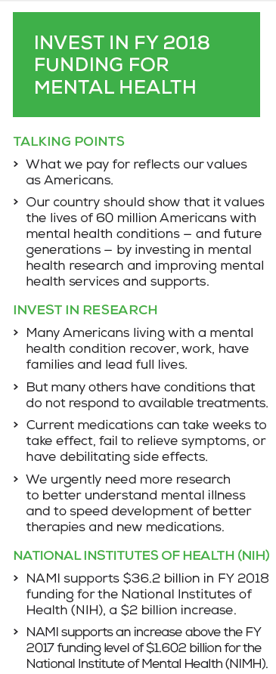
FY 2018 Funding for Mental Health
ASK
Fight for funding for:
Research at NIH and NIMH
SAMHSA programs
Housing and Urban Development
Department of Justice
See page 5 of Hill Day Guide

Slide 7
Leave Behinds and Priority Issues
Materials to give to congressional offices
Review of NAMI priority issues
Military and veterans’ mental health
Mental health family caregivers
Early intervention for psychosis
Decriminalizing mental illness
Research and innovation
Emily Blair Manager, Military, Veterans & Policy NAMI

Slide 8
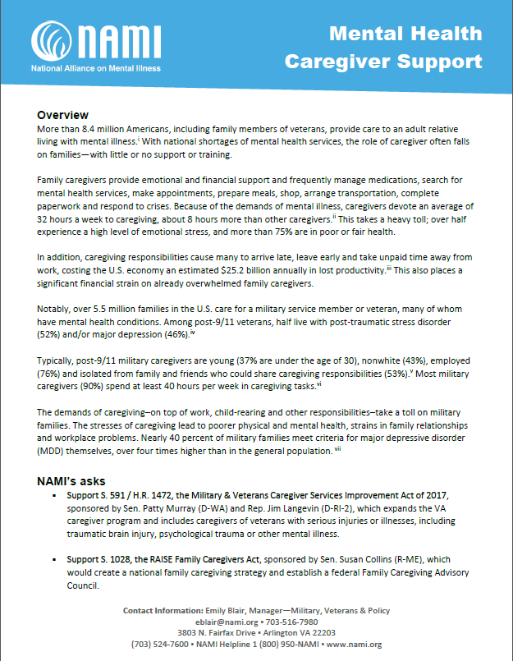
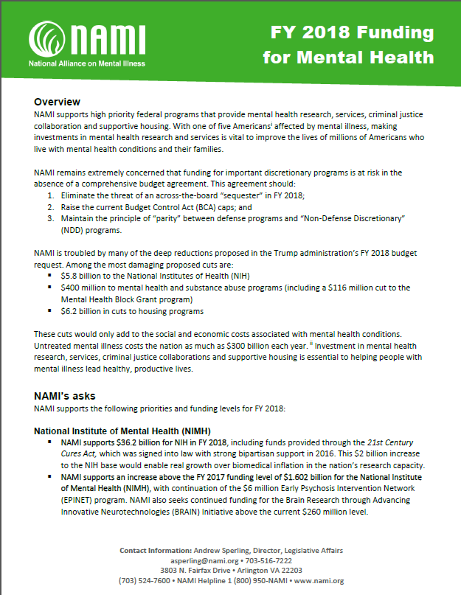
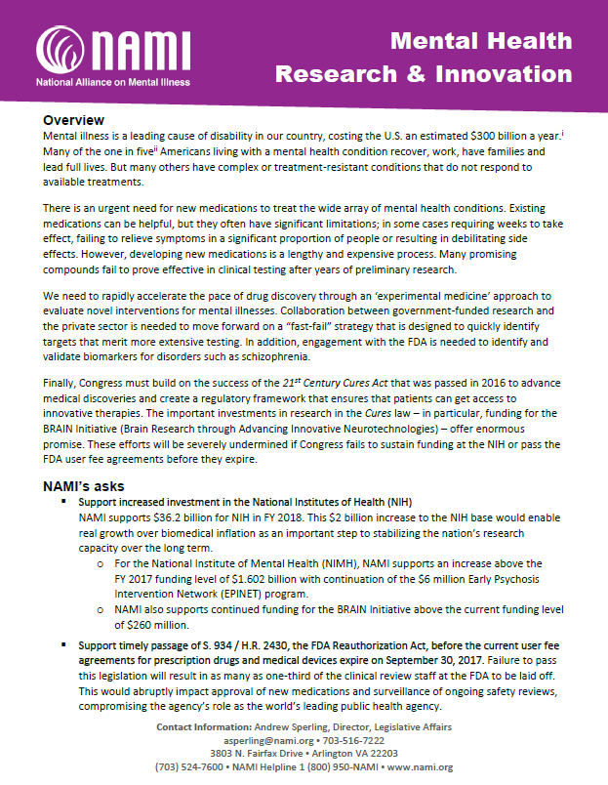
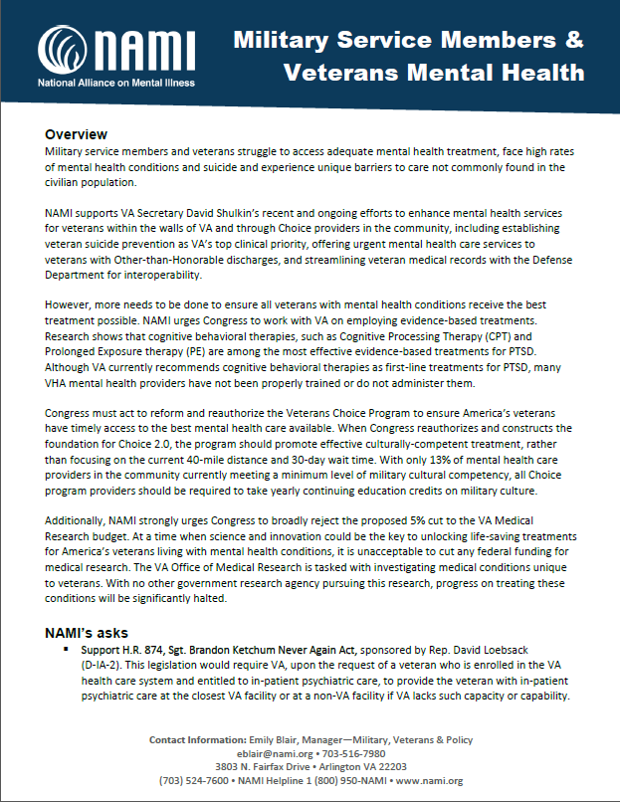
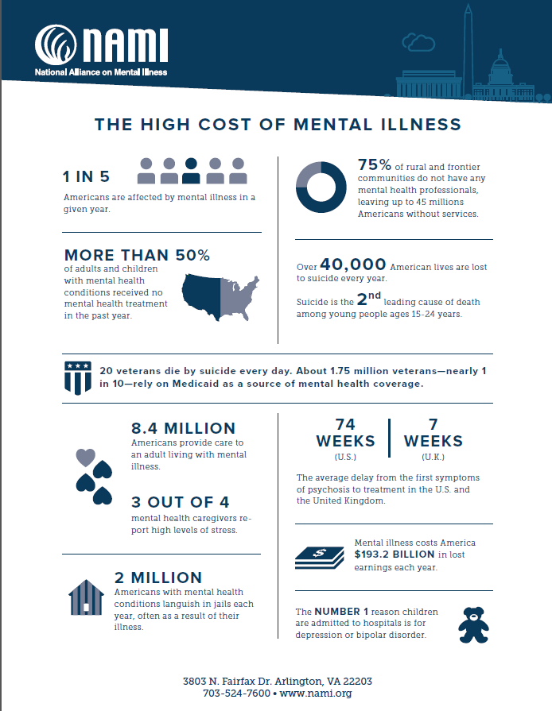
Leave Behind Materials

Slide 9
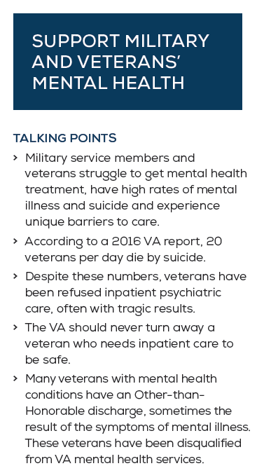
Military & Veterans’ Mental Health
ASKS
Support H.R. 874, Sgt. Brandon Ketchum Never Again Act
Support H.R. 918, Veteran Urgent Access to Mental Healthcare Act
Support S. 992 / H.R. 2652, Veteran Overmedication Prevention Act of 2017
Support budget and appropriations for mental health
See page 6 of Hill Day Guide

Slide 10
Mental Health Family Caregivers
ASKS
Support S. 591 / H.R. 1472, the Military and Veteran Caregiver Services Improvement Act of 2017, to expand the VA caregiver program
Support S. 1028, the RAISE Family Caregivers Act, to establish a national family caregiving strategy
See page 8 of Hill Day Guide

Slide 11
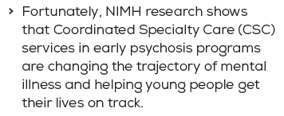
Invest in Early Psychosis Programs
ASK
Continue the $50 million investment in expanding early psychosis programs through the 10% set-aside of the Community Mental Health Block Grant program
See page 7 of Hill Day Guide

Slide 12
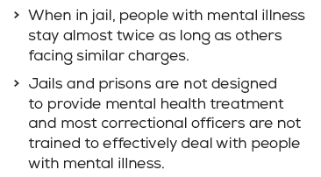
Decriminalizing Mental Illness
ASKS
Support $15 million in FY 2018 for the Mentally Ill Offender Treatment and Crime Reduction Act of 2004
Support $403 million in FY 2018 for the Edward Byrne Memorial Justice Assistance Program (Byrne JAG)
See page 6 of Hill Day Guide

Slide 13
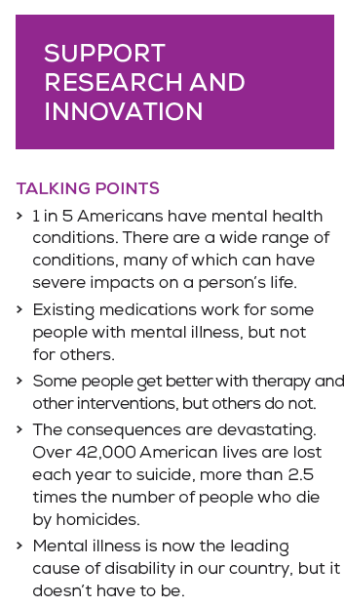
Research & Innovation
ASKS
Support $36.2 billion in FY 2018 funding for NIH
Support an increase above 2017 funding level of $1.602 billion for NIMH
Support timely passage of S. 934 / H.R. 2430, the FDA Reauthorization Act
See page 7 of Hill Day Guide

Slide 14
Questions?
Join us at 2:45 for the Hill Day Prep Session (in this room)

