Slide 1
Special Interest Session
PRESENTATIONS

Slide 3
NAMI In Our Own Voice: Goals of Update
Increase:
Effectiveness of the program
Preparedness of presenters
Program availability
Program consistency

Slide 4
Process
Current research
Nearly 800 surveyed
IOOV advisory group of stakeholders
IOOV program coordinators, trainers and presenters
Multiple experts
Multiple pilots

Slide 5
What We Found
Presentation
Confirmed general format
Venues requesting variety of presentation lengths
Shorter format is equally effective
Modeling non-stigmatizing conversations
Desire for fewer labels, relevant language, more current look
Training
Ongoing training to support learning
Majority of presenter trainees open to blended learning
Need for more cost-effective training

Slide 6
Results
Consistent general format – Two presenters, video, discussion, handout
Fewer story sections
Two video lengths
Modified video format – presenters modeling conversations
Blended learning presenter training

Slide 7
NAMI In Our Own Voice Preview

Slide 8
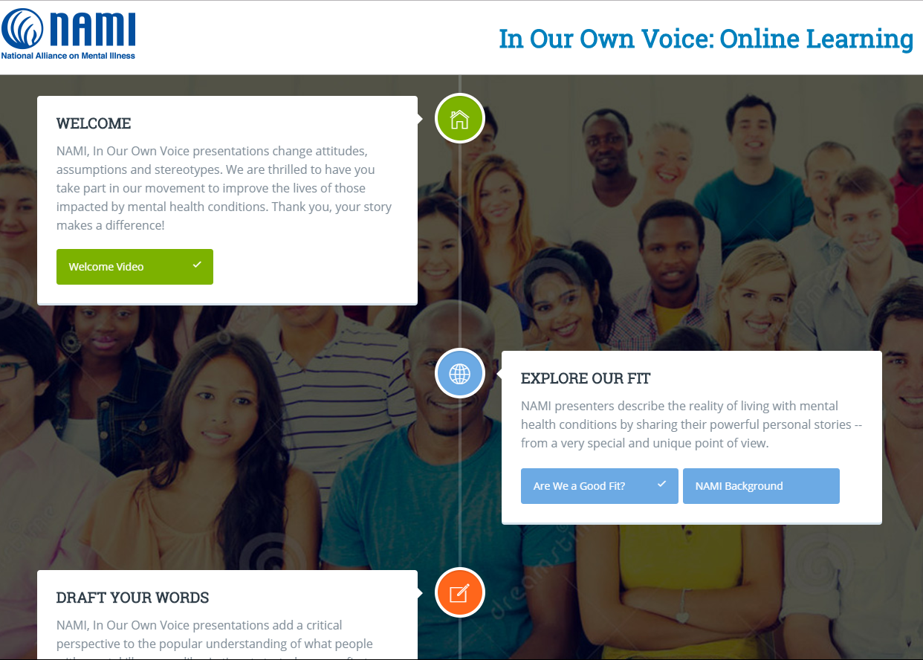
Presenter Training

Slide 9
Presenter Training

Slide 10
NAMI Ending the Silence Updates
Parents & Teachers as Allies ETS
ETS for School Staff
ETS for Families
Funding for expansion nationwide
Online training for presenters and “coaches”
Additional online modules
What do YOU need to know as a NAMI presenter

Slide 11
Preparing for Updates
Make sure you have a nami.org account
Ask to be designated as a IOOV/ETS presenter in NAMI 360
Sign into the program-specific webinars
Check the program-specific extranets
www.nami.org/extranet/ets
www.nami.org/extranet/ioov
Complete online modules

Slide 13
Time to Network
20 minutes – 10 minutes per topic
YOU pick your 2 topics, choose a note taker!
TOPICS:
Overcoming stage fright
Presenting when you are struggling
New and exciting audiences
One thing you share that really resonates

Slide 14
~FOR CHOCOLATE~

Slide 15
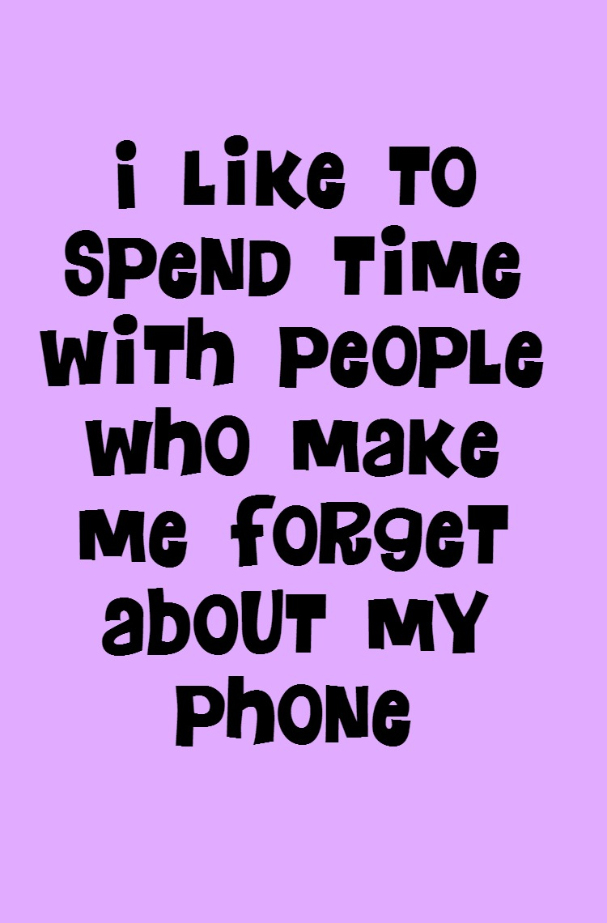
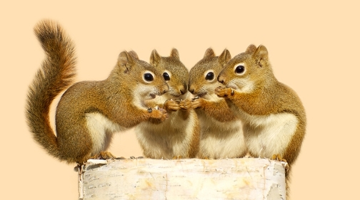
STAND UP, STRETCH MOVE GROUPS

Slide 16
We Need Your Input!
10 minutes for discussion of topics below
Choose a note taker
Online training for presenter coaches
Positives? Negatives?
What to include?
General story-telling training
What need would this training meet in your community?
Any needs not met by ETS and IOOV that might be served by this informal “program”?

Slide 17
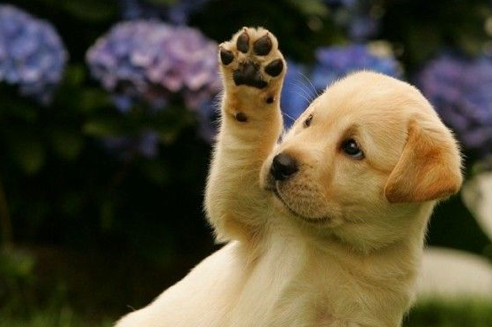
QUESTIONS?

Slide 18
Jennifer Rothman, ETS, Basics: jrothman@nami.org
Julie Erickson, IOOV, FSG: jerickson@nami.org

