Slide 1
Recovery-Oriented Cognitive Therapy: Actualizing Recovery, Resilience, and Flourishing
Paul M. Grant, Ph.D.
Ellen Inverso, Psy.D.
Aaron Brinen, Psy.D.
National Alliance on Mental Illness

Slide 2
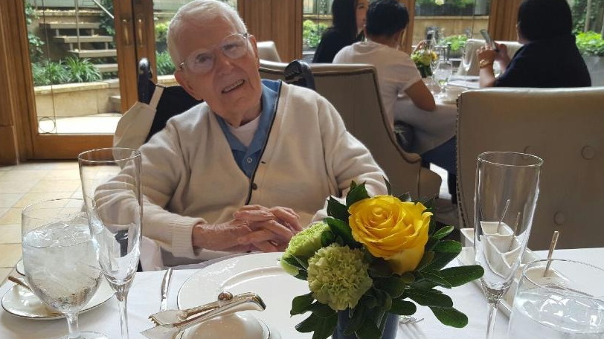
Greetings from Dr. Beck!

Slide 3
Take Home Points
Recovery extends to all
There are concrete and effective procedures for bringing it about
Everyone who works with these individuals can collaborate to promote flourishing
The best treatment doesn’t look like treatment
Promoting individuals as they step down through levels of care toward independence

Slide 4
Recovery
Hope
Connection
Empowerment
Resiliency
“It’s given me the confidence that I needed…Just believing that I can do this or I can succeed at whatever I do and whatever I try. I no longer looked at myself as being like, disabled, handicapped…”
-Individual

Slide 5
Recovery extends to all

Slide 6
Common Themes
Isolation
Lack of belonging
Rejection
Together alone

Slide 7
When are they at their best?
Birthday party
March madness challenge
Picnic
Play
Music Group

Slide 8
What does it look like when they are at their best?
Funny
Knowledgeable
Warm
Energized
Personable

Slide 9
Concrete and effective procedures for bringing about recovery

Slide 10
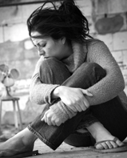
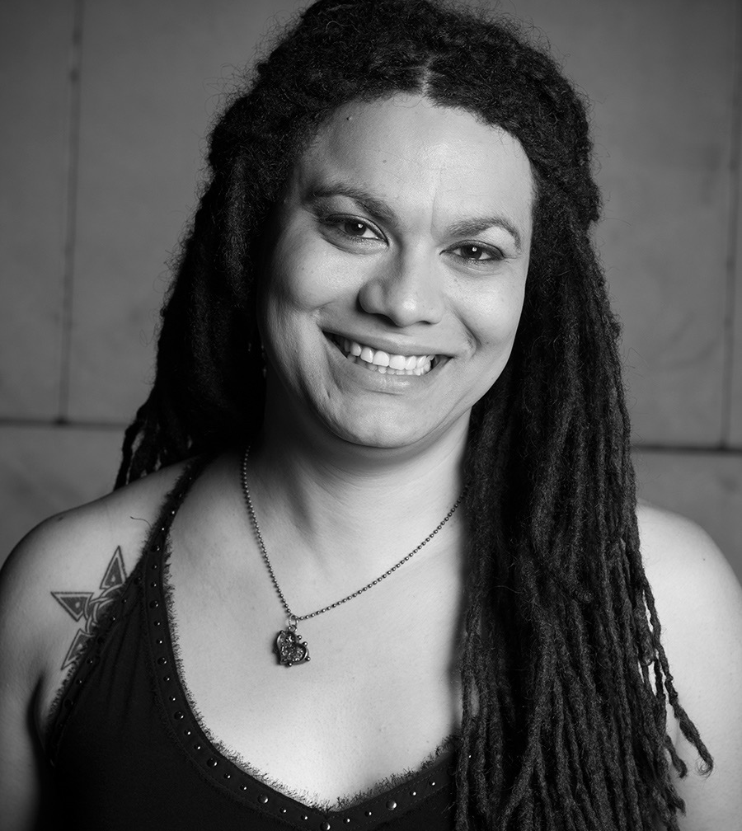
Patient Mode vs. Adaptive Mode

Slide 11
The Adaptive Mode
Access
Energize
Develop
Strengthen
Actualize

Slide 12
Accessing the Adaptive Mode
Through shared interests, doing things together
  Food
  Music
Ask the individual for advice

Slide 13
Energizing the Adaptive Mode
Establish connection through engagement in meaningful pleasurable activities
  Reveal strengths and capabilities
  Energize non-patient-related schema
  Experience belonging and meaningful role
  Develop trust
  Begin to think about the future
Access to motivation + energy

Slide 14
Developing the Adaptive Mode: Aspirations
Identify
Enrich
Meaning behind long-term aspirations
Action now linked to the meaning

Slide 15
Actualizing the Adaptive Mode: Positive Action
Community participation (going to church with family and friends, cooking family dinners, performing at an open mic)
Meaningful role
Growing social network
Achieve Aspirations

Slide 16
Strengthening the Adaptive Mode
Conclusions
  Draw attention to positive experiences
  Strengthening beliefs through targeted questions
    Connection
    Control
    Capability
    Energy
Developing resiliency in the face of stress and challenges
Adaptive mode becomes dominant mode

Slide 17
Deactivating the Patient Mode: Neutralizing Challenges
Positive beliefs strengthened
Negative beliefs weakened
Resiliency-promoting skills and interventions

Slide 18
It Works

Slide 19
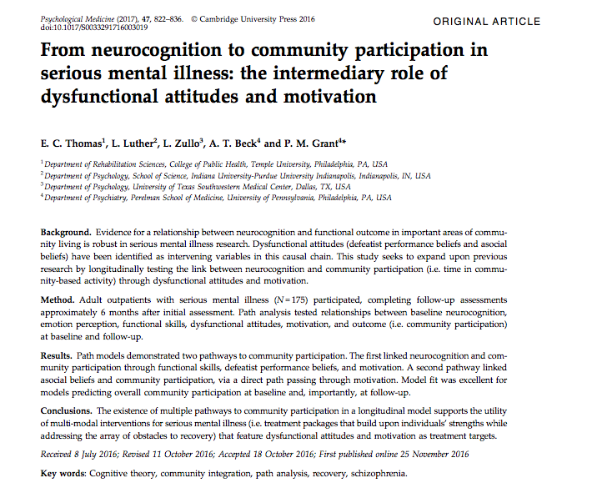

Slide 20
Pathway Paper
Asocial and defeatist beliefs are linked to community participation
These beliefs are a part of the patient mode
Notes:
Asocial and defeatist beliefs are linked to community participation

Slide 21
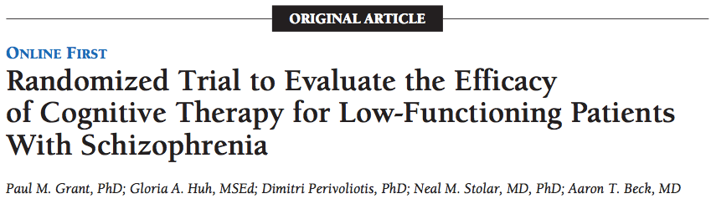
Clinical Trial of Recovery-Oriented Cognitive Therapy

Slide 22
Summary of CT-R Clinical Trial
Compared to the Standard Treatment (ST) patients, CT+ ST patients had:
  Better functioning (d = 0.56)
  Reduced avolition-apathy (d = -0.66)
  Reduced positive symptoms (d = -0.46)

Slide 23
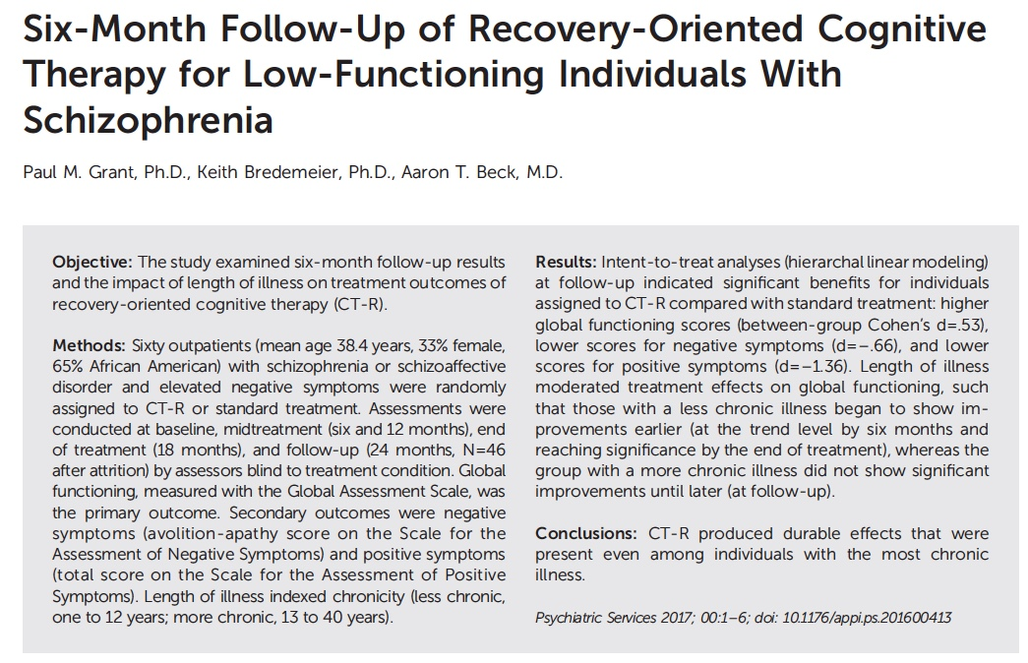

Slide 24
Clinical Trial Follow-Up
Gains maintained over the course of 6-month follow-up in which no therapy was delivered:
  Better Functioning (d = 0.53)
  Reduced Negative Symptoms (d = -0.60)
  Reduced Positive Symptoms (d = -1.36)
Everyone can improve

Slide 25
Clinical Trial Follow-Up
NOTE: * p .05, ** p < .01
Notes:
Everyone can improve

Slide 26
Neurocognition Review
Performance on neurocognitive tests do not truly reflect potential
Factors that get in the way of performance on these tests include:
  Stress
  Beliefs
  Effort
  Context
  Symptoms

Slide 27
Mechanism of Change in the Clinical Trial
Changes in attitudes, self-concept, hopelessness relate to changes in behavioral outcome
Changes in neurocognitive test performance do not relate to these outcomes

Slide 28
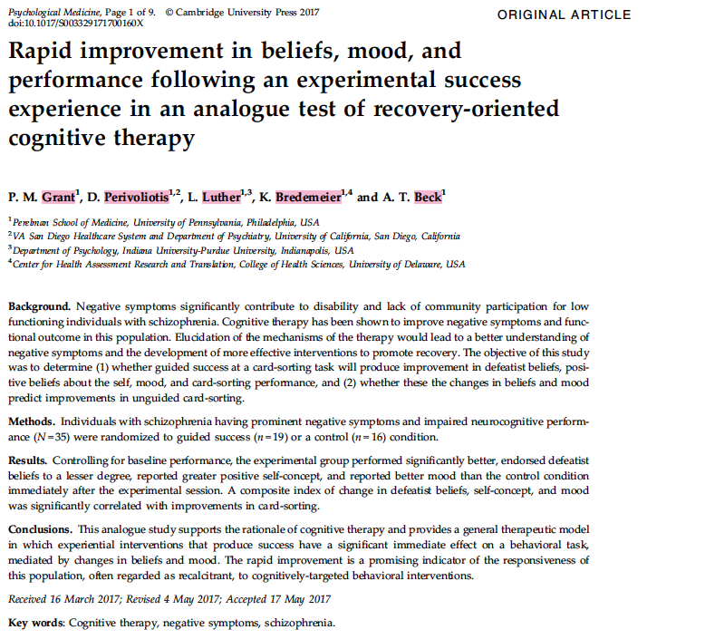

Slide 29
Experimental Study
Guided Success vs Control
Changes in positive beliefs and mood most impact improvement in card sorting performance
Everyone has potential – success brings out adaptive mode
Notes:
Everyone has potential – success brings out adaptive mode

Slide 30
Promoting individuals as they step down through levels of care toward independence

Slide 31
Network of Care
Notes:
66 people discharged from Norristown

Slide 32
“In essence, we have used [CT-R training] to try to create a continuum of care for these very challenged citizens, who otherwise might languish in institutions bereft of hope for a better life. Succinctly put, [the Beck team] have performed miracles…”
-Lawrence Real, M.D.
Chief Medical Officer
Philadelphia Department of Behavioral Health and Intellectual disAbility Services

Slide 33
State Hospital
Forensic
Step-down units

Slide 34
Programmatic Residences
More Intensive
Less Intensive
Supportive Housing

Slide 35
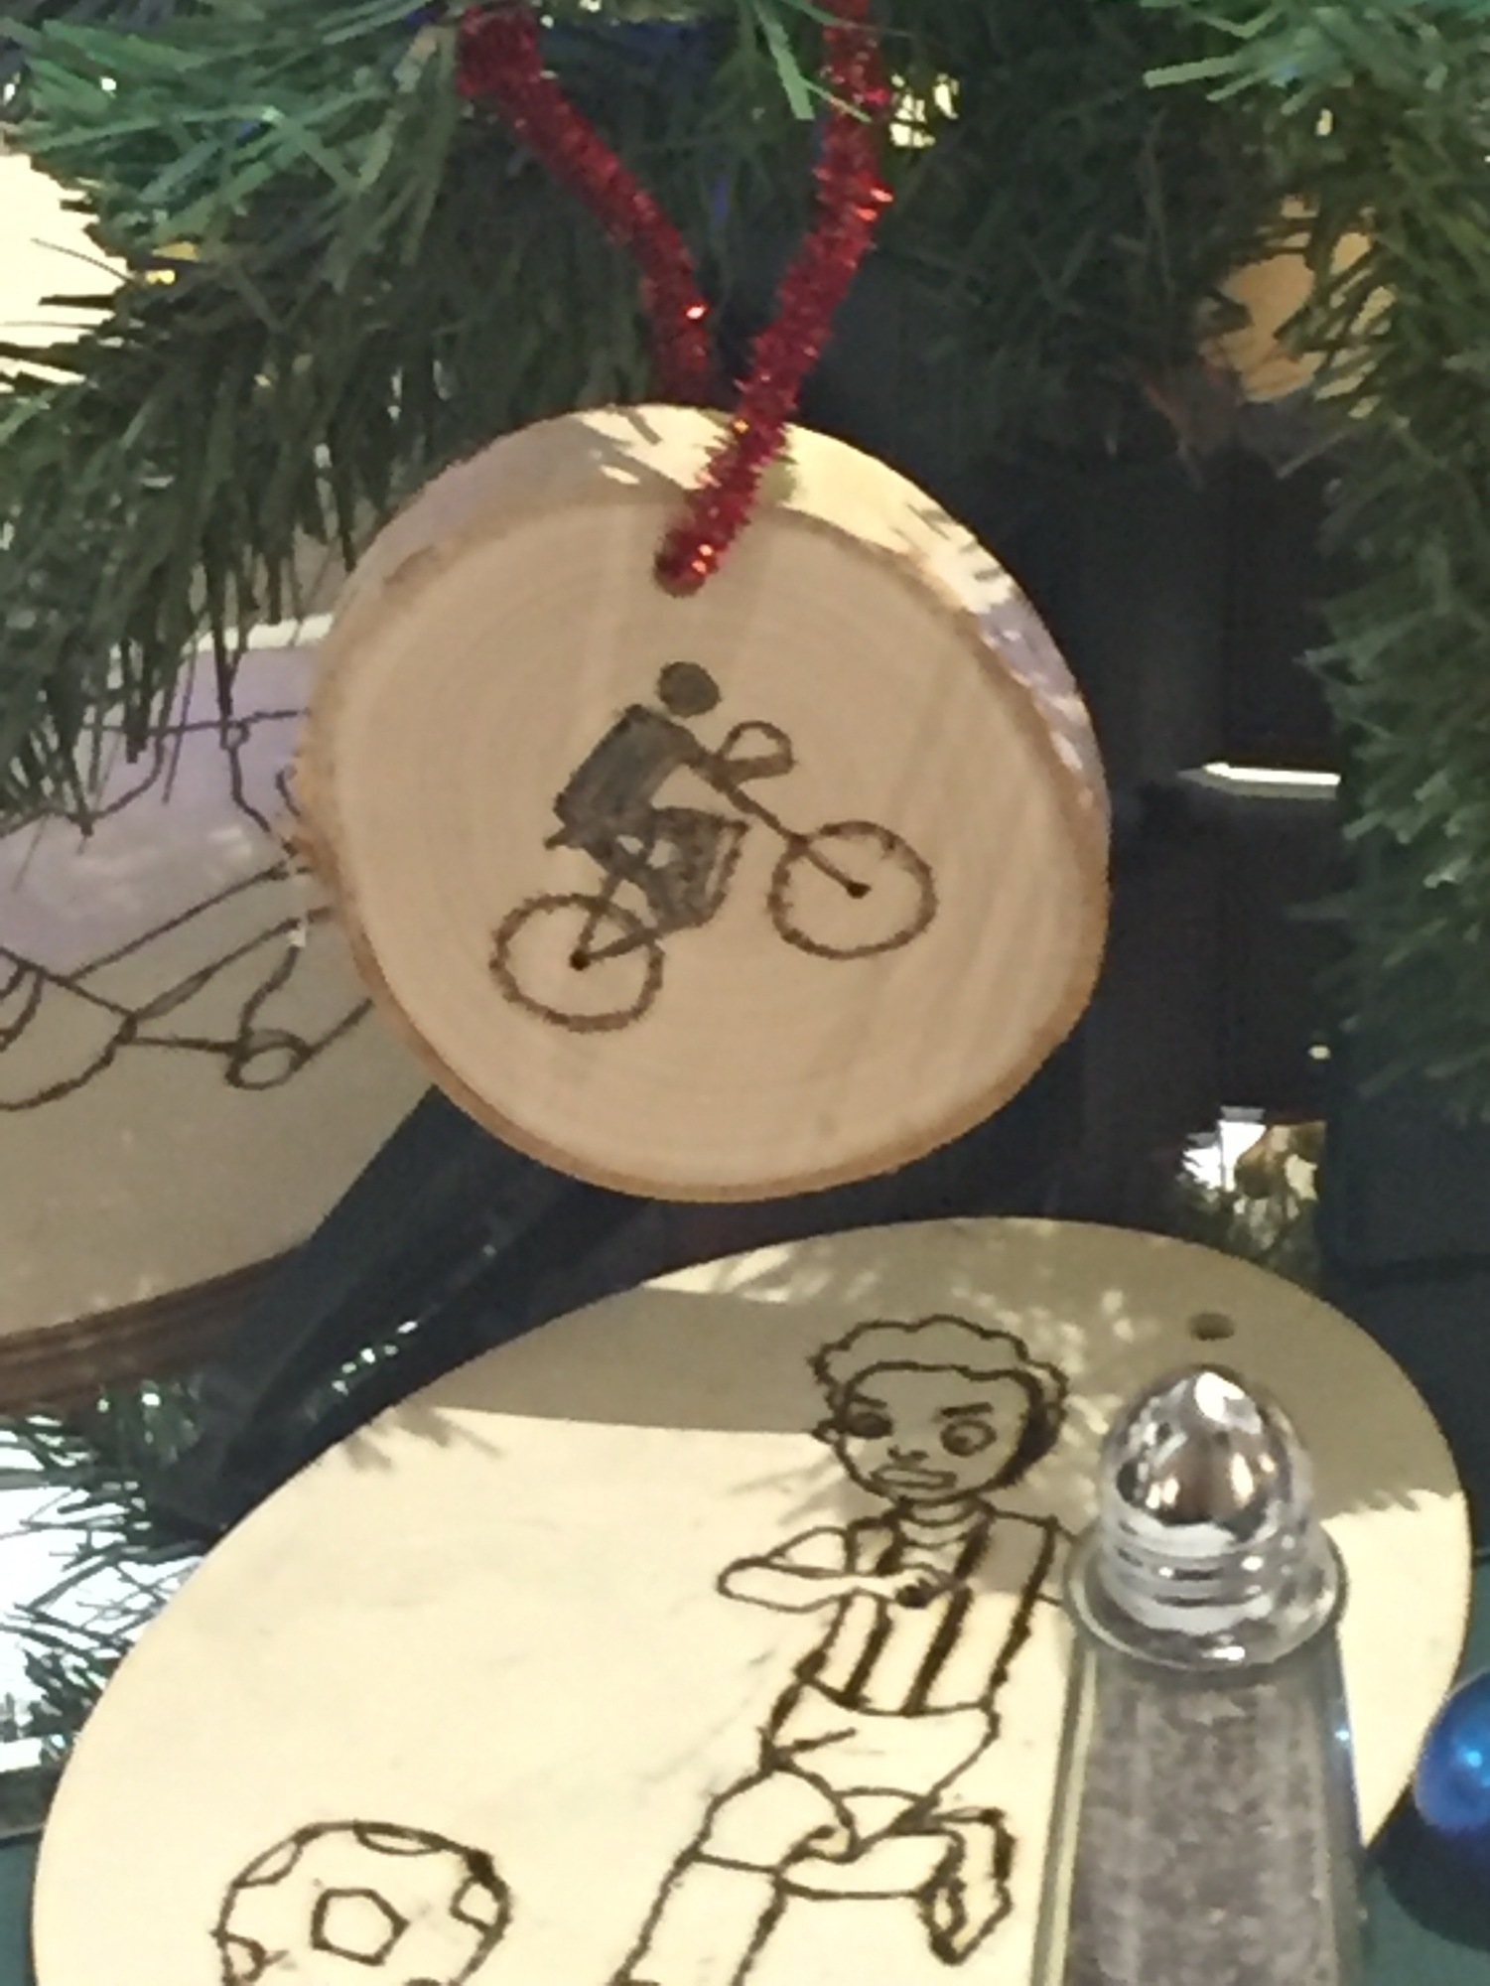
Clubs
Future-oriented
Beauty, Cooking, Walking, Crochet, Helping, Can Drive, Breakfast, Wood burning, Hiking, Decorating

Slide 36
Feedback From Individuals

Slide 37
Individuals’ Accounts of Effectiveness
Access to Activities
Fostering Sense of Community
Walks outside
Games with others
Cooking
Exercise
Music
Spirituality in the community
Roles in house (jobs, responsibility, related to future)
Staff and residents relate to each other and find things in common
People who listen or try to understand

Slide 38
Treatment Team
Individualized planning
Collaborative
Developing resilient independence
Promoting community participation

Slide 39
Case Management Teams as Link Across Levels of Care
Coordinate care with the hospital
Use standard ACT team methods (e.g., home visits) as a vehicle for CT-R interventions
Creates a comprehensive strategy among team members to facilitate recovery (Lead, Therapist, D&A specialist)
Fidelity to both models maintained

Slide 40
Program Evaluation
Georgia
  SAMHSA Recovery Dimensions (69%)
  Community involvement
  Getting back to meaningful life
Philadelphia
  53 returned to community
  Already stepping to less-intensive
Notes:
Outcomes in Georgia – currently analyzing, enhances units (more meaningful contacts), time out of the room, actual interaction on milieu, service utilization

Slide 41
Frontiers

Slide 42
Supportive Housing
Promote Resilience
Grow and sustain social network
Hook up to resources
Collaboration with Mark Salzer of Temple University

Slide 43
Acting Class

Slide 44
VA Study

Slide 45
Families & Peers
In an emerging crisis:
  Intervene early
    What are they doing when they are at their best 0 ask to do that
    Offer an opportunity to help you

Slide 46
Jail Diversion
Team
In the programs
Case formulation
Access and energize adaptive mode

Slide 47
Thank you
Paul M. Grant, Ph.D.
Department of Psychiatry, Perelman School of Medicine, University of Pennsylvania,
3535 Market Street, Room 3049
Philadelphia, PA 19104
Telephone: (215) 898-1825
Email: pgrant@mail.med.upenn.edu

