Slide 1

Technology to Improve Care
Steve Daviss MD DFAPA
Chief Medical Informatics Officer
M3 Information, LLC
Rockville, MD
Twitter: @HITshrink

Slide 2

Hats I Wear
CMIO, M3 Information
President, Fuse Health Strategies
Assembly Recorder, American Psychiatric Association
Chair, APA Committee on Mental Health IT
Chair, Parity Accreditation Committee, ClearHealth Quality Institute
Psychiatrist
Family member
Shrink Rap Blog/Book, My Three Shrinks Podcast
SAMHSA?
@HITshrink

Slide 3


Slide 4
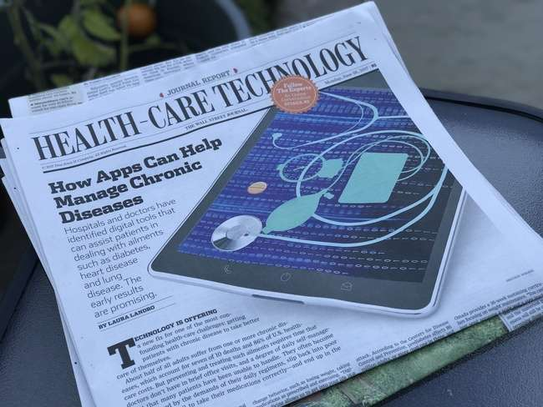
@HITshrink

Slide 5
Basic infrastructure
  Electronic Health Records (EHRs)
  Health Information Exchange (HIE)
  Care coordination/Care management
  “Big data”
Assessment tools
  Active vs Passive
  Telehealth
  Genetics
  Neuroimaging

Slide 6
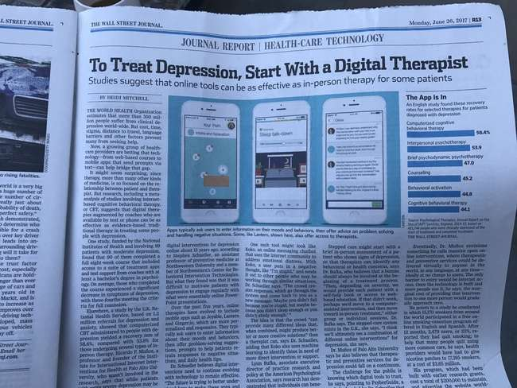
App Reviews – APA Guidelines
APA Innovation Lab
@HITshrink

Slide 7


















@HITshrink

Slide 8
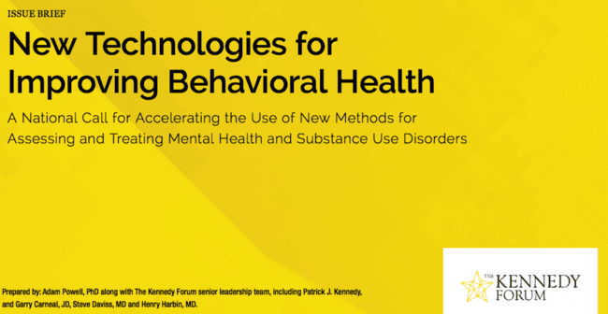
@HITshrink

Slide 9
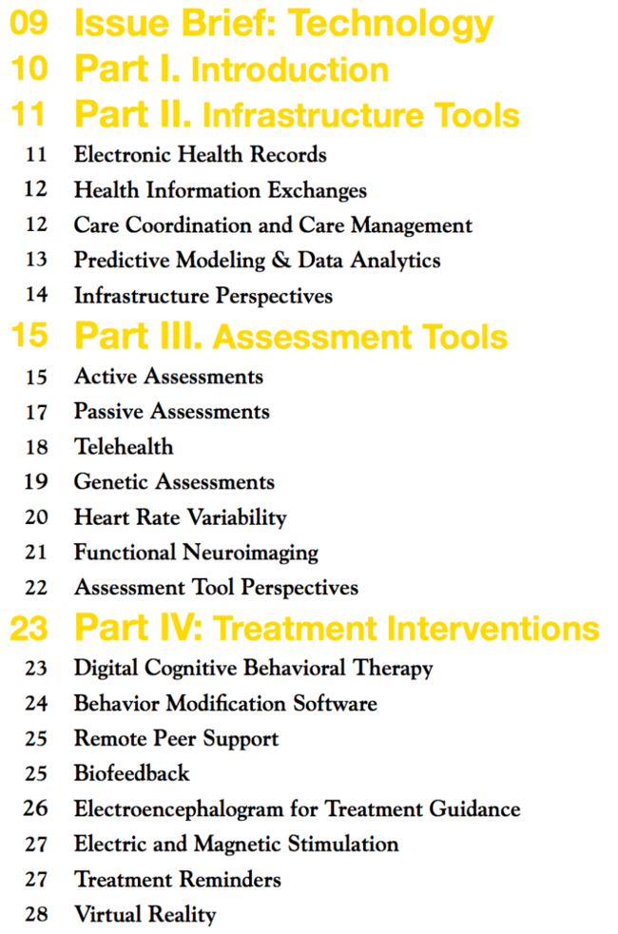
@HITshrink

Slide 10
EHRs
BH left behind - market, privacy, HITECH $, state laws
lack of features need - psychotherapy notes
interoperability, datablocking
usability
Valant, Askesis, Netsmart, Credible
@HITshrink

Slide 11
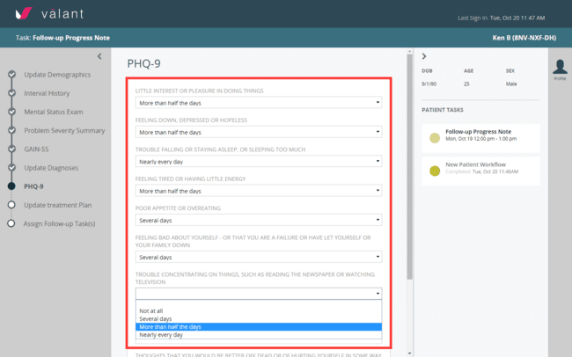
@HITshrink

Slide 12
HIEs
HL7, interoperability, CCDA
opt-in, opt-out, DS4P, who owns the data
states, privacy
PDMPs
third-party APIs
Mirth, Intersystems, Medicity
@HITshrink

Slide 13
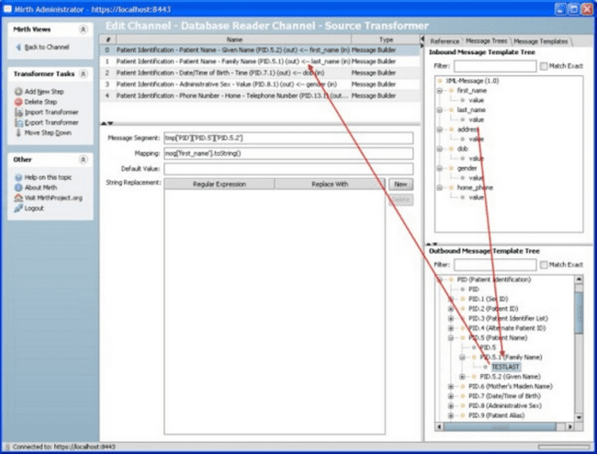
@HITshrink

Slide 14
Care coordination,
Care management
web, texting, apps
scheduling, logistics, transportation
population health, analytics
Phytel, CareManager, Mindoula, Quartet
@HITshrink

Slide 15
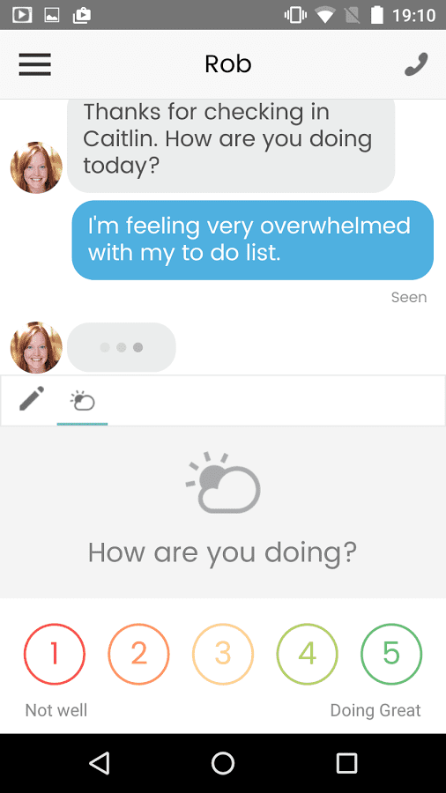
Mindoula
@HITshrink

Slide 16
Big Data
data analytics, machine learning, cognitive computing
predictive modeling, comorbidities
limitations, poor quality data, claims
sensor-based data — phone as tracker
Netsmart, Explorys, ginger.io
@HITshrink

Slide 17
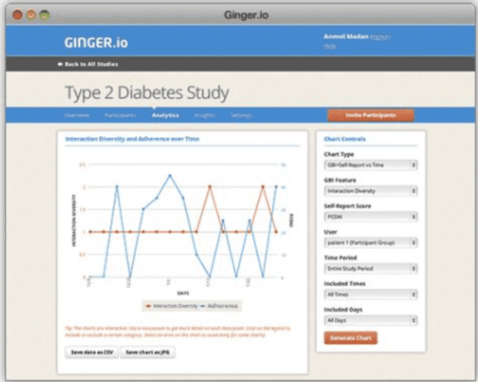
@HITshrink

Slide 18
Active Assessment
Measurement-based care
Multidimensional assessments
USPSTF - screen for depression, look beyond depression
EHR integration, workflow
M3 Checklist, LabCorp, BH-Works
@HITshrink

Slide 20
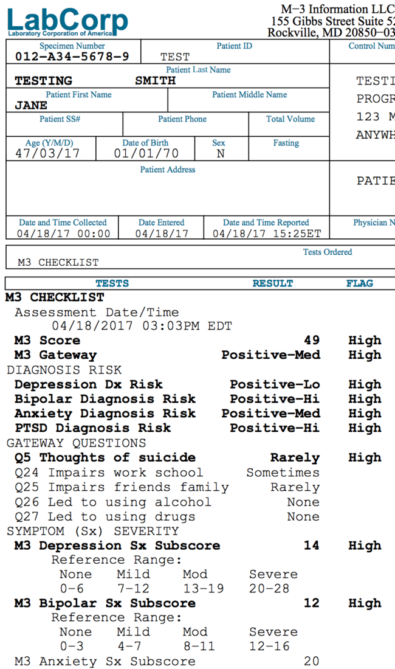
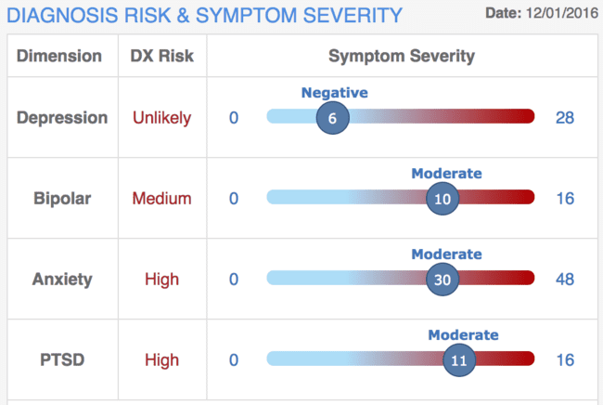
LabCorp’s
M3 Checklist
@HITshrink

Slide 21
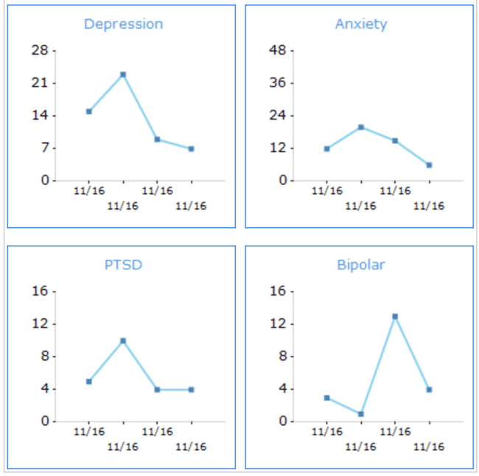
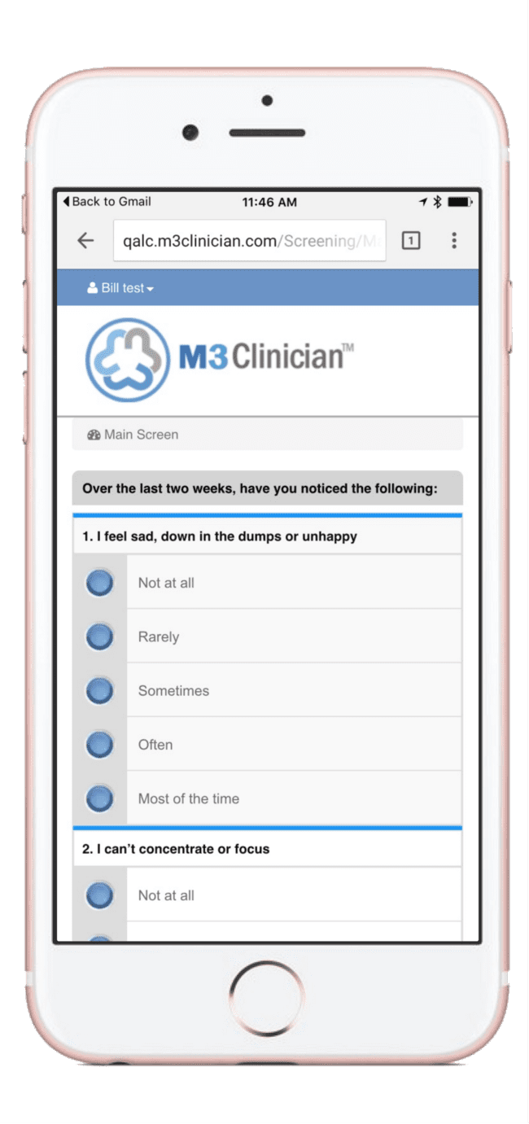
M3 Checklist
@HITshrink

Slide 22
Passive Assessment
sensor-based: phone/text activity, GPS, fitbit
voice & speech characteristics
privacy
Ginger.io, Neurolex, MindStrong
@HITshrink

Slide 23
Telehealth
real-time televideo for teletherapy, consultations
effectiveness same as face-to-face
access to care
standards, licensing, privacy, reimbursement
Breakthrough, Arcadian, BetterMynd, Silvercloud
@HITshrink

Slide 24
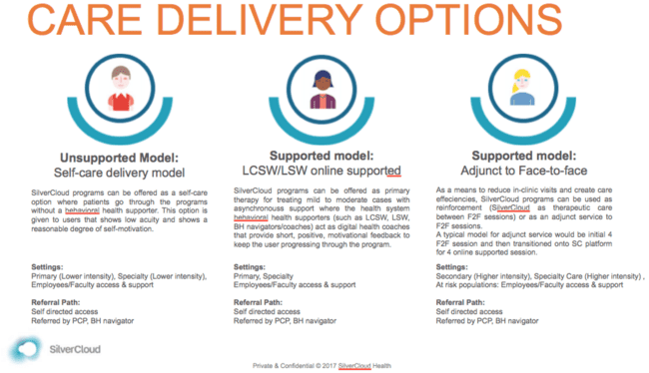
@HITshrink

Slide 25
Genetics
pharmacogenetics
costs, privacy
Genomind, Assurex, 23andMe
@HITshrink

Slide 26
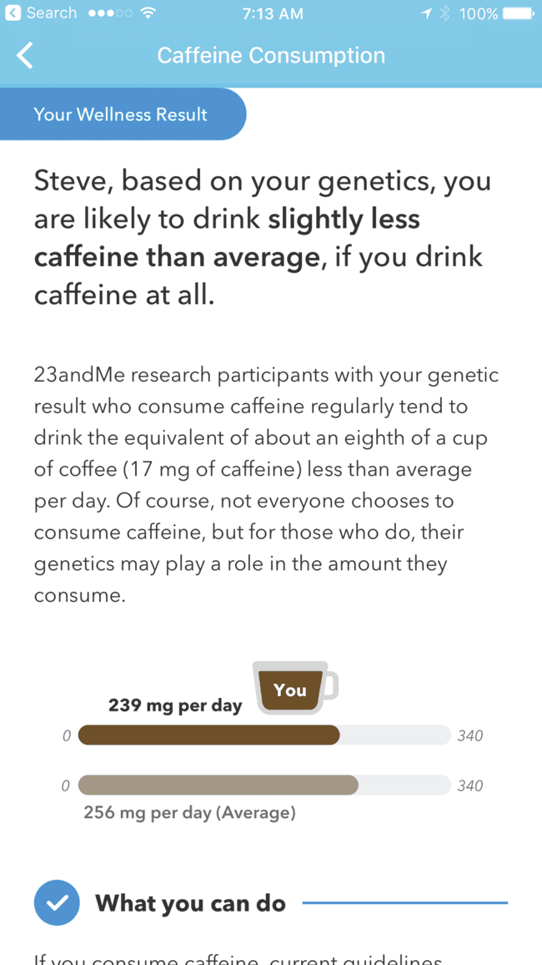
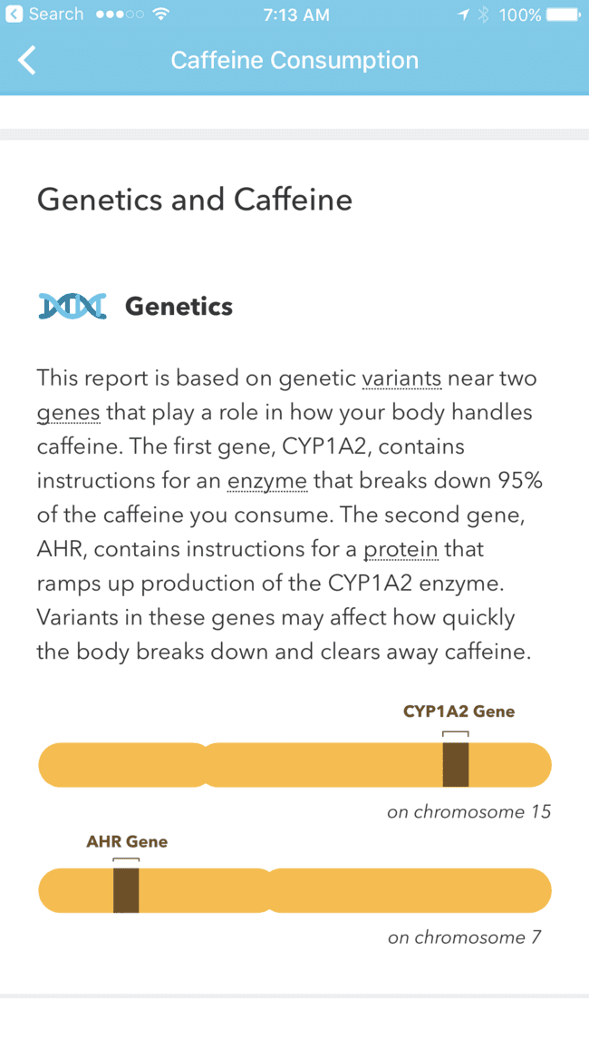
@HITshrink

Slide 27
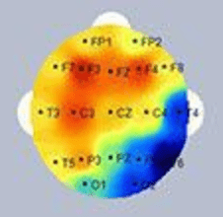
Neuroimaging
fMRI
QEEG
MEG
NeuroGuide, BrainMaster
@HITshrink

Slide 28
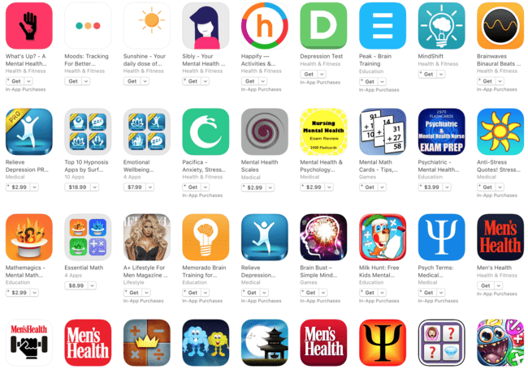
Mental Health Apps: iTunes
@HITshrink

Slide 29
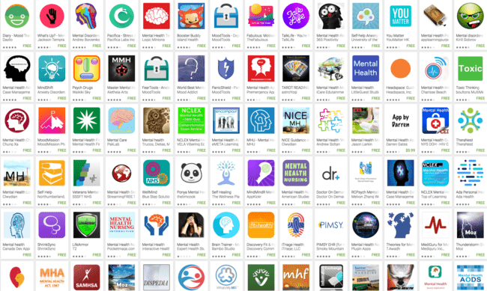
Mental Health Apps: Android
@HITshrink

Slide 30
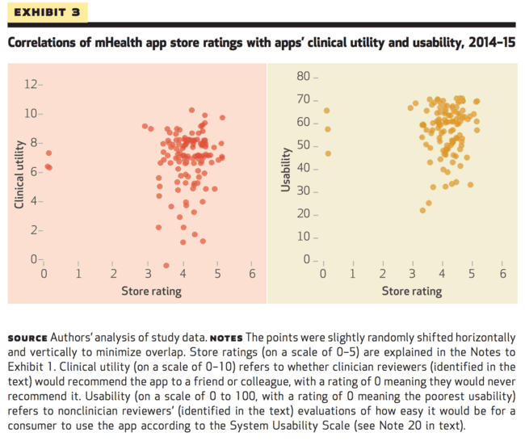

App Stores Ratings are Not Helpful
K Singh et al. Many Mobile Health Apps Target High-Need, High-Cost Populations, But Gaps Remain. Health Affairs. 2016
http://content.healthaffairs.org/content/35/12/2310.abstract
Slides courtesy of
@JohnTorousMD

Slide 31
Why Static Scores Don’t Work
Apps are always changing and updating
There is no A+ or ’95/100’ medication or therapy or treatment
Health
Dynamic
SCORE?
Context
Many personal factors ratings cannot account for
Personal
It depends on the context and patient at hand.
@JohnTorousMD

Slide 32
American Psychiatric Association
Jan 2017: App Evaluation Model –
A Customized Framework
No Static Score
Instead a hierarchy and questions to guide informed decision making, ensuring relevant information is considered.
@JohnTorousMD

Slide 33
APA App Evaluation Model
Safety
Efficacy
Usability
Interoperability
App
App
App
Remaining Apps
App
Apps that share data in useful ways
Apps that easy to use and stick with
App
Apps that have evidence to support use
Apps that respect privacy and secure data
@JohnTorousMD

Slide 34
APA App Evaluation Model
Ground
Understanding the context of the app
Ease of Use
Understanding usability and adherence
Risk / Privacy / Security
Assessing for potential risk and harm
Interoperability
Making sure data is used meaningfully
Evidence
Ensuring the app may offer benefits
@JohnTorousMD

Slide 35
Ground Level
☐ Business model / If free then how does it support?
☐ Developer ?
☐ Does it claim to be medical?
☐ Cost / In-App Purchases / Free?
☐ Advertising?
☐ What platforms does it work on?
☐ When was it last updated?
@JohnTorousMD

Slide 36
Risk, Privacy, and Security Level
Apps present some unique risks that may often be overlooked including profiling, loss of confidentiality, and misinformation
RISK
RISK
@JohnTorousMD

Slide 37
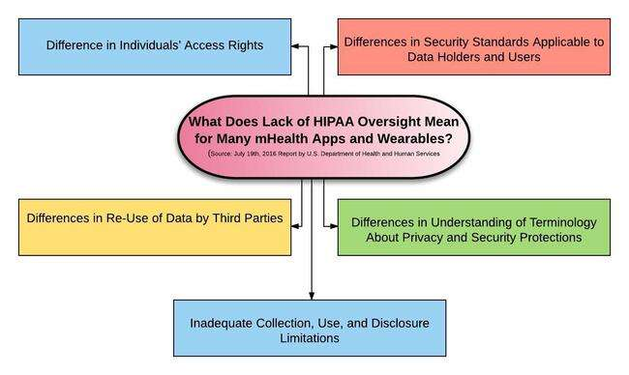
Risks: Privacy / Transparency
@JohnTorousMD

Slide 38
Risk/Privacy and Safety
Is there a privacy policy?
What data is collected?
Is personal data de-identified?
Can you opt out of data collection?
Can you delete data?
Are cookies placed?
Who is data shared with; what data is shared?
Is data maintained on the device or the web?
What security measures are in place? Is data encrypted on the device and server?
Does it say it meets HIPAA / (or not need to)
@JohnTorousMD

Slide 39
Evidence Level
App developers often make many claims even though there is currently little clinical evidence to support such. This does not mean that apps don’t work, but rather that there is much we still do not know.
Evidence
Evidence
@JohnTorousMD

Slide 40
Evidence
☐ What does it claim to do vs actually do?
☐ Is there peer-reviewed, published evidence about tool or science behind it?
☐ Is there any feedback from users to support claims (App store, website, Review sites, etc)?
☐ Does the content appear of at least reasonable value?

Slide 41
Ease of Use Level
An app is only as useful as you find it to actually use
Use
Use

Slide 42
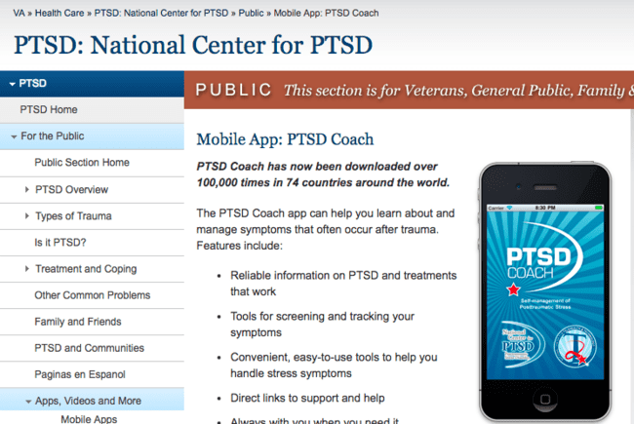
@HITshrink

Slide 43
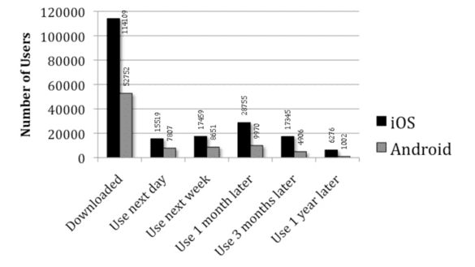
Adherence
Owen et al. mHealth in the Wild: Using Novel Data to Examine the Reach, Use, and Impact of PTSD Coach. JMIR Mental Health. Dec 2015
@JohnTorousMD

Slide 44
Ease of Use
Is it easy to access for the patient at hand?
Would it be easy to use on a long term basis?
Is it customizable?
Does it need internet to work?
What platforms does it work on?
Accessible for those with impaired vision or other disabilities?
@JohnTorousMD

Slide 45
APA App Evaluation Model
Interoperability
Risk / Privacy / Security
Making sure data is used meaningfully
Assessing for potential risk and harm
Ease of Use
Ground
Understanding usability and adherence
Understanding the context of the app
Evidence
Ensuring the app may offer benefits
@JohnTorousMD

Slide 46
Data Sharing
Can it share data with EHR?
Can you print out your data?
Can you export/download you data?
Can it share data with other user data tools (eg, Apple HealthKit, FitBit)?
@JohnTorousMD

Slide 47
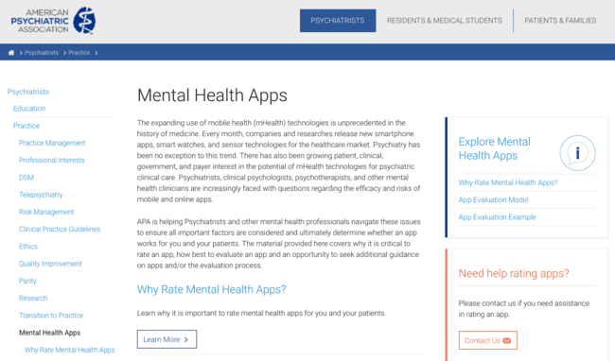
Online at Psychiatry.org

Slide 48

APA
Psychiatry Innovation Lab
How It Works
The event will be a highly collaborative and hands-on experience guided by a panel of expert judges.
The Psychiatry Innovation Lab has four parts:
Pitch an Idea
Learn from Experts
Build a Team + Design a Venture
Win Prizes
psychiatryinnovation.com
@HITshrink

Slide 49
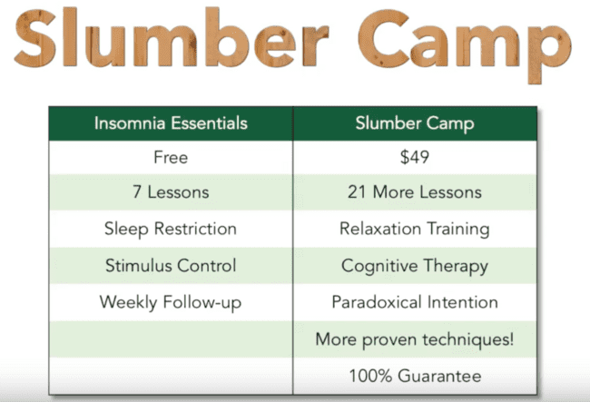
2017 Grand Prize Winner:
Jeff Clark – Slumber Camp
@HITshrink

Slide 50
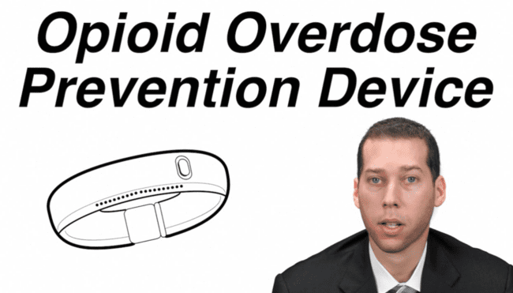
Fall 2016 Grand Prize Winner:
Joseph Insler – Overdose Recovery Bracelet
@HITshrink

Slide 51

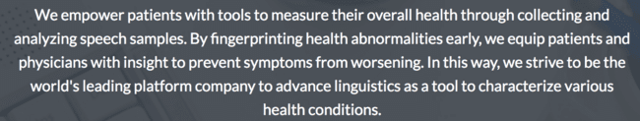
Spring 2016 Grand Prize Winner:
Jim Schwoebel -- NeuroLex
neurolex.ai
@HITshrink

Slide 52
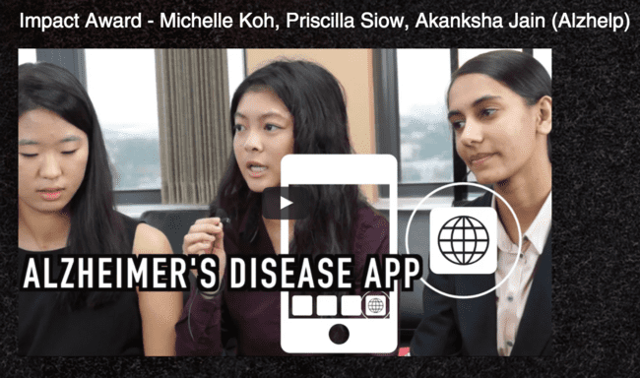
AlzHelp
@HITshrink

Slide 53
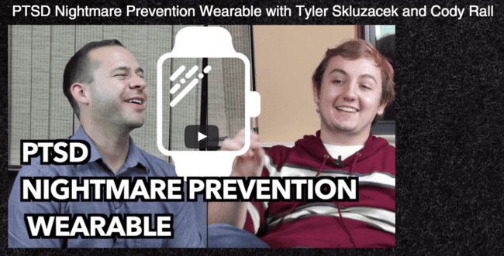
PTSD Nightmare Prevention
@HITshrink

Slide 54

MiHelper
@HITshrink

Slide 55
Basic infrastructure
  Electronic Health Records (EHRs)
  Health Information Exchange (HIE)
  Care coordination/Care management
  “Big data”
Assessment tools
  Active vs Passive
  Telehealth
  Genetics
  Neuroimaging
App Reviews – APA Guidelines
APA Innovation Lab

Slide 56
Technology to Improve Care
Steve Daviss MD DFAPA
Chief Medical Informatics Officer
M3 Information, LLC
Rockville, MD
Twitter: @HITshrink

